Slide 1
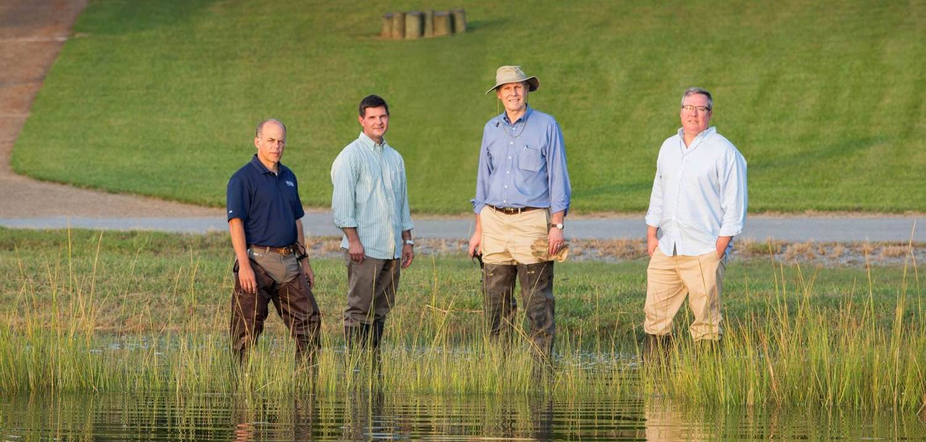


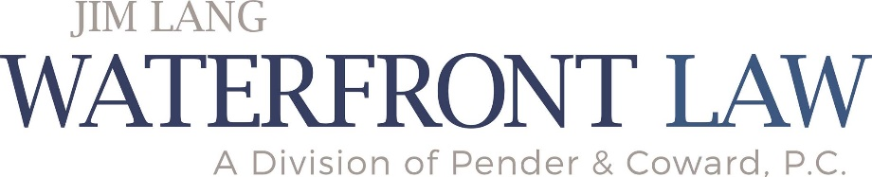
Phase I Environmental Site Assessment
September 24, 2021
All content copyright © 2021. James T. Lang. All rights reserved.

Slide 2
What We Will Cover Today
How the Phase I ESA shields the prospective purchaser from CERCLA liability (Jim Lang)
What is a Phase I ESA? (Charles Hall, Director of Environmental Sciences, MSA)
Questions
All content copyright © 2021. James T. Lang. All rights reserved

Slide 3
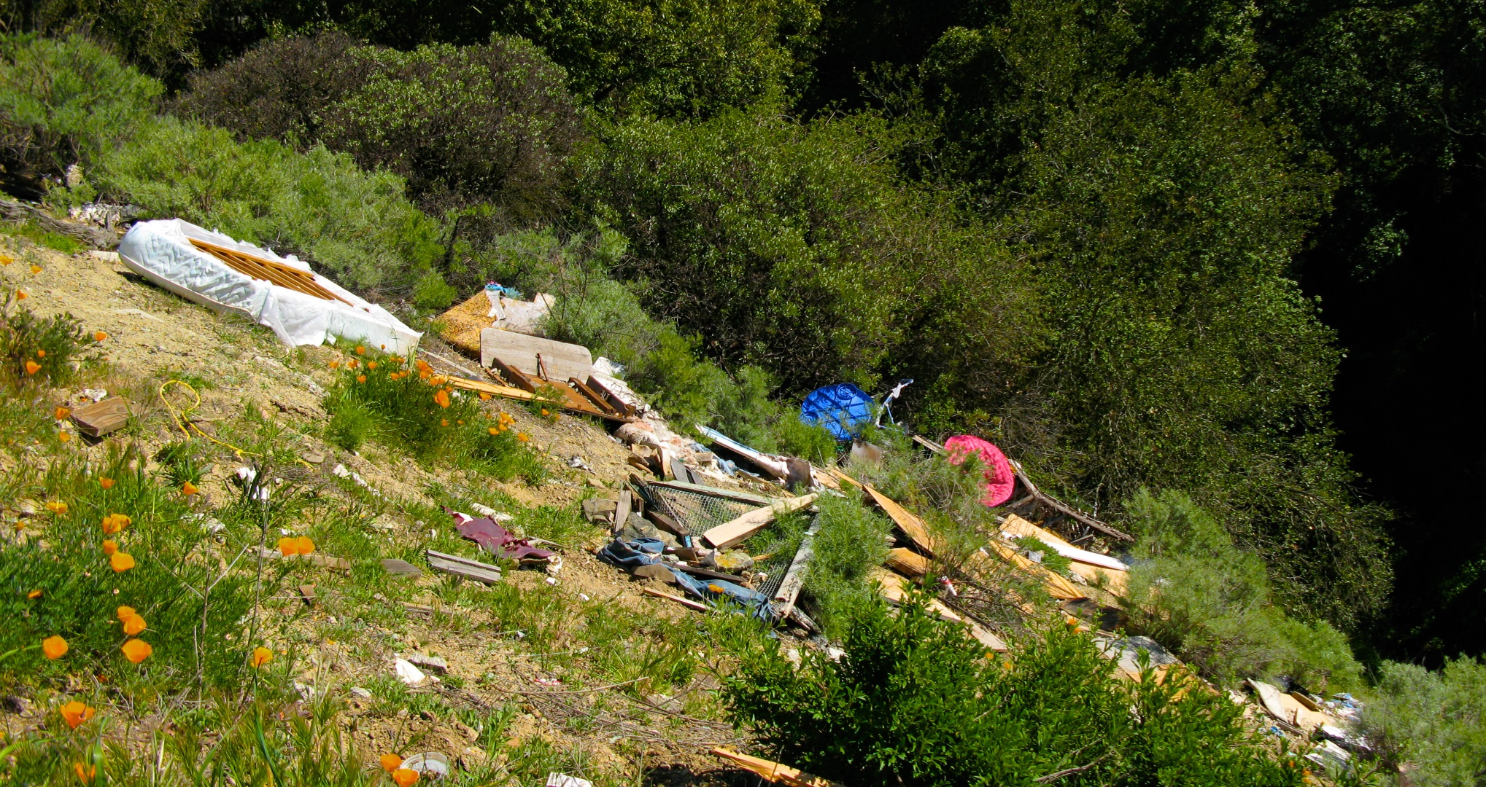
Environmental Compliance is a (Relatively) New Concept

Slide 4
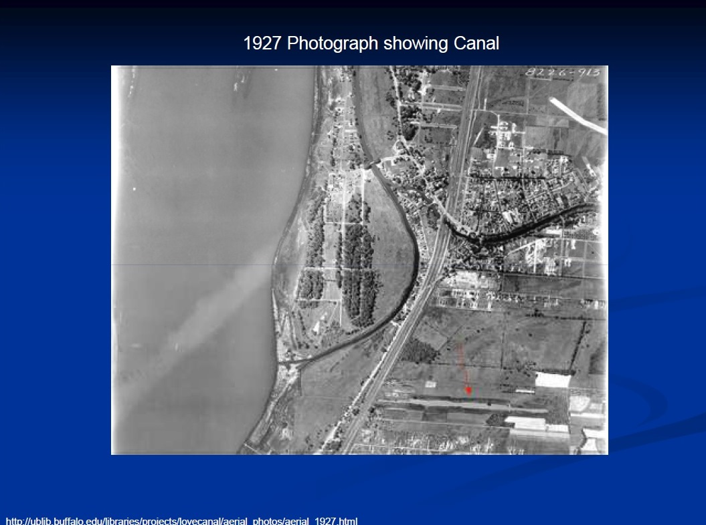
Love Canal
In 1890’s William T. Love wanted to build a canal connecting the upper and lower Niagara Rivers so that power could be generated cheaply to fuel the industry and homes of his planned model city. The state assisted the project through use of condemnation to acquire land. Love started his canal but could not finish it: 1 mile, 15 feet wide, 10 feet deep.

Slide 5
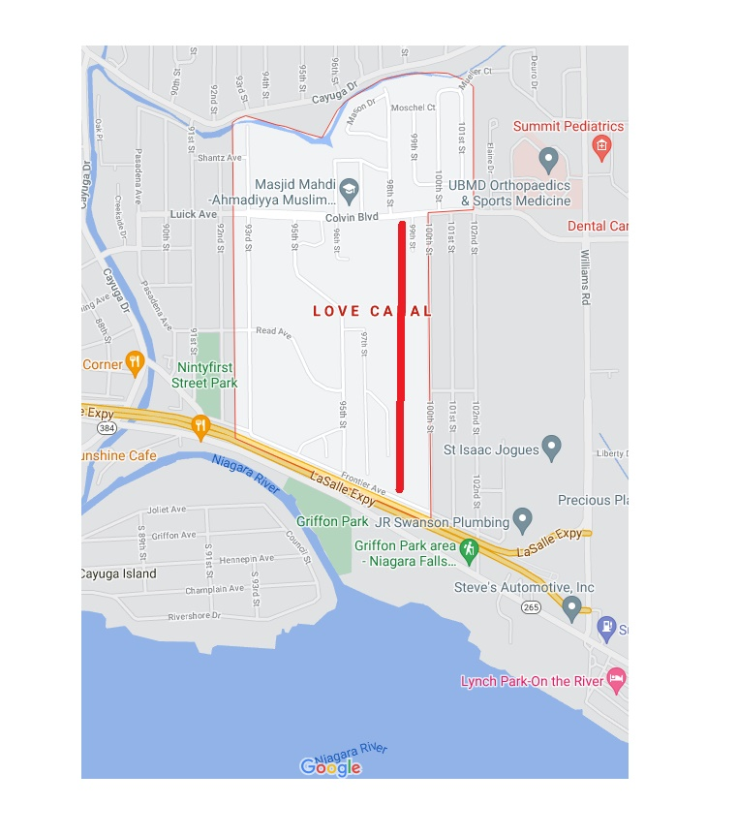
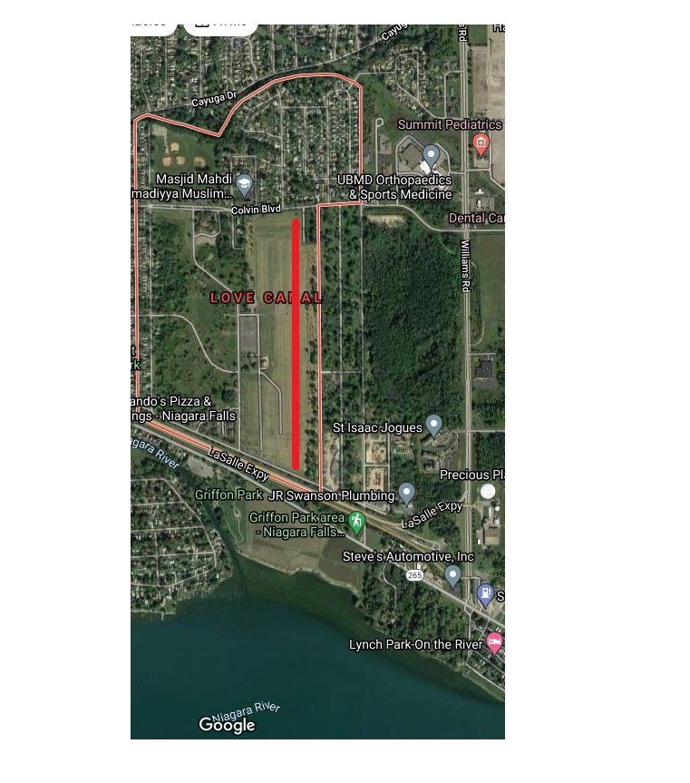

Slide 6
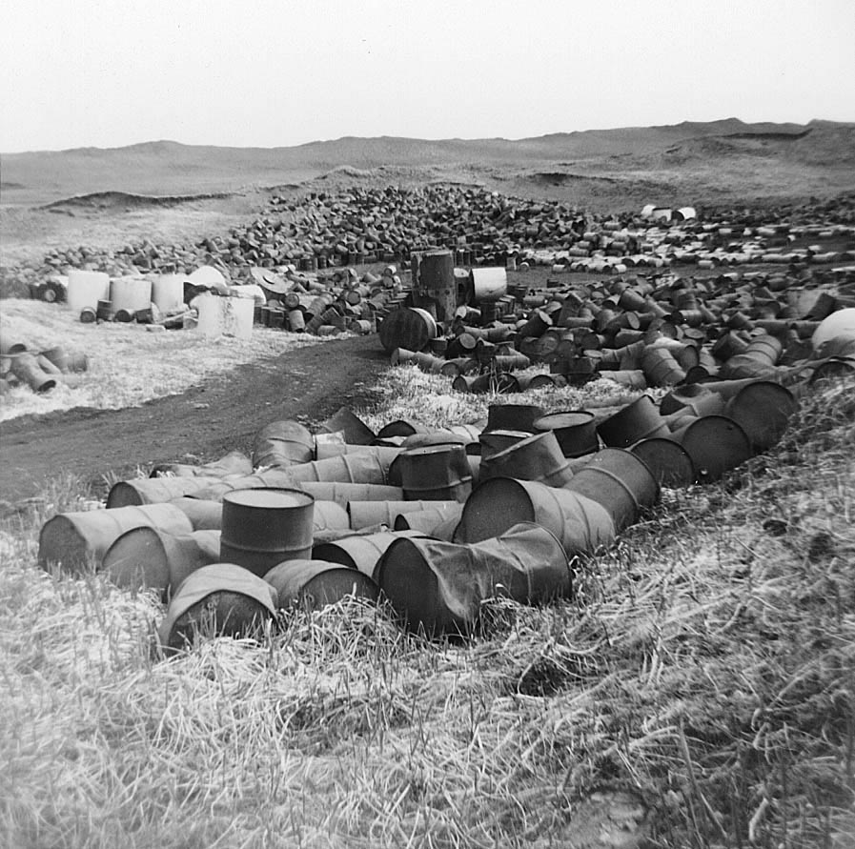
Love Canal
In 1942 Hooker Chemical and Plastics Corporation purchased the trench. Seizing on the industrial boom around World War II, Hooker manufactured plastics, chlorine, pesticides, caustic soda and fertilizers. During its 11 years of ownership Hooker disposed of 21,000 tons of hazardous chemicals at Love Canal.

Slide 7
1953
Waste from Hooker, the US Army, and the City of Niagara Falls has filled the canal
Backfill the canal and cover it with 4 feet of clay
Niagara Falls Board of Education wants to buy the property from Hooker

Slide 8
1953 -- continued
Hooker says “no” it’s not suitable for a school
Hooker took school officials to the site, bored holes to show what was under the ground
School officials threatened to acquire the property via condemnation
Hooker sold for $1 and full written disclosure of what lay underneath the ground

Slide 9
Site Development After Hooker Sells the Property
The Niagara Falls Board of Education builds “The 99th Street School” on the site
Over time: 800 homes, 240 low income apartments, 3 schools in neighborhood
Record rainfall in 1978
  Contaminants seeped into the homes and schools
  Puddles of toxic chemicals on the ground
  Air had a faint choking smell
  Children returned from play with burns on their hands and faces

Slide 10
NY Times August 5, 1978
NY Times August 5, 1978: “Time Bomb in Love Canal”
August 7, 1978:
  NY Governor Hugh Carey announces that the state will purchase homes affected by chemicals
  President Carter approves emergency financial aid (first time emergency funds were used for something other than a “natural” disaster)
  U.S. Senate adopts a “sense of Congress” resolution saying federal aid should be provided
98 families evacuated by end of August
1980 fed/state government buy 500 homes

Slide 11
Comprehensive Environmental Response, Compensation and Liability Act
“CERCLA” or “The Superfund Law”
42 USC §§9601 to 9675
Enacted in 1980 to clean up leaking hazardous waste disposal sites
“Who” pays for the clean up – 42 USC §9607
  Joint and several liability
  Retroactive

Slide 12
CERCLA Liability
42 USC §9607(a)
Current owner and operator of Love Canal
Person who owned or operated Love Canal at the time when the disposal occurred
  1983 Hooker pays $20M (homeowners)
  1989 Hooker accepts responsibility to clean up
  1994 Hooker pays $98M (state govt)
  1995 Hooker pays $129M (fed govt)
Person who “generated” the waste disposed at Love Canal
Person who “arranged”for the waste to be disposed at Love Canal

Slide 13
2002 “Brownfields” Amendment to CERCLA
Only defenses pre-2002
  The hazardous substances were released by “an act of God” 42 USC §9607(b)(1)
  The hazardous substances were release by “an act of War” 42 USC §9607(b)(2)
New defenses created by 42 USC §9607(b)(3) & (r)
  Impetus for Phase I ESA
  Innocent landowner 42 USC §9607(b)(3)
  Bona fide prospective purchaser 42 USC §9607(r)

Slide 14
Innocent Landowner & Bona Fide Prospective Purchaser Defenses
Use Innocent Landowner defense when Phase I ESA is “clean” but after taking ownership legacy contamination is discovered
  The hazardous substances were released by an act of 3rd party
  Defendant exercised due care
  Defendant took precautions against foreseeable acts of the 3rd party
Use Bona Fide Prospective Purchaser defense when Phase I ESA finds contamination prior to taking ownership (during due diligence)
  Report the findings to regulators
  Stop continuing releases
  Prevent or limit human, environmental or natural resource exposure

Slide 15
Study Period
Never contract to purchase commercial real estate without a clause in the contract that provides for a suitable “study period”
  At least 30 days
  60-90 days is more mainstream
  Require the seller to cooperate and provide information
Due diligence
If purchaser decides not to purchase prior to expiration of the study period, all of purchaser’s earnest money deposit is returned

Slide 16
Phase I Environmental Site Assessment
Evaluation of property to determine the potential for environmental conditions that might present a current or future risk.
To obtain CERCLA liability protections.
Used by landowners or investors, lenders, attorneys, businesses, and developers. Some municipalities use them for CUP or Rezoning.
ASTM Standard.

Slide 17
Industry Standard
Standard Practice. ASTM E 1527-13
  Original ASTM E 1527-93
  Potential update by end of year.
Identify Recognized Environmental Concerns
  REC
  HREC
  CREC
Business Environmental Concerns

Slide 18
What is the ESA process?
Four main steps:
        Environmental Records
        Site Visit
        Interviews
        Reporting

Slide 19
How long does it take?
Typical time to complete 2 – 3 weeks.
Time Constraints:
        Developed - Undeveloped
        Site Access
        History
        Interviews, FOIA
        Reporting

Slide 20
How much do they cost?
Typical cost $2,000
Larger, more complicated: $5,000 +

Slide 21
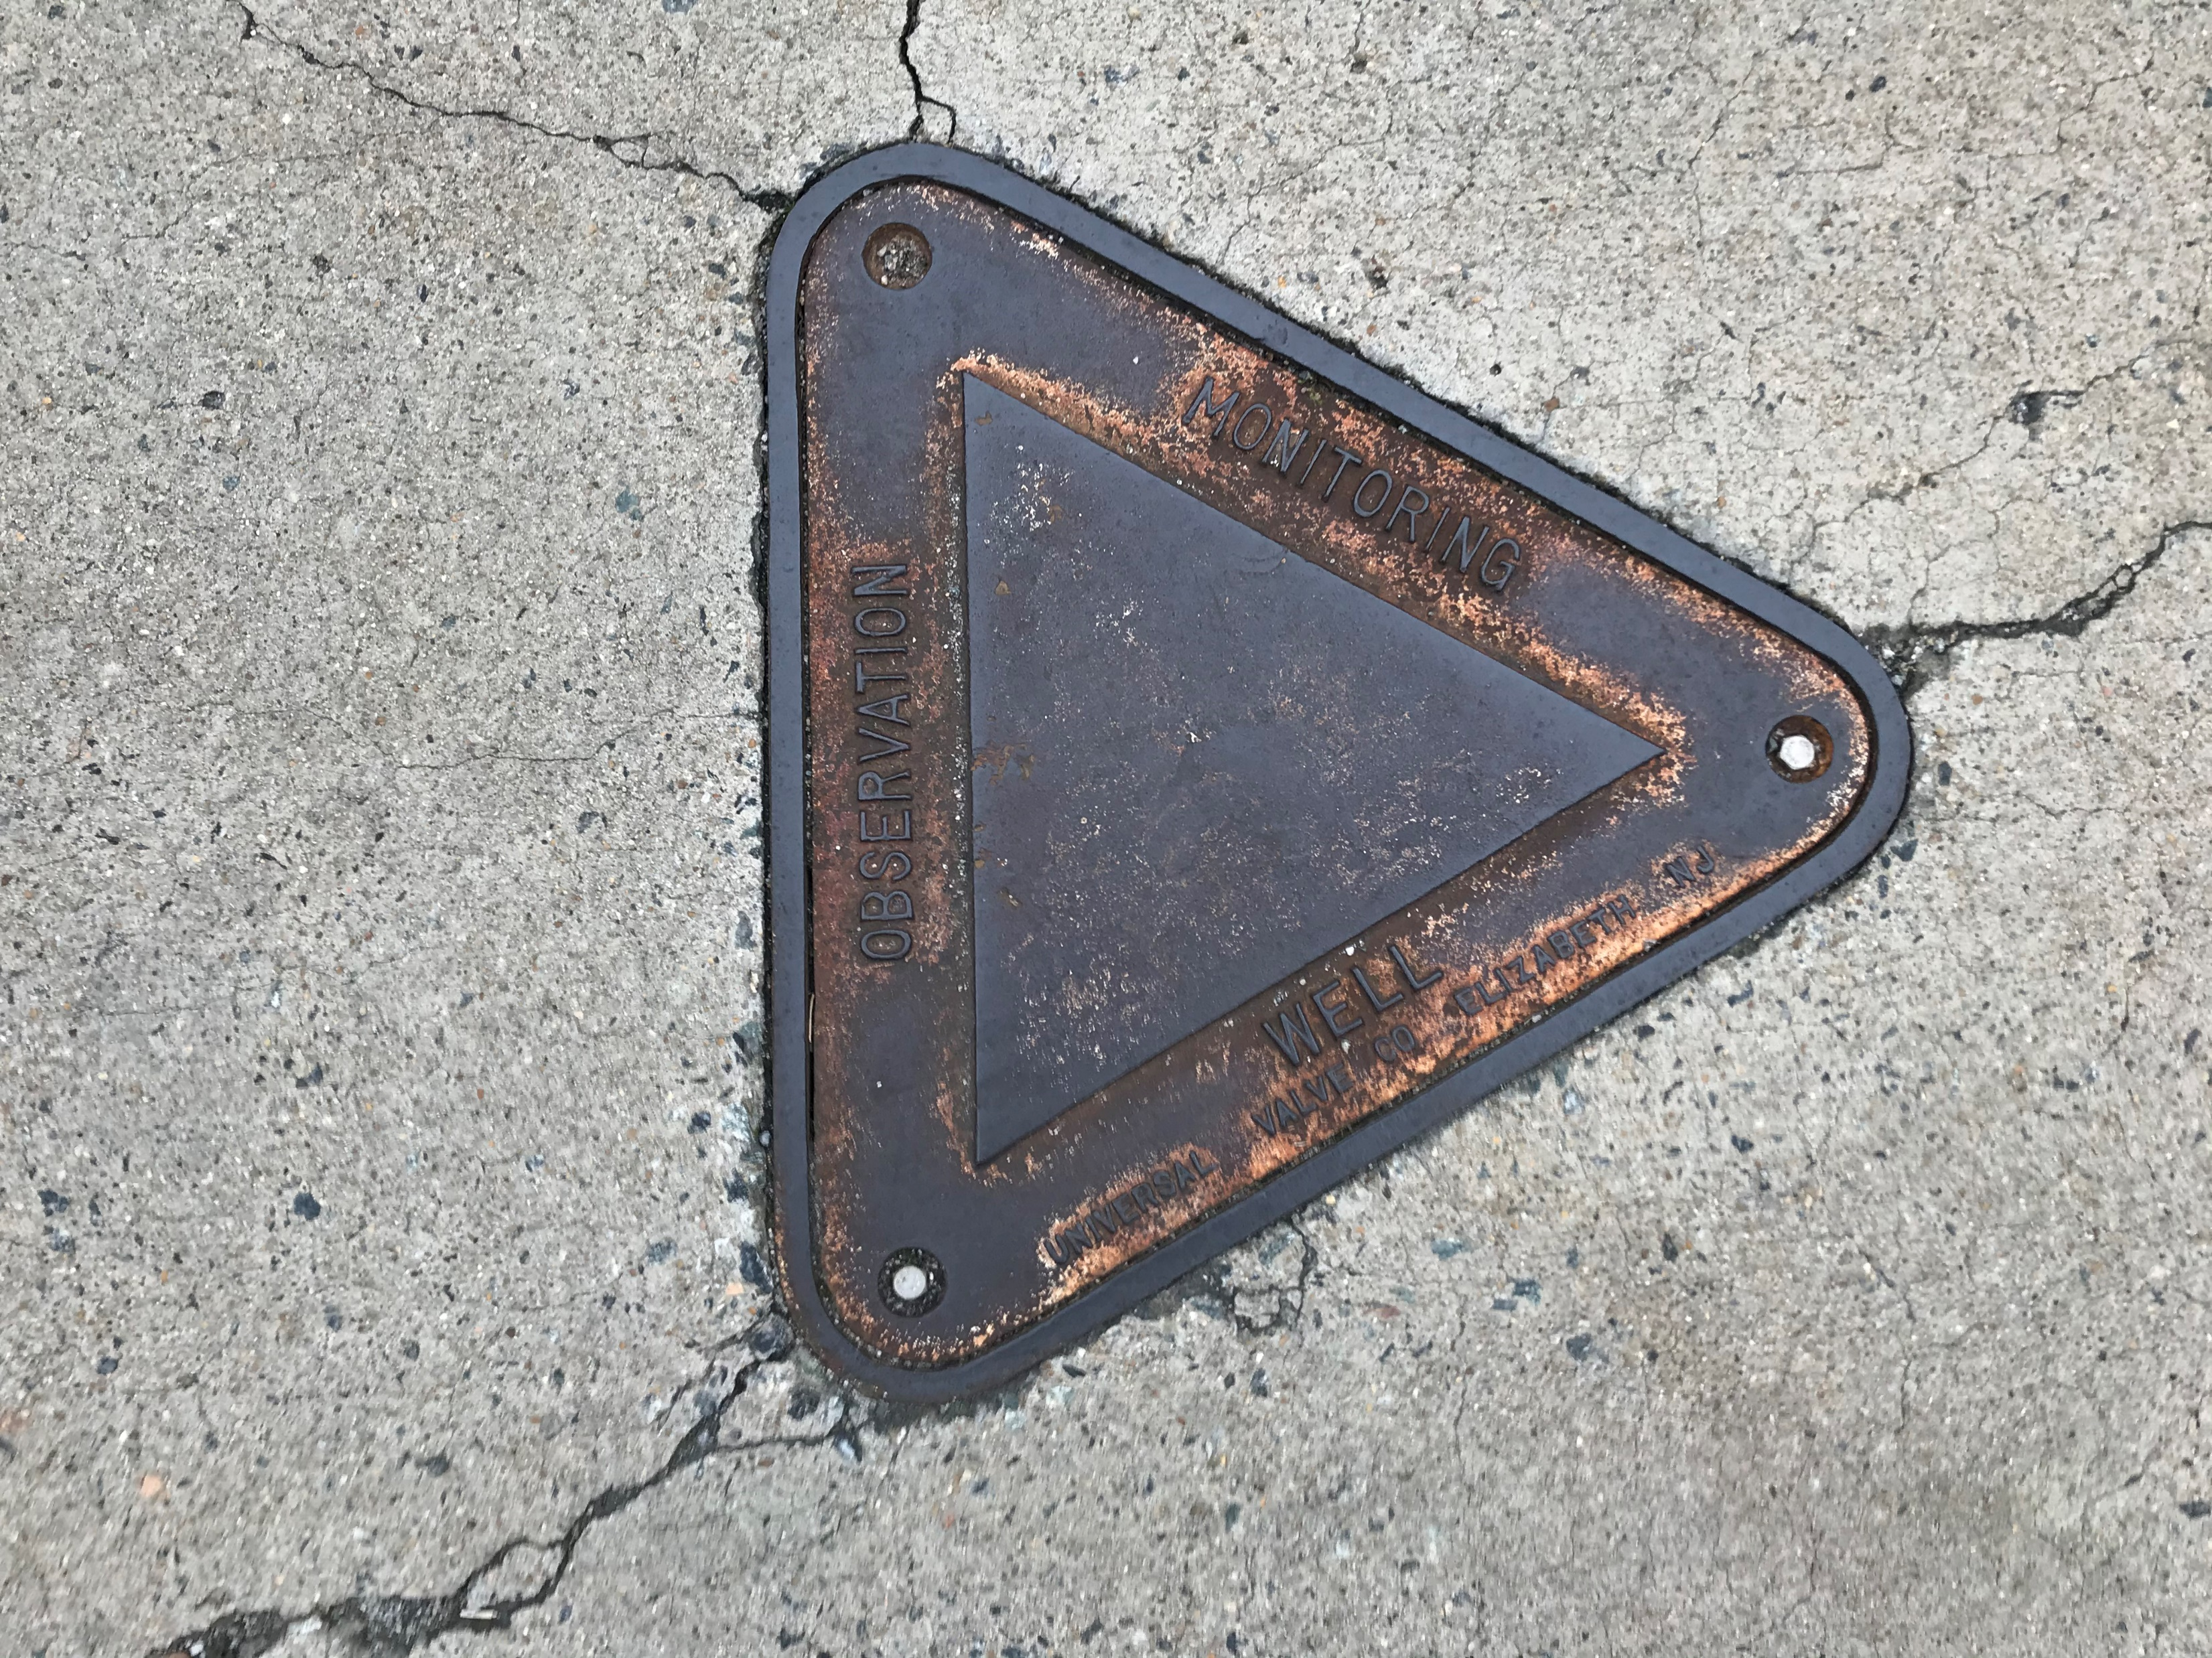
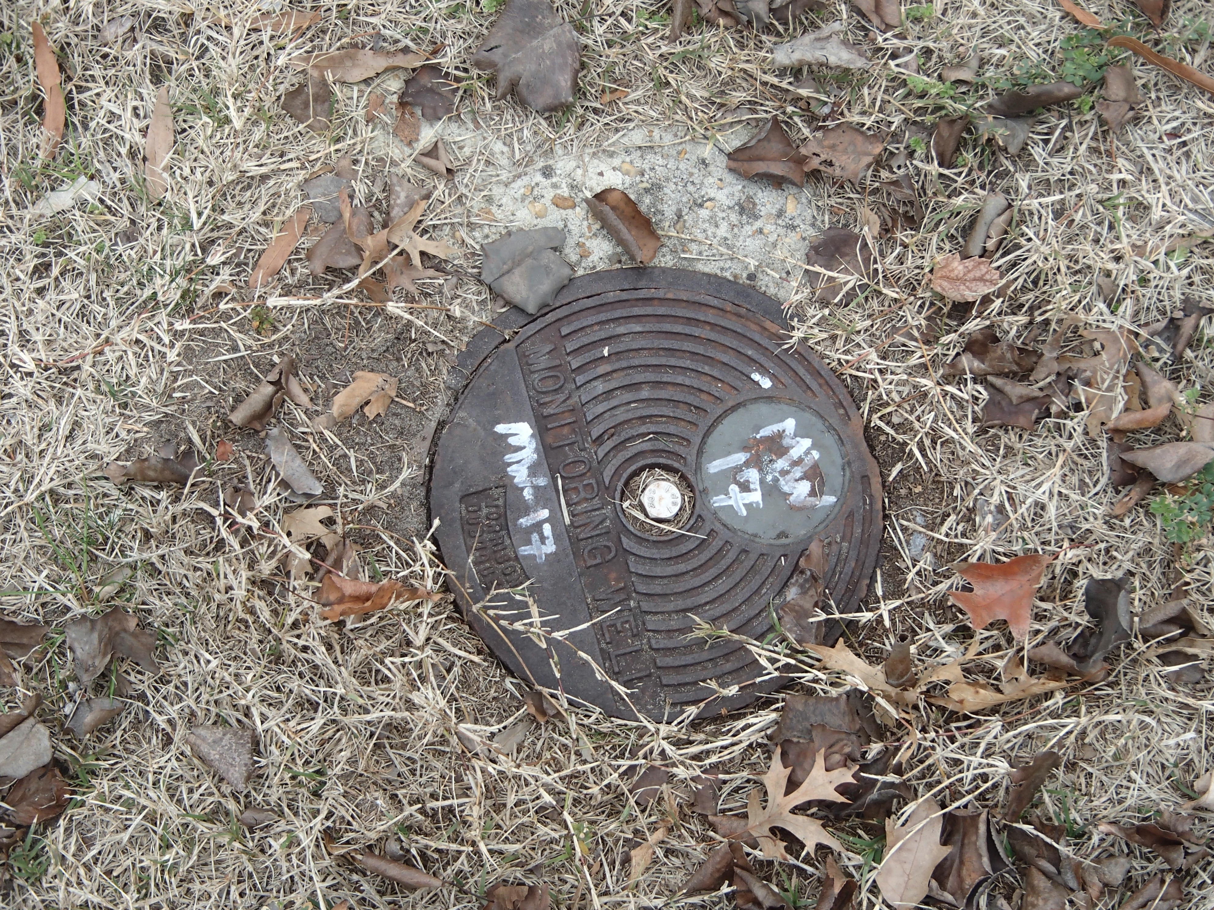
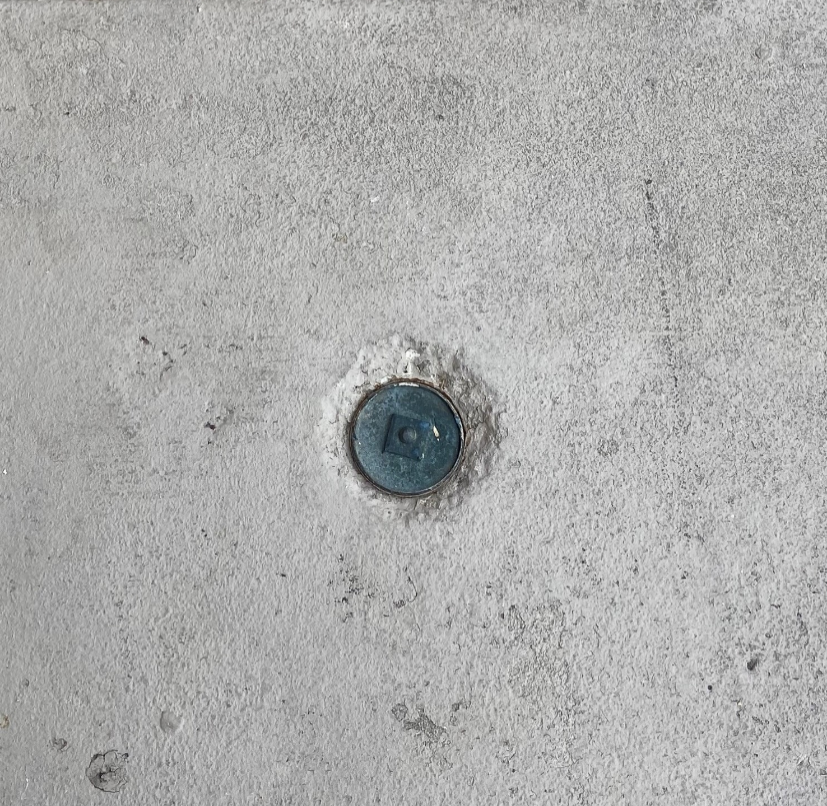
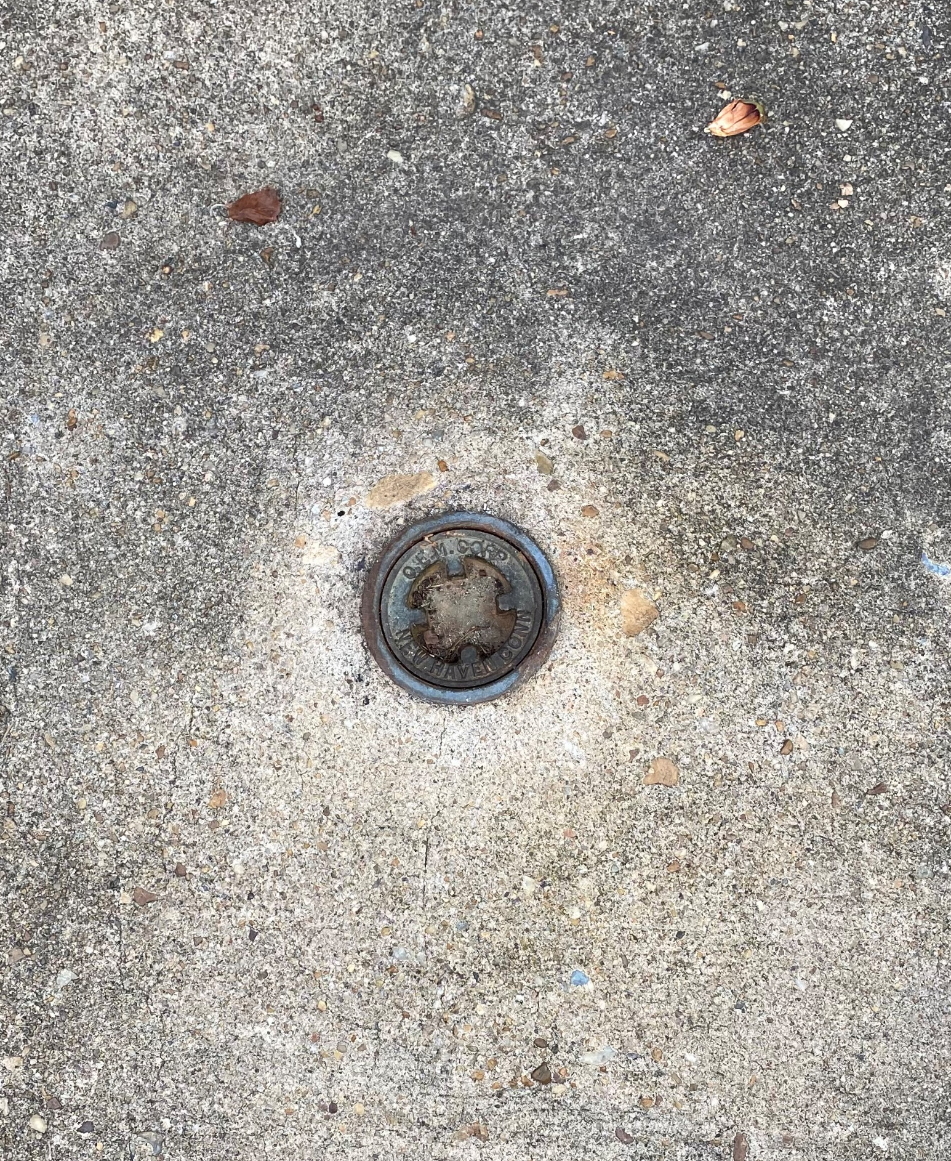
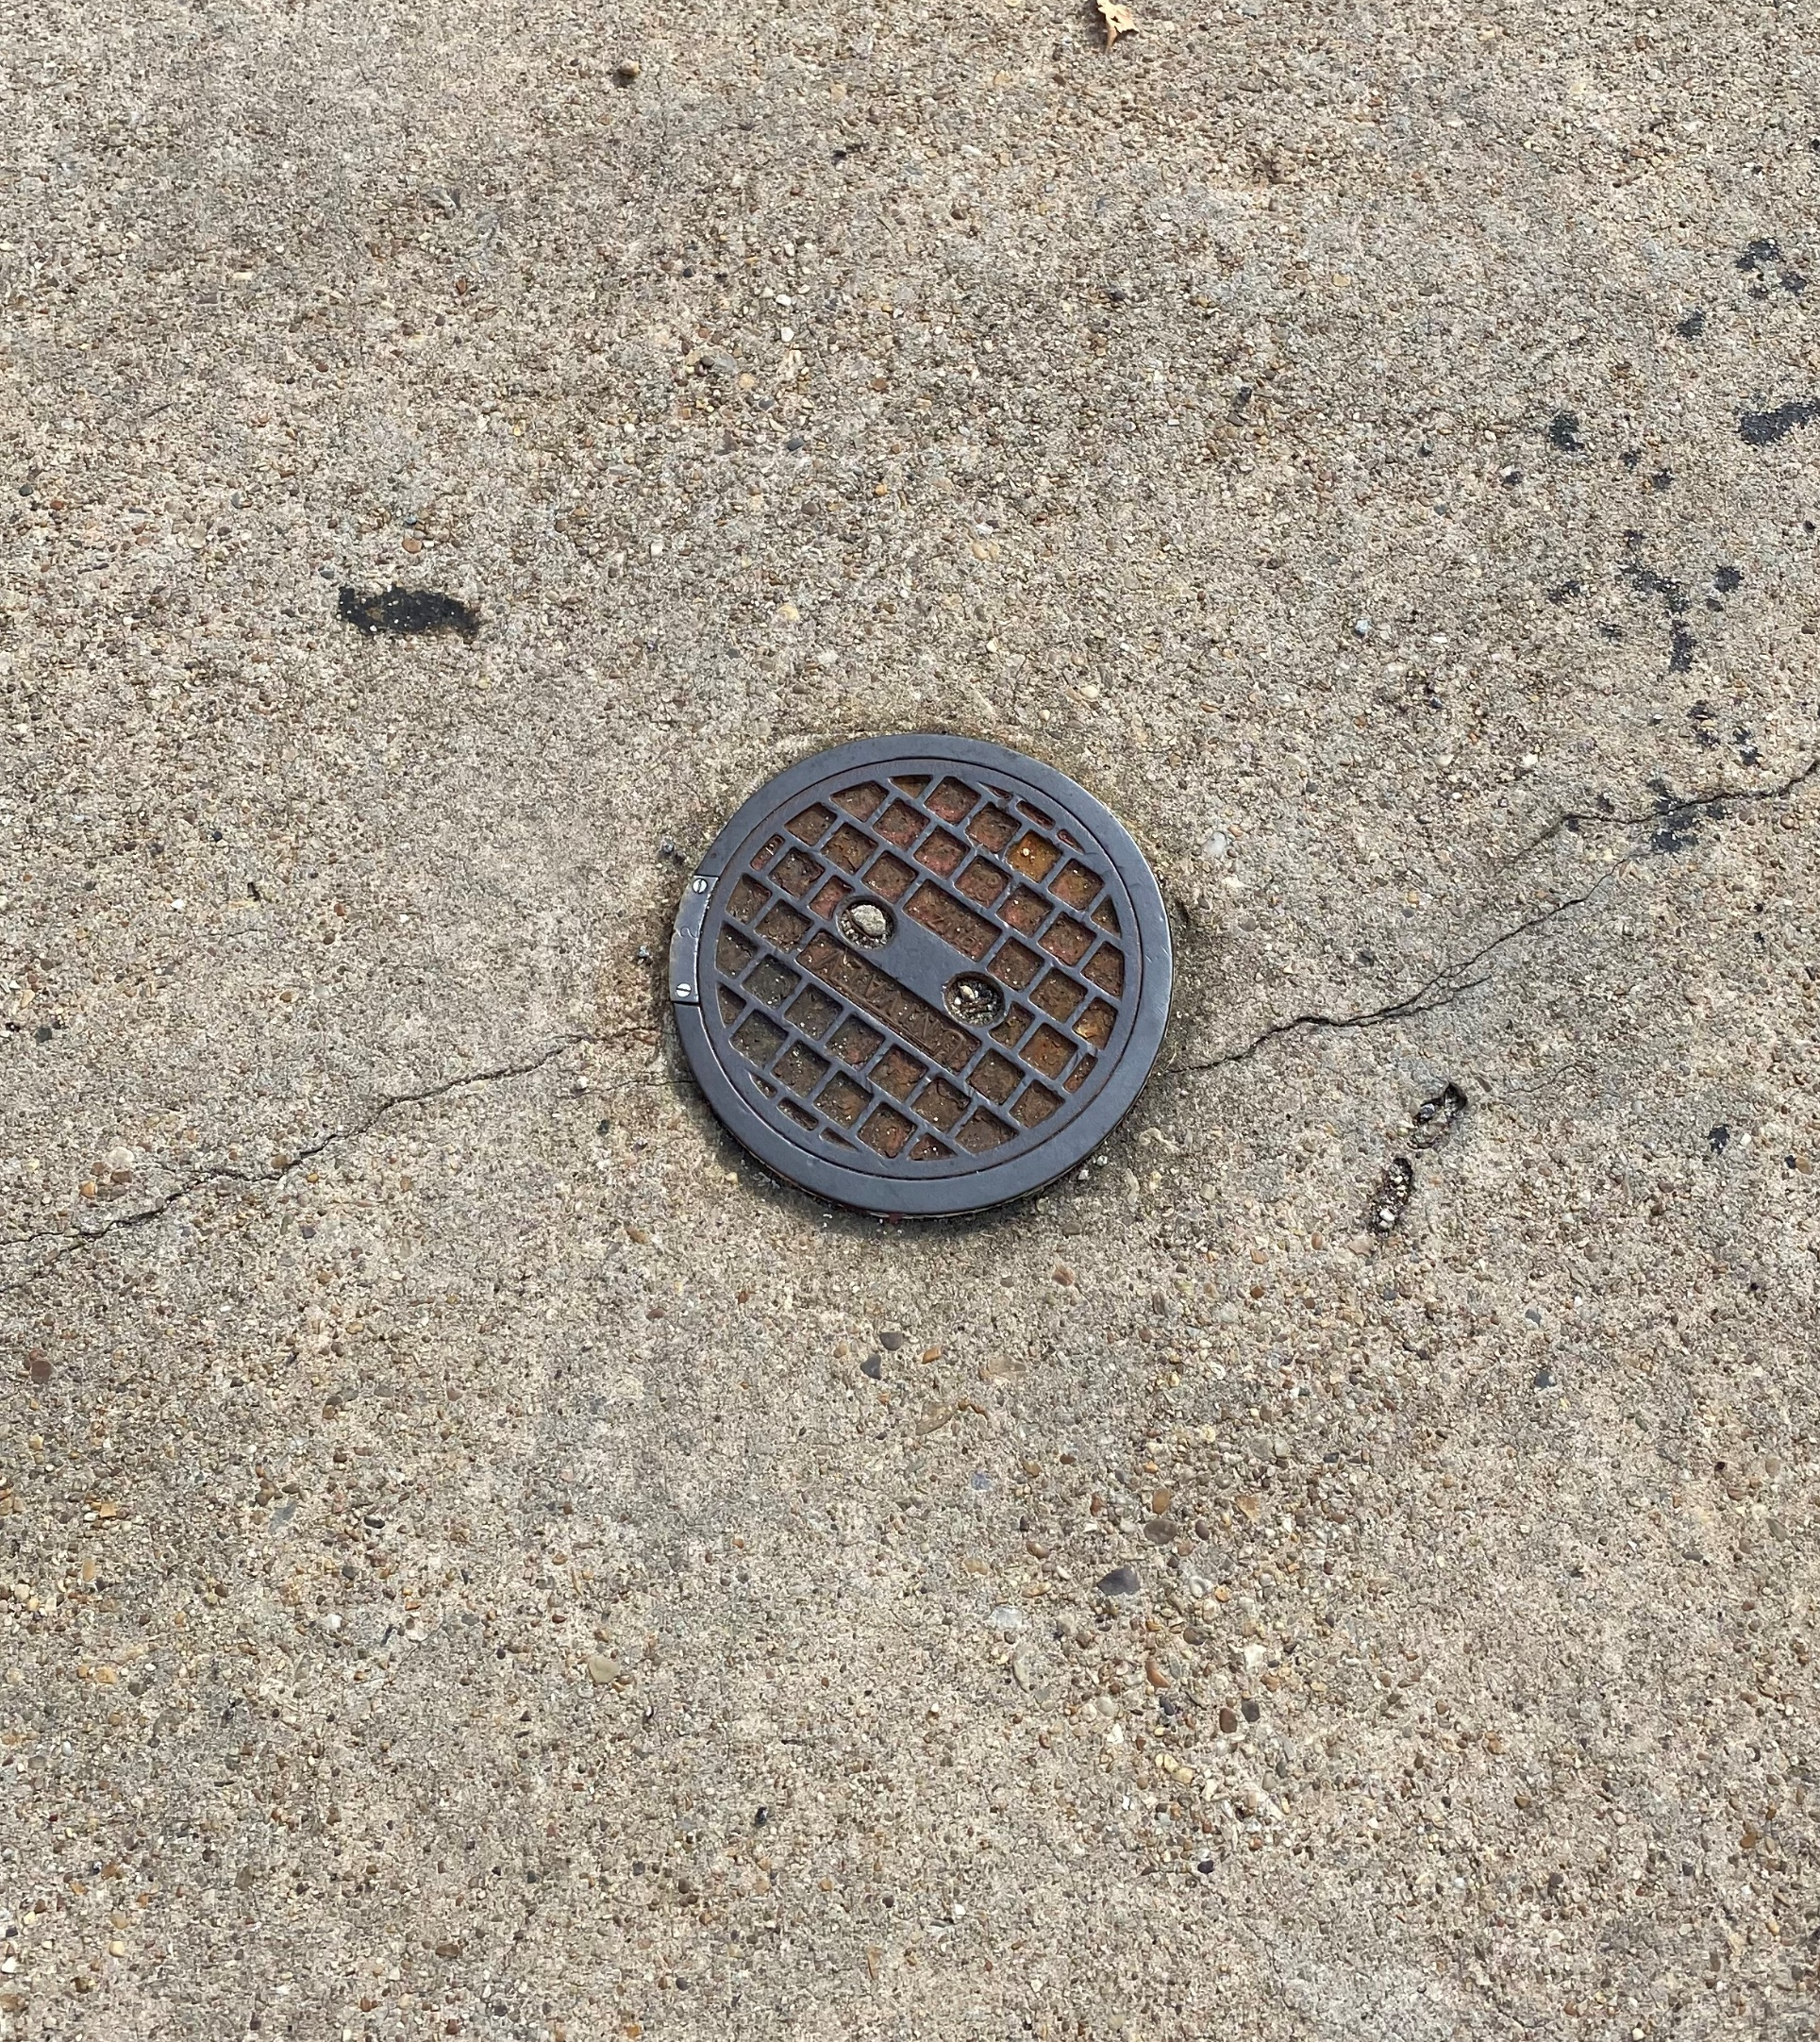
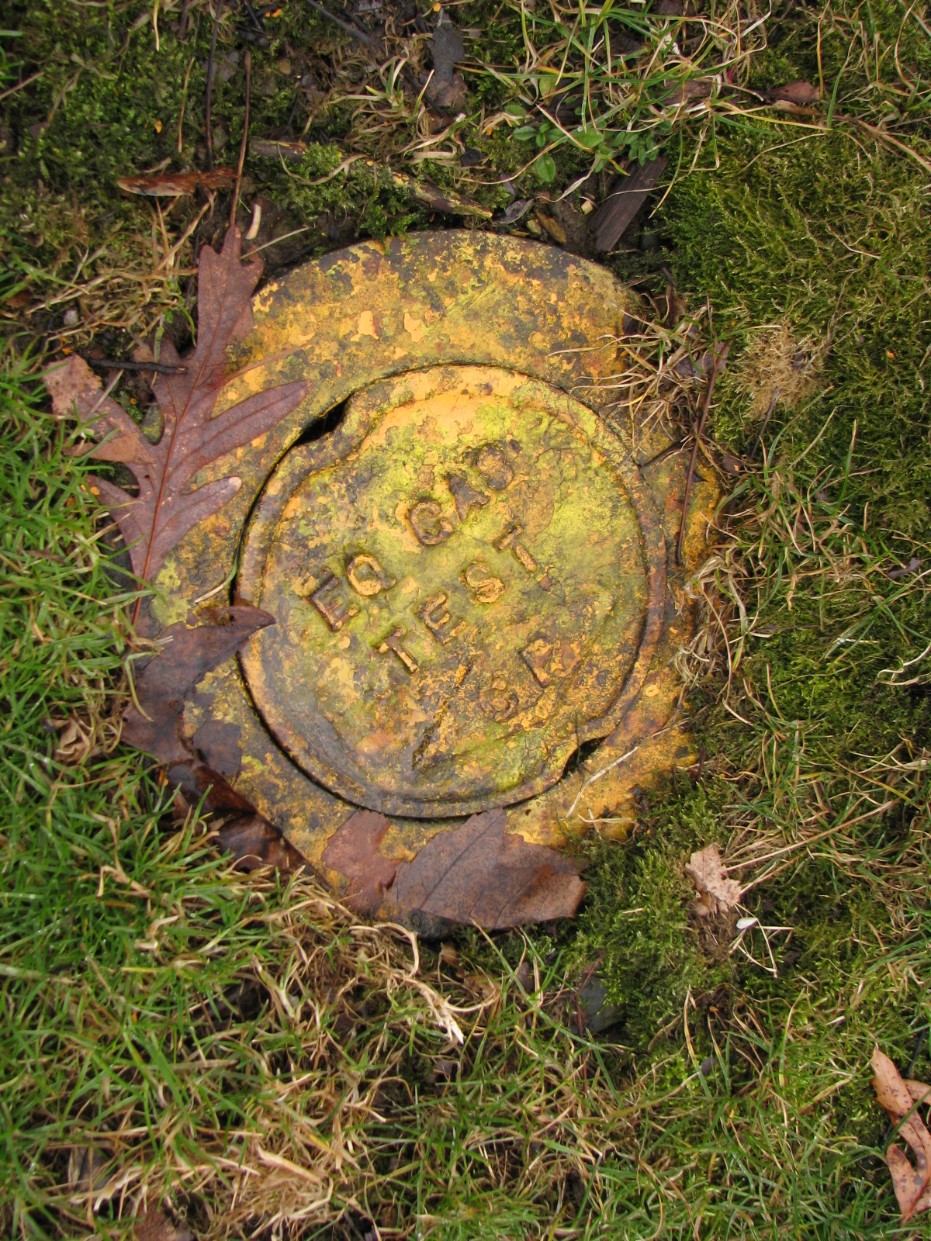
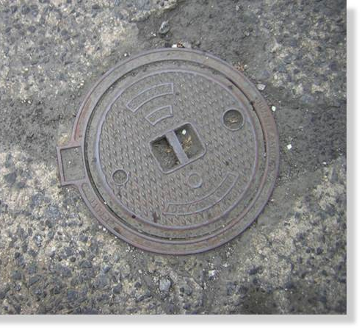
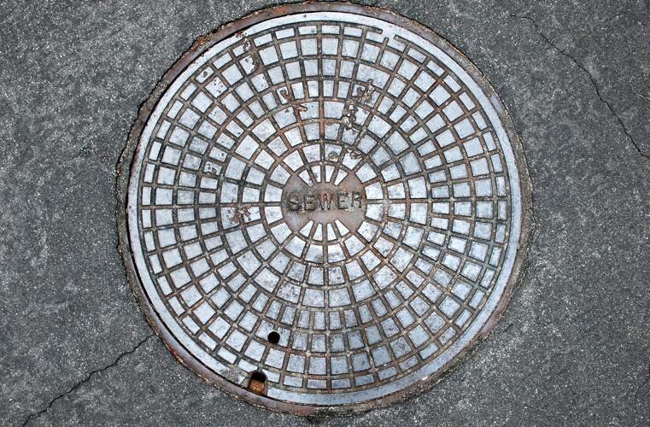

Slide 22
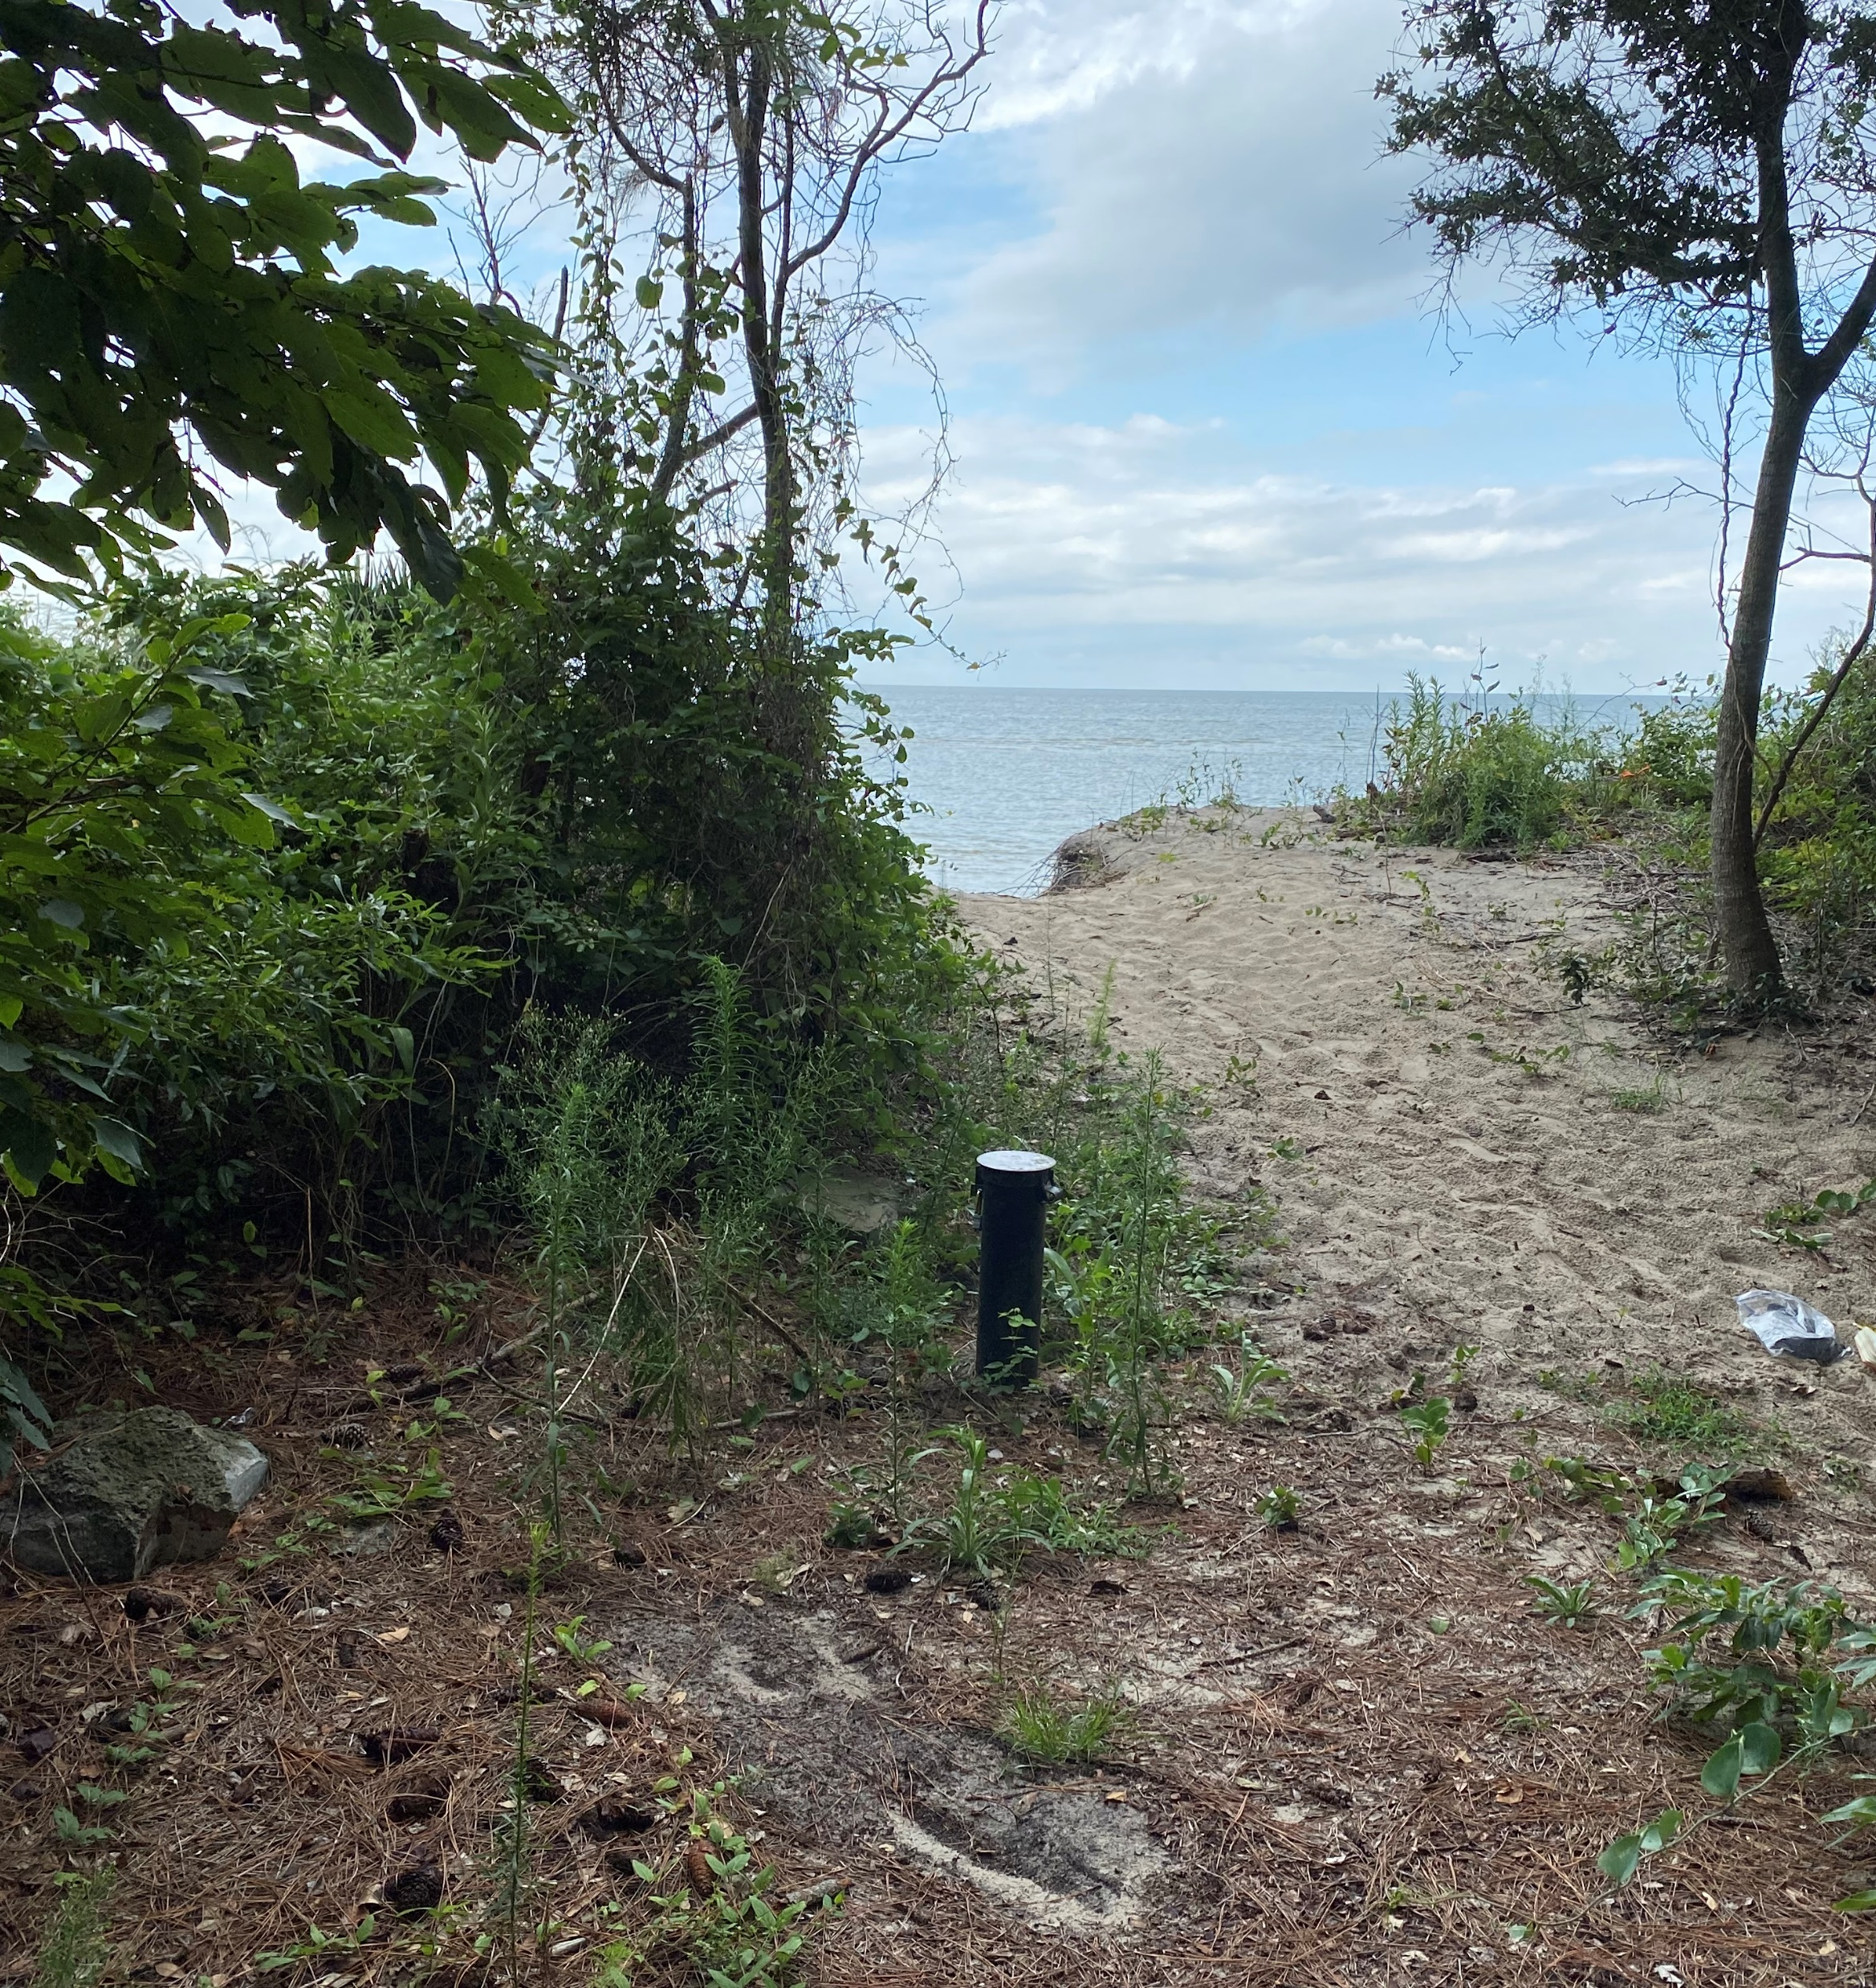
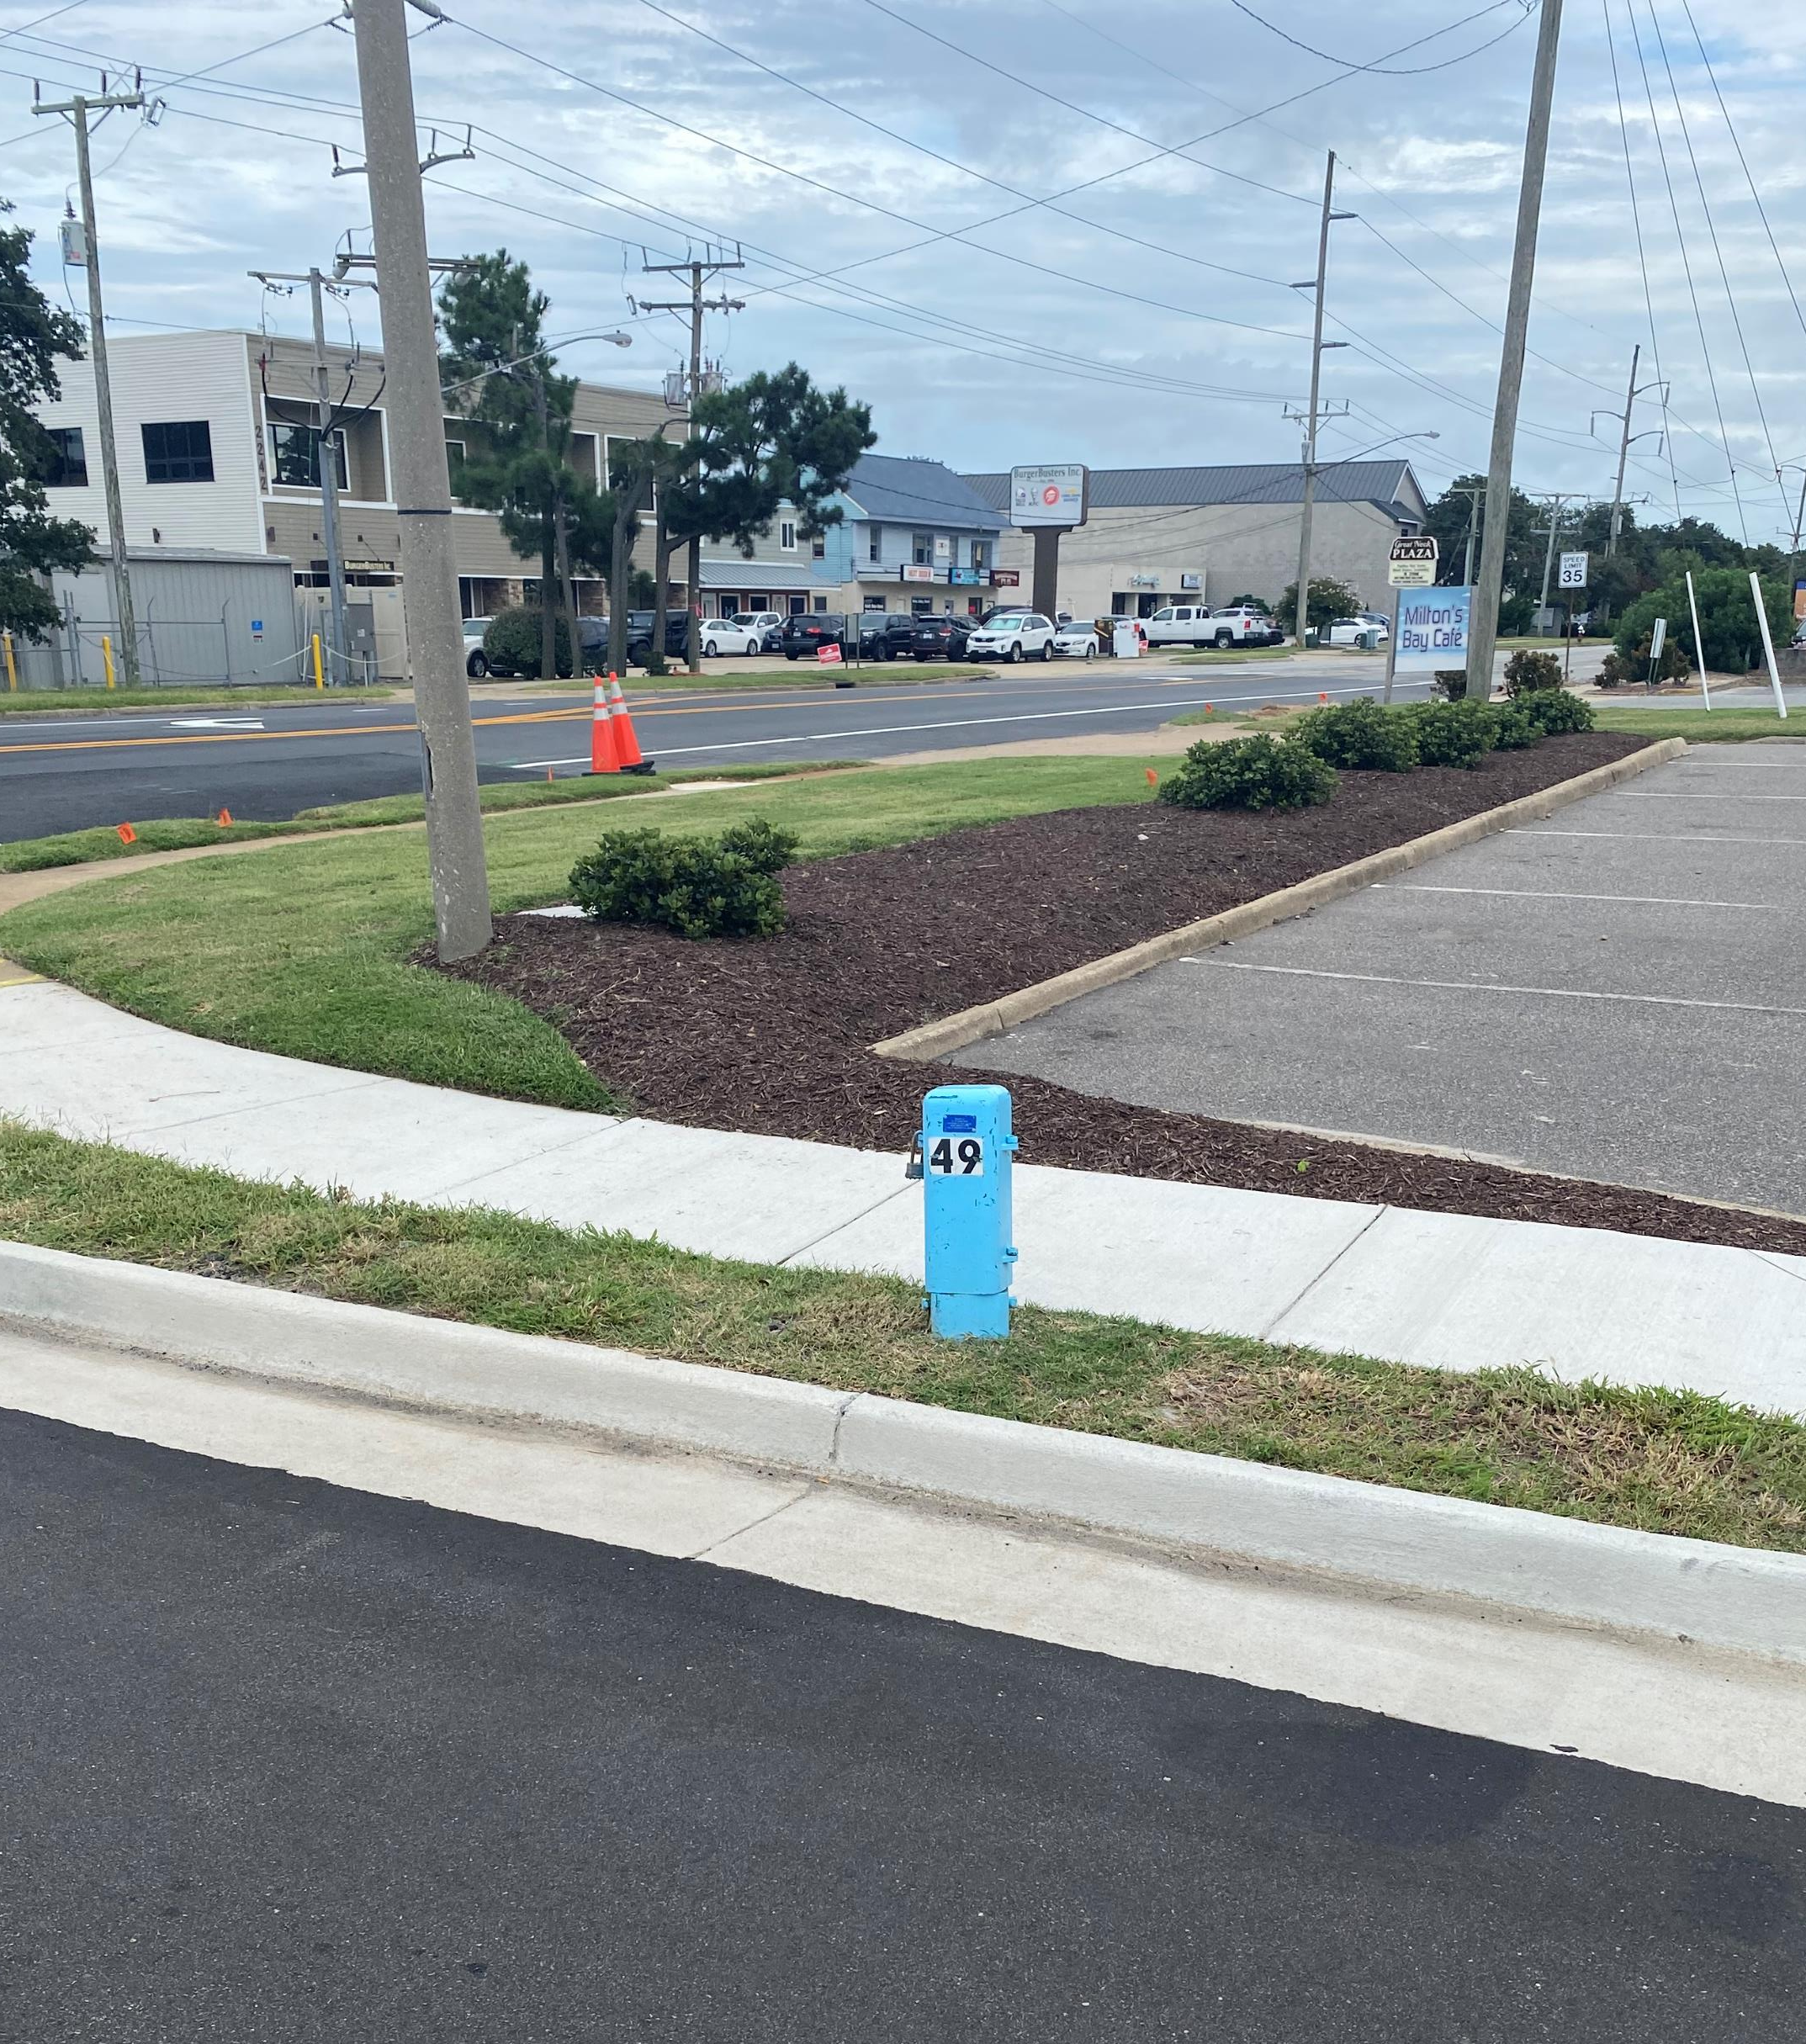
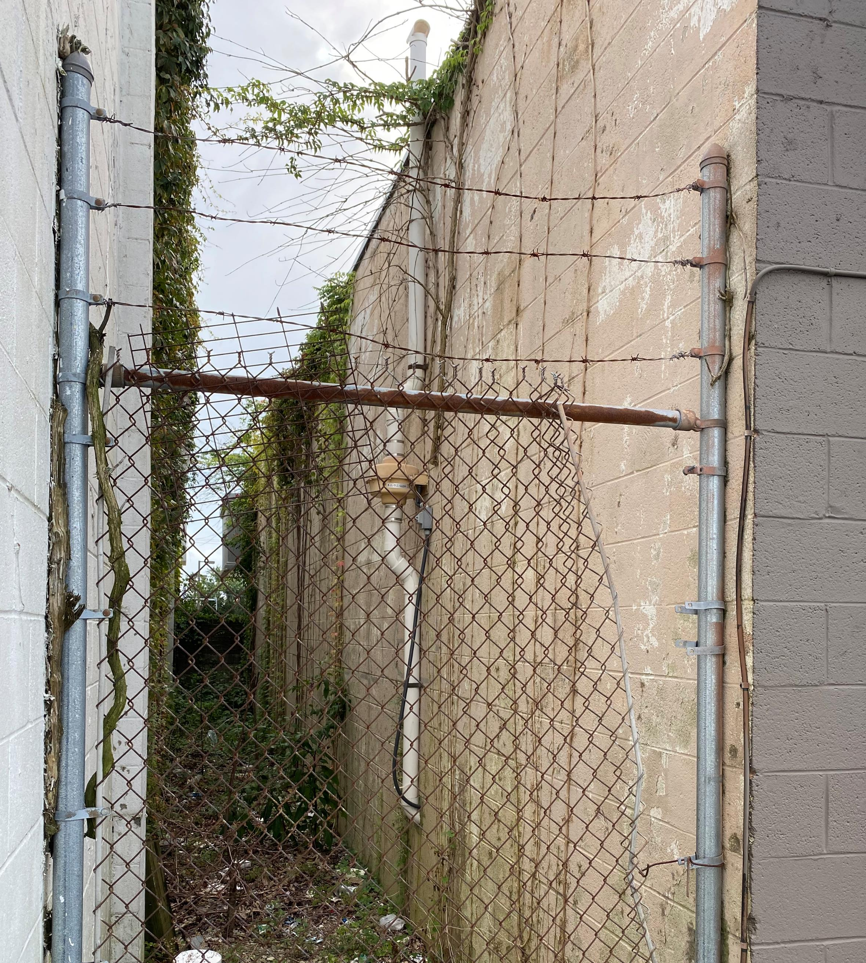
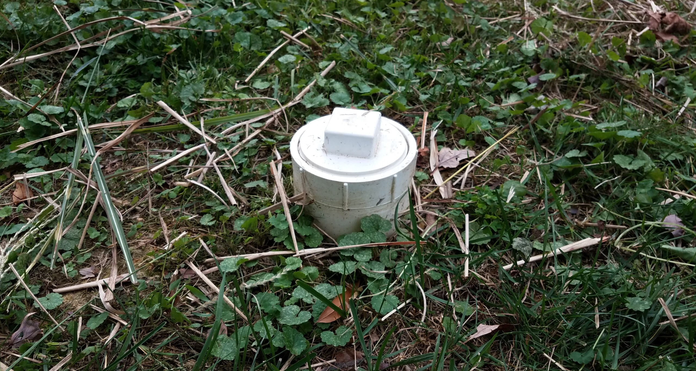

Slide 23
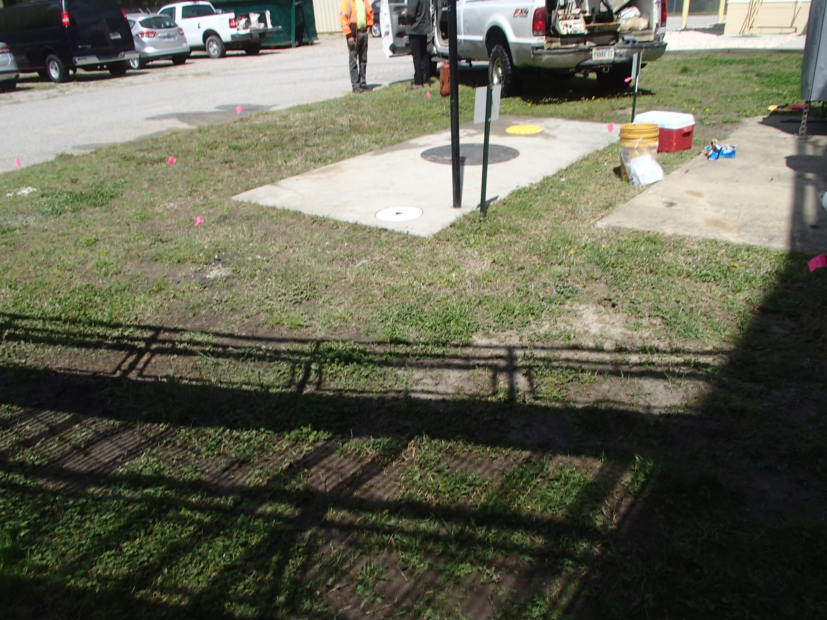
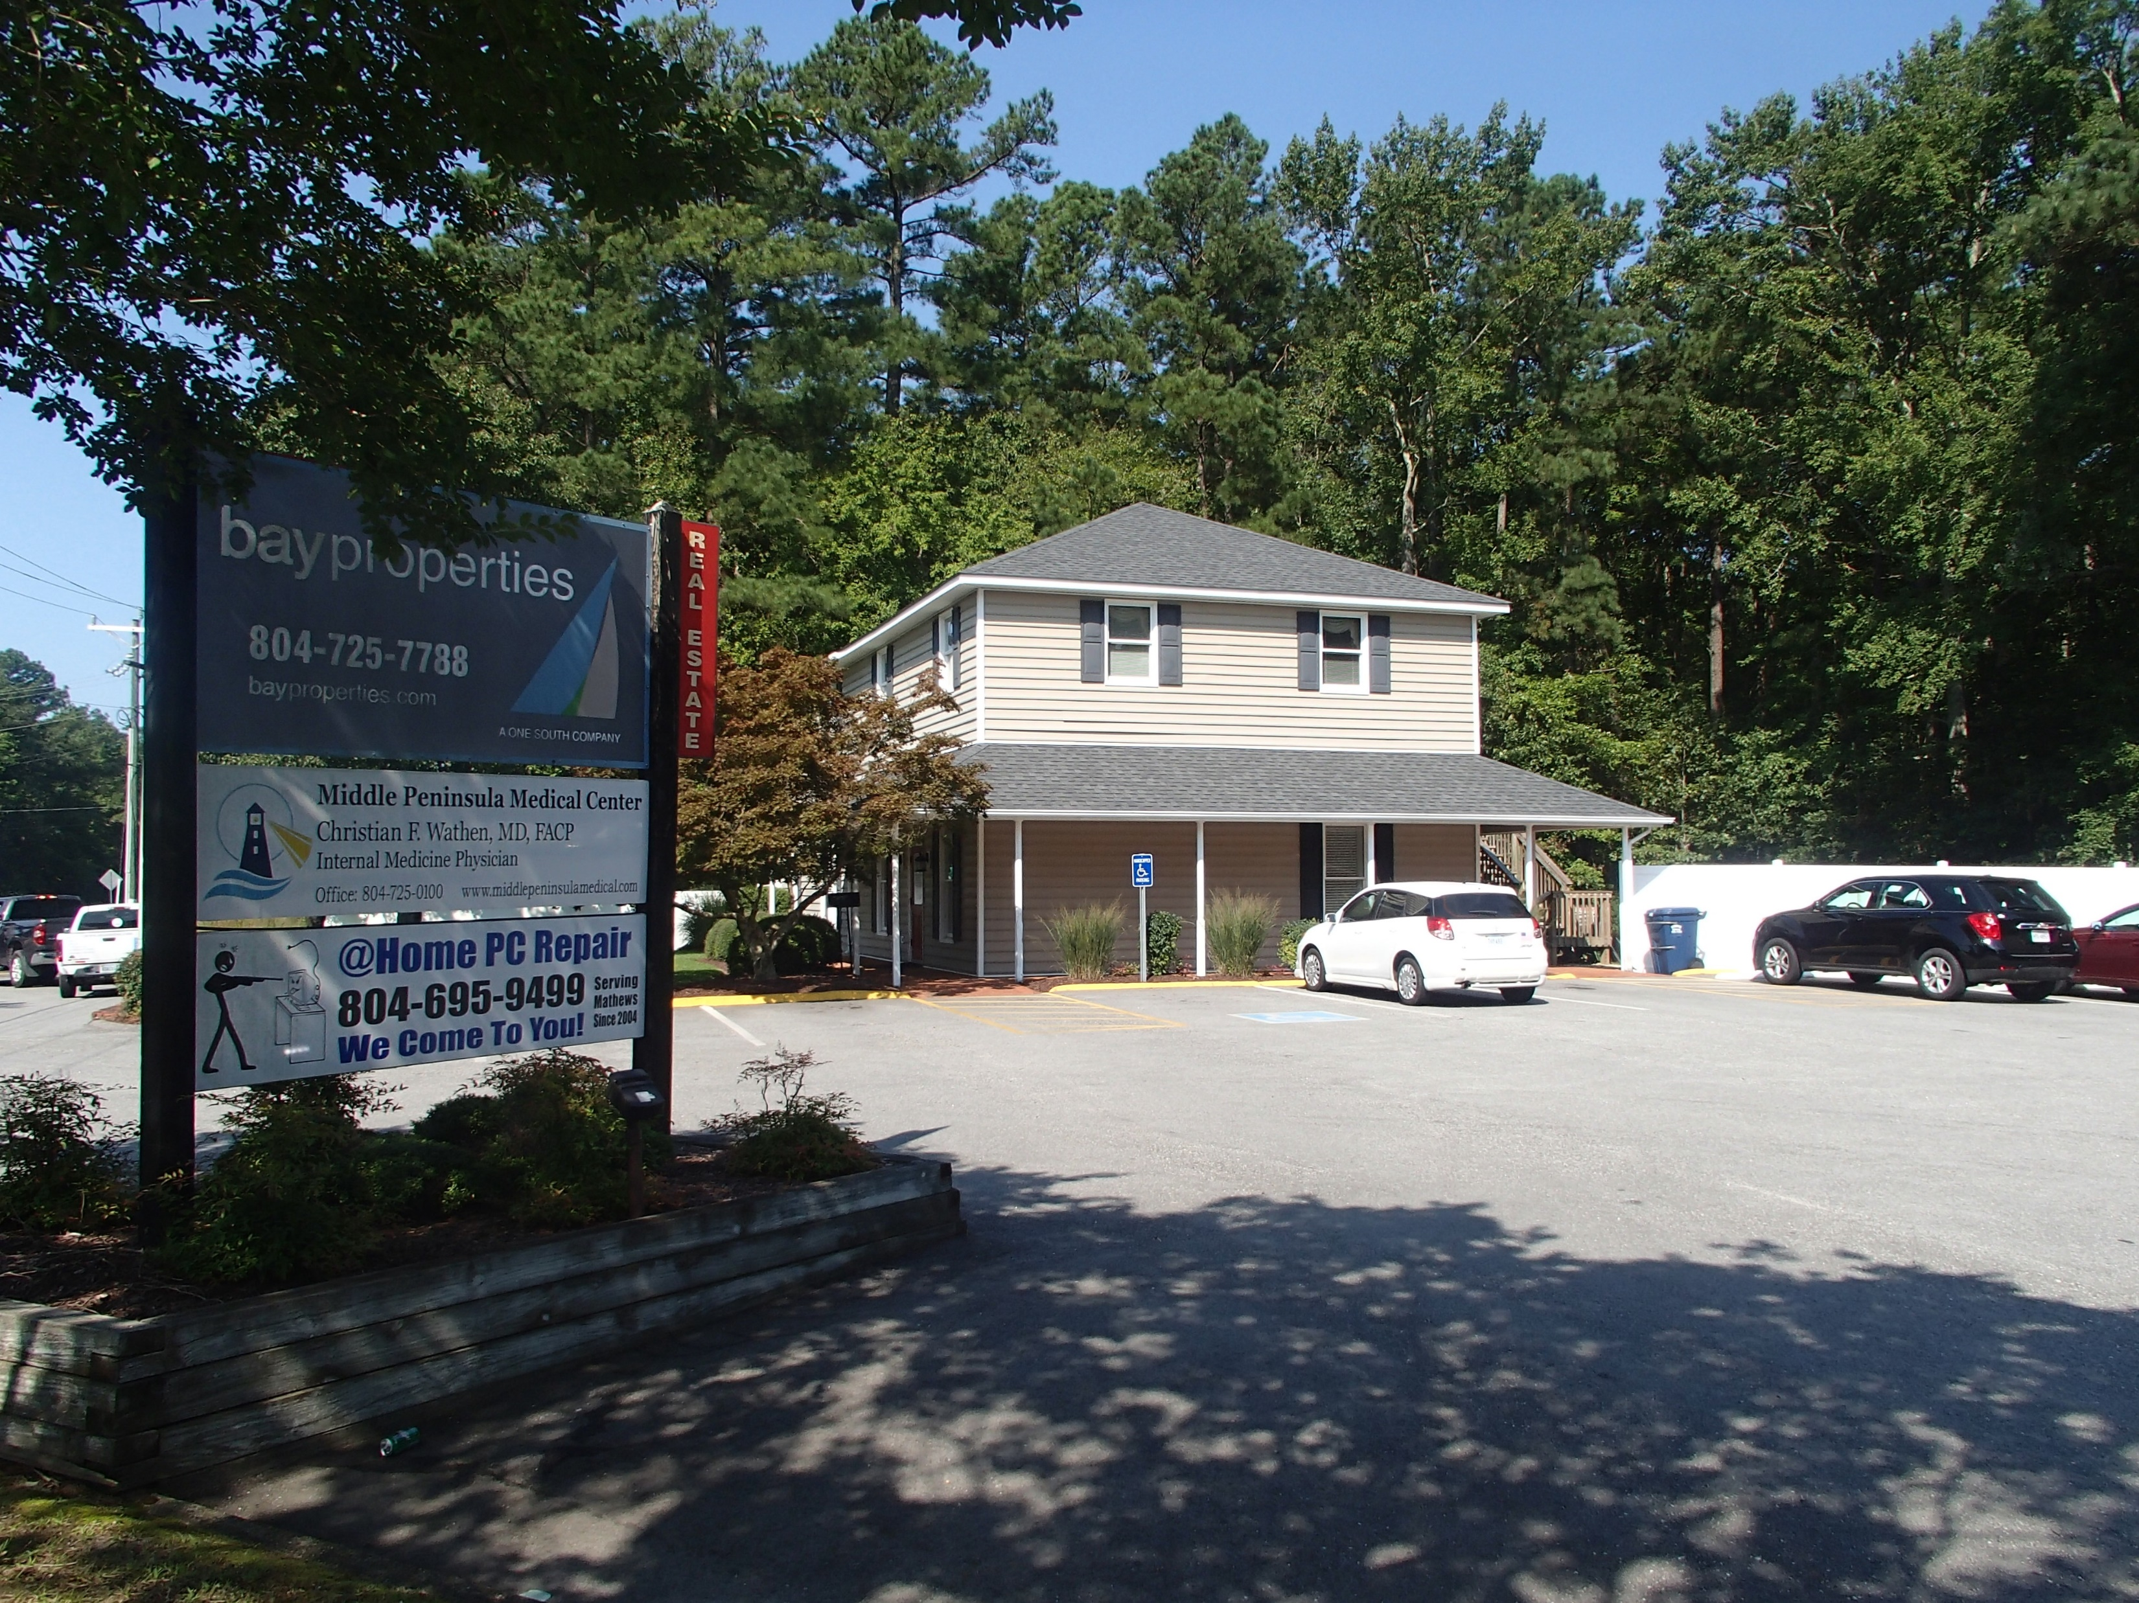

Slide 24
Additional Resources
Blog article: Get a Phase I Environmental Site Assessment Before Purchasing Commercial, Industrial or Agricultural Real Estate
  https://www.waterfrontpropertylaw.com/blog/posts/phase-i-environmental-site-assessment-purchasing-real-estate/
EPA Fact Sheet
  https://www.epa.gov/sites/default/files/2020-07/documents/assessing_brownfield_sites.pdf

Slide 25

Questions?
(757) 502-7326
jlang@pendercoward.com
490-9264
charles.hall@msaonline.com
All content copyright © 2021. James T. Lang. All rights reserved

