Slide 1
The Federal Clean Water Act: A Presentation for the Nansemond River Preservation Alliance
Jim Lang November 16, 2023

Slide 2


What We Will
Cover Today
What set of conditions gave rise to the Clean Water Act?
Clean Water Act overview
Describe the major CWA programs

Slide 3
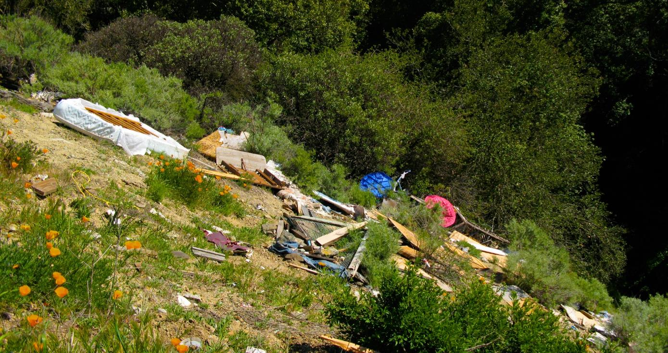
Environmental Compliance is a
(Relatively) New Concept

Slide 4
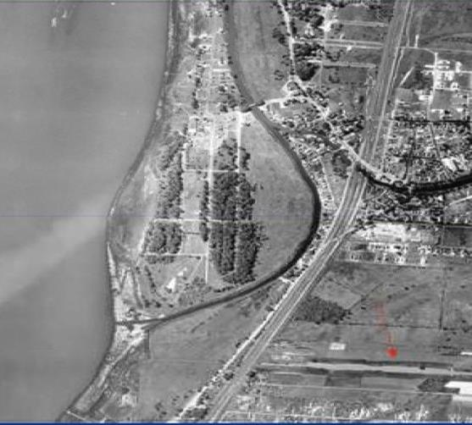
In 1890’s William T. Love wanted to build a canal connecting the Niagara River with Niagara Falls. The state assisted the project through use of condemnation to acquire land. Love started his canal but could not finish it: 1 mile, 15 feet wide, 10 feet deep.
Love Canal
1927 Photograph showing Canal
http://ublib.buffalo.edu/libraries/projects/lovecanal/aerial_photos/aerial_1927.html

Slide 5
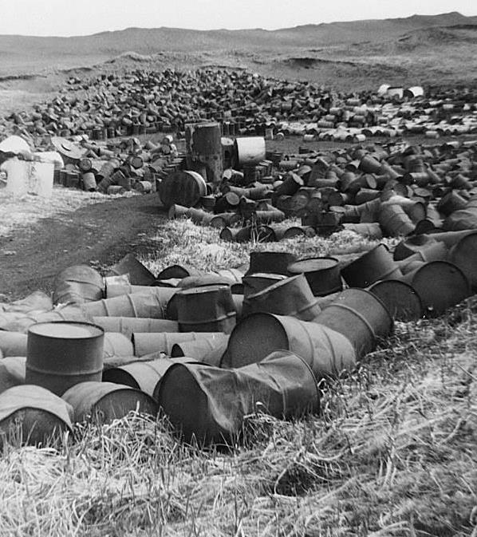
Love Canal
In 1942 Hooker Chemical and Plastics Corporation purchased the trench.
Seizing on the industrial boom around World War II, Hooker manufactured plastics, chlorine, pesticides, caustic soda and fertilizers.
During its 11 years of ownership Hooker disposed of 21,000 tons of hazardous chemicals at Love Canal

Slide 6
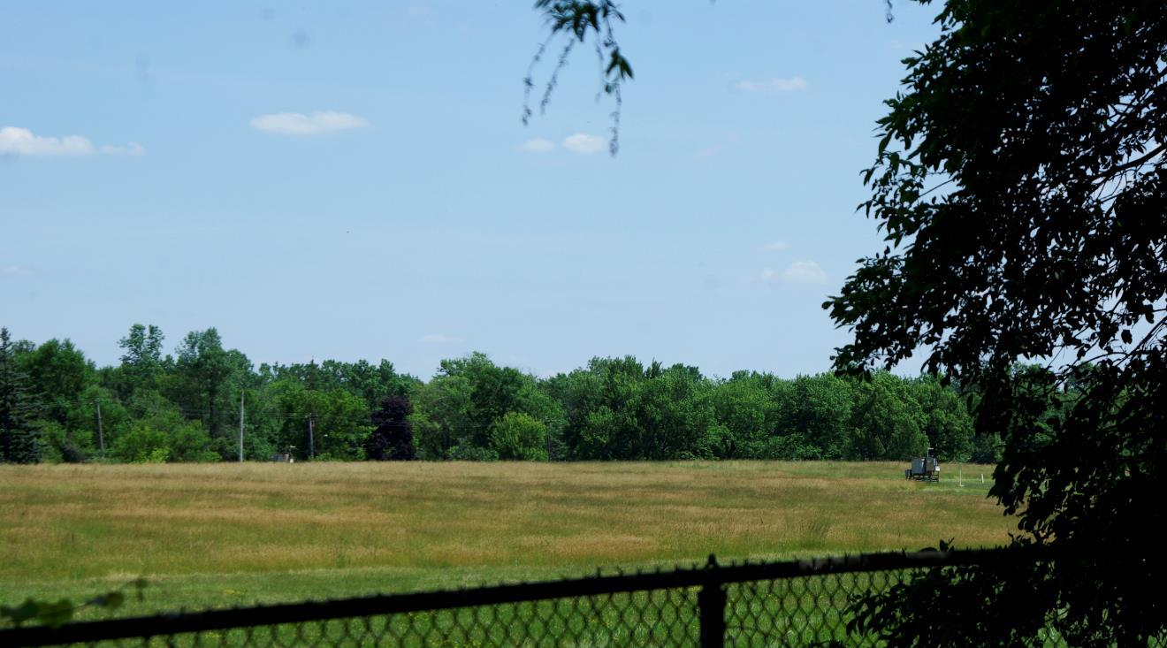
1953
Waste from Hooker, the US Army, and the City of Niagara Falls has filled the canal
Backfill the canal and cover it with 4 feet of clay
Niagara Falls Board of Education wants to buy the property from Hooker
A View of Love Canal in 2012
Buffalutheran, CC0, via Wikimedia Commons

Slide 7

1953 - continued
Hooker says “no” it’s not suitable for a school
Hooker took school officials to the site, bored holes to show what was under the ground
School officials threatened to acquire the property via condemnation
Hooker sold for $1 and full written disclosure of what lay underneath the ground
All content copyright ©2023. James T. Lang. All rights reserved
All content copyright ©2023. James T. Lang. All rights reserved
7
All content copyright ©2023. James T. Lang. All rights reserved
7
7
7

Slide 8
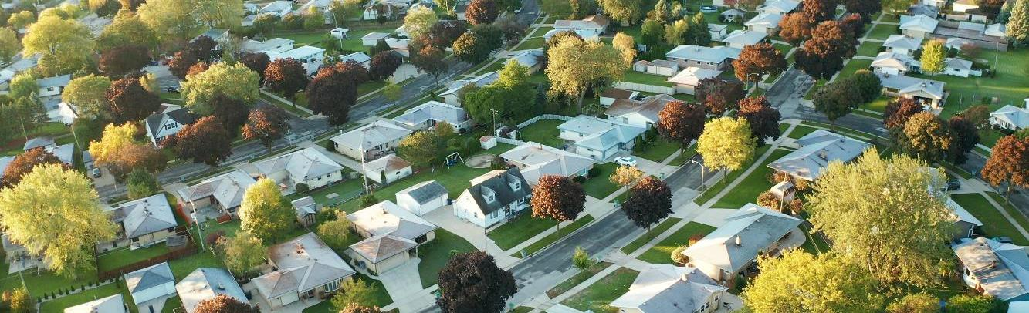
Construction
(in the Era of No Environmental Compliance)
The Niagara Falls Board of Education builds “The 99th Street School” on the site
Over time: 800 homes, 240 low income apartments, 3 schools in neighborhood
1978 national headlines as contaminants seeped into some nearby homes
1980 fed/state government buy 500 homes
All content copyright ©2023. James T. Lang. All rights reserved
All content copyright ©2023. James T. Lang. All rights reserved
8
All content copyright ©2023. James T. Lang. All rights reserved
8
8
8

Slide 9
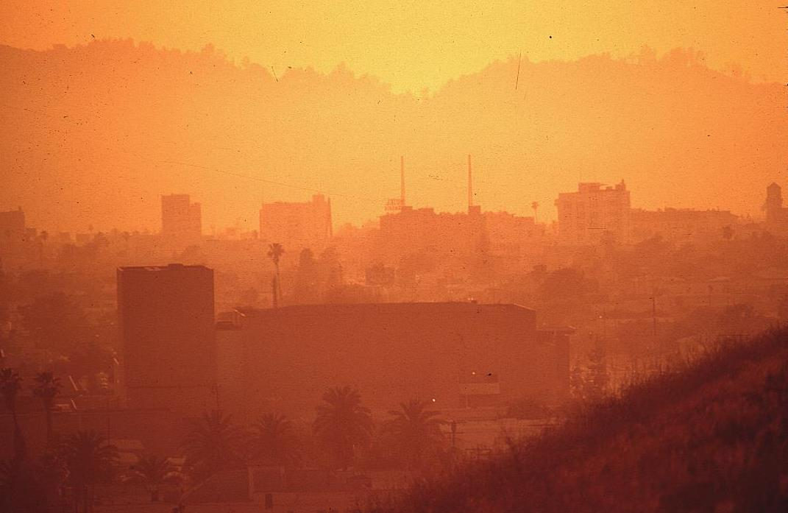
Prior to Environmental Law
When a smog attack hit Los Angeles during World War II, serious inquiry was made to determine whether the Japanese had launched a chemical attack on the city.
In the1950’s and 60’s the people of Los Angeles were breathing some of the dirtiest air in the world.
National Archives at College Park, Public domain, via Wikimedia Commons
All content copyright ©2023. James T. Lang. All rights reserved
All content copyright ©2023. James T. Lang. All rights reserved
9
All content copyright ©2023. James T. Lang. All rights reserved
9
9
9

Slide 10
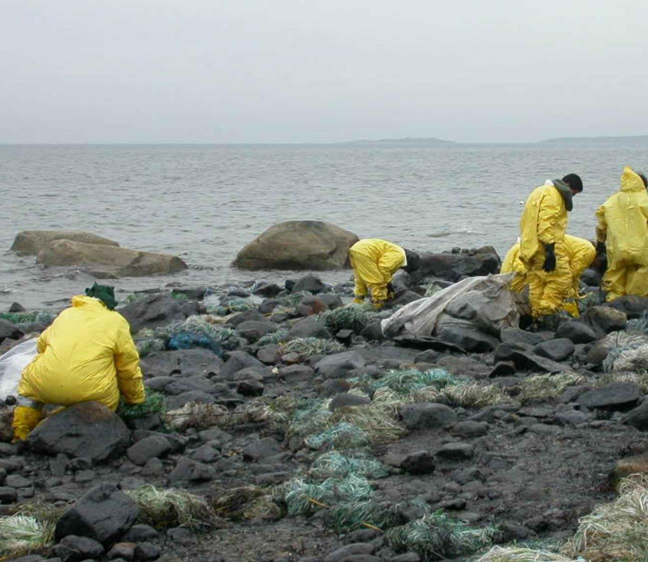

Union Oil Company Spill 1969
In January 1969, a “blowout” at a Union Oil Company oil platform six miles offshore in the Pacific Ocean released 200,000 gallons of crude oil over an eleven-day period, marring 35 miles of coastline near Santa Barbara, California.
Gore Lamar, U.S. Fish and Wildlife Service, Public domain, via Wikimedia Commons
All content copyright ©2023. James T. Lang. All rights reserved
All content copyright ©2023. James T. Lang. All rights reserved
10
All content copyright ©2023. James T. Lang. All rights reserved
10
10
10

Slide 11
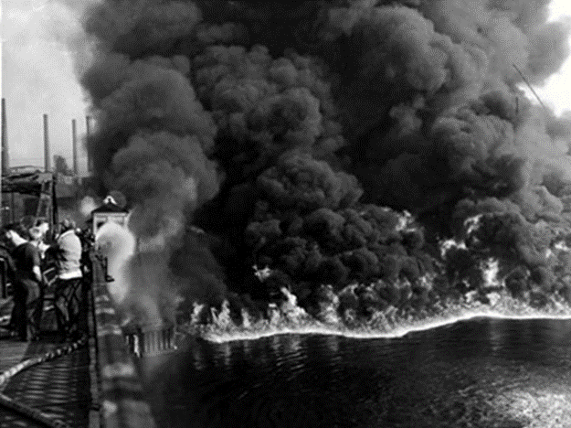
Cuyahoga River Fire Nov. 3, 1952
In June 1969, the Cuyahoga River burst into flames in Cleveland, Ohio, after sparks from a passing train set fire to oil-soaked debris floating on the surface of the water.
Courtesy of Special Collections, Michael Schwartz Library at Cleveland State University from the Cuyahoga River – Fires, Accidents Collection.
All content copyright ©2023. James T. Lang. All rights reserved
All content copyright ©2023. James T. Lang. All rights reserved
11
All content copyright ©2023. James T. Lang. All rights reserved
11
11
11

Slide 12
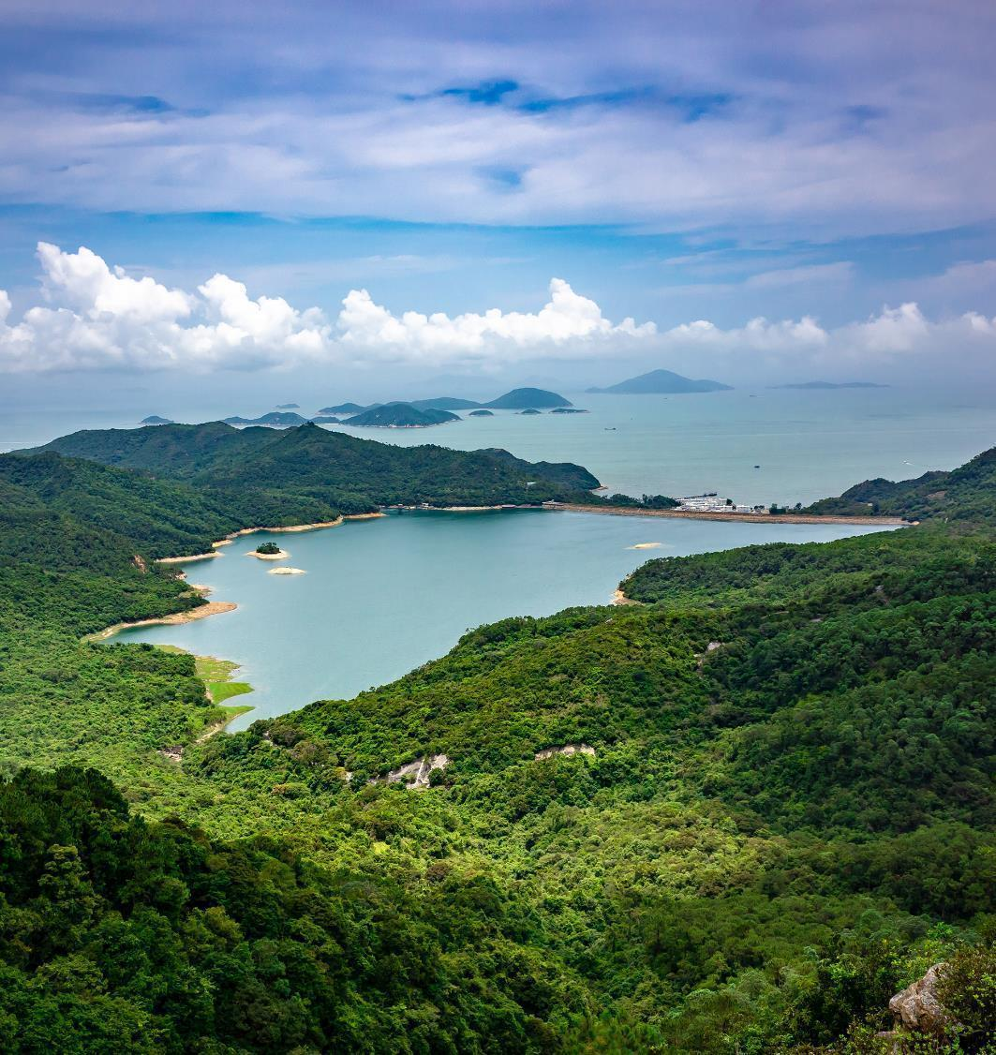
This Series of Catastrophes Birth the Environmental Laws
National Environmental Policy Act (1969)
Clean Air Act (1970)
Clean Water Act (1972)
RCRA (1976)
CERCLA (1980)
All content copyright ©2023. James T. Lang. All rights reserved
All content copyright ©2023. James T. Lang. All rights reserved
12
All content copyright ©2023. James T. Lang. All rights reserved
12
12
12

Slide 13
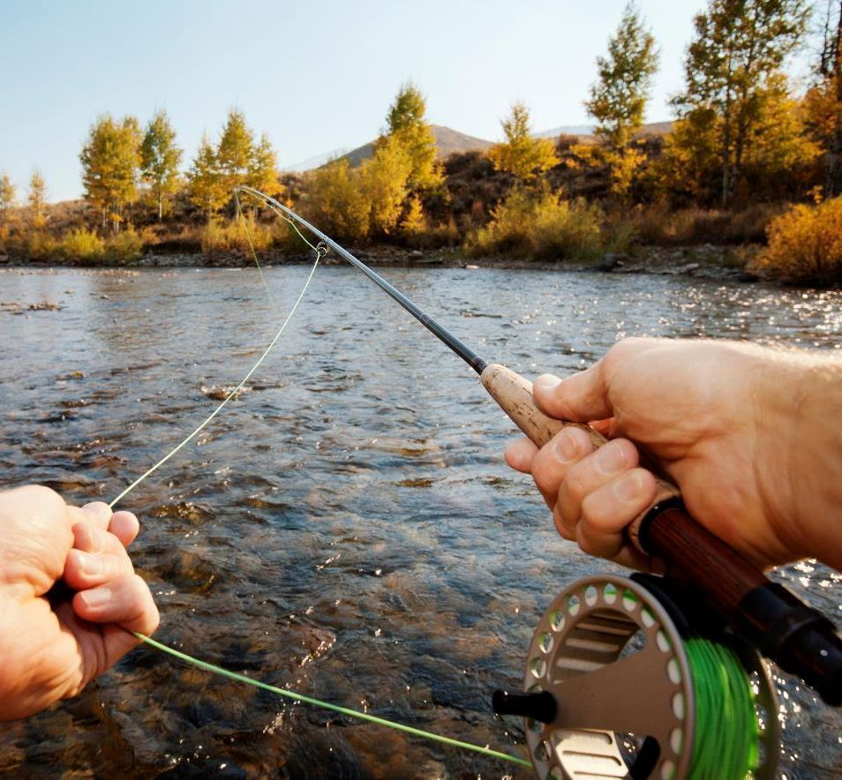
Clean Water Act Overview
Goal: Fishable and swimmable by 1983 & eliminate all discharges of pollutants by 1985
Federal/State Partnership
Upgrade sewage treatment plants
Permits needed for end of pipe discharges
Permits needed for placement of fill (wetlands)
Control pollution in stormwater
Enforcement
All content copyright ©2023. James T. Lang. All rights reserved
All content copyright ©2023. James T. Lang. All rights reserved
13
All content copyright ©2023. James T. Lang. All rights reserved
13
13
13

Slide 14
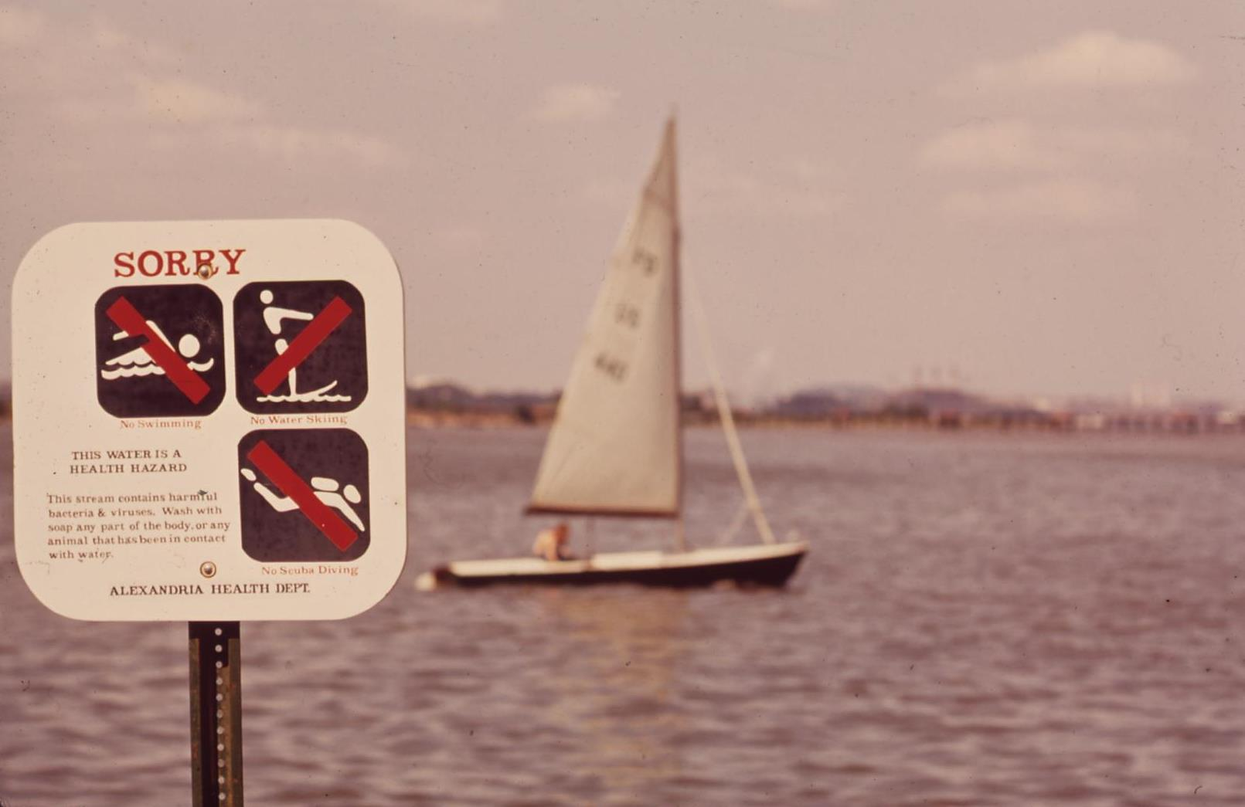
Fishable and Swimmable?
Certainly not fishable and swimmable as of 1983
Significant amendments in 1977,1987 & 1990
Citizen Environmental Lawsuits pushed EPA
  Total Maximum Daily Load
  Stormwater
National Archives at College Park, Public domain, via Wikimedia Commons
All content copyright ©2023. James T. Lang. All rights reserved
All content copyright ©2023. James T. Lang. All rights reserved
14
All content copyright ©2023. James T. Lang. All rights reserved
14
14
14

Slide 15
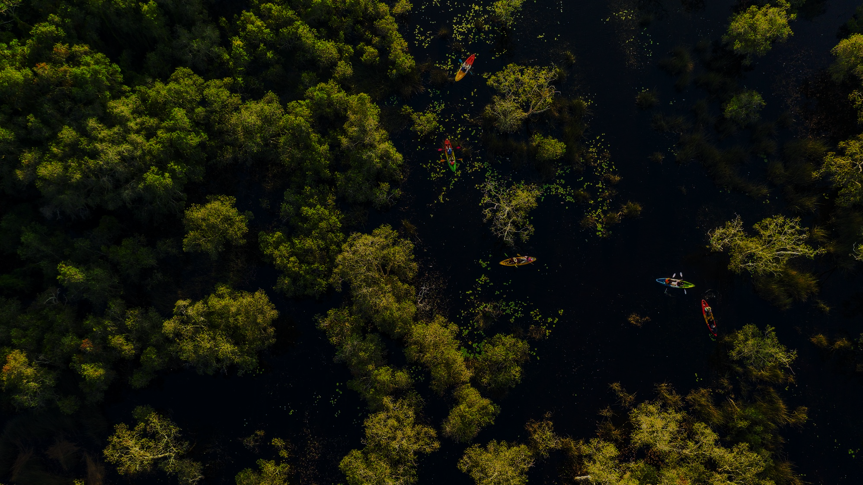
Federal/State Partnership
Va. Tidal Wetlands Act of 1972 (Va. Code §§28.2-1300 to 1320)
Va. Nontidal Wetlands Act of 2001(Va. Code §§62.1-44.15:20 to 44.15:23.1)
Chesapeake Bay Preservation Act of 1988 (Virginia code §§ 62.1-44.15:67 to 62.1-44.15:79)
Va. State Water Control Law
  VPDES permit for end of pipe discharges
  VWP permit for wetlands
  Va Erosion and Sediment Control Law
  Va Stormwater Management Act
All content copyright ©2023. James T. Lang. All rights reserved
All content copyright ©2023. James T. Lang. All rights reserved
All content copyright ©2023. James T. Lang. All rights reserved
15
15
All content copyright ©2023. James T. Lang. All rights reserved
15
15
15

Slide 16
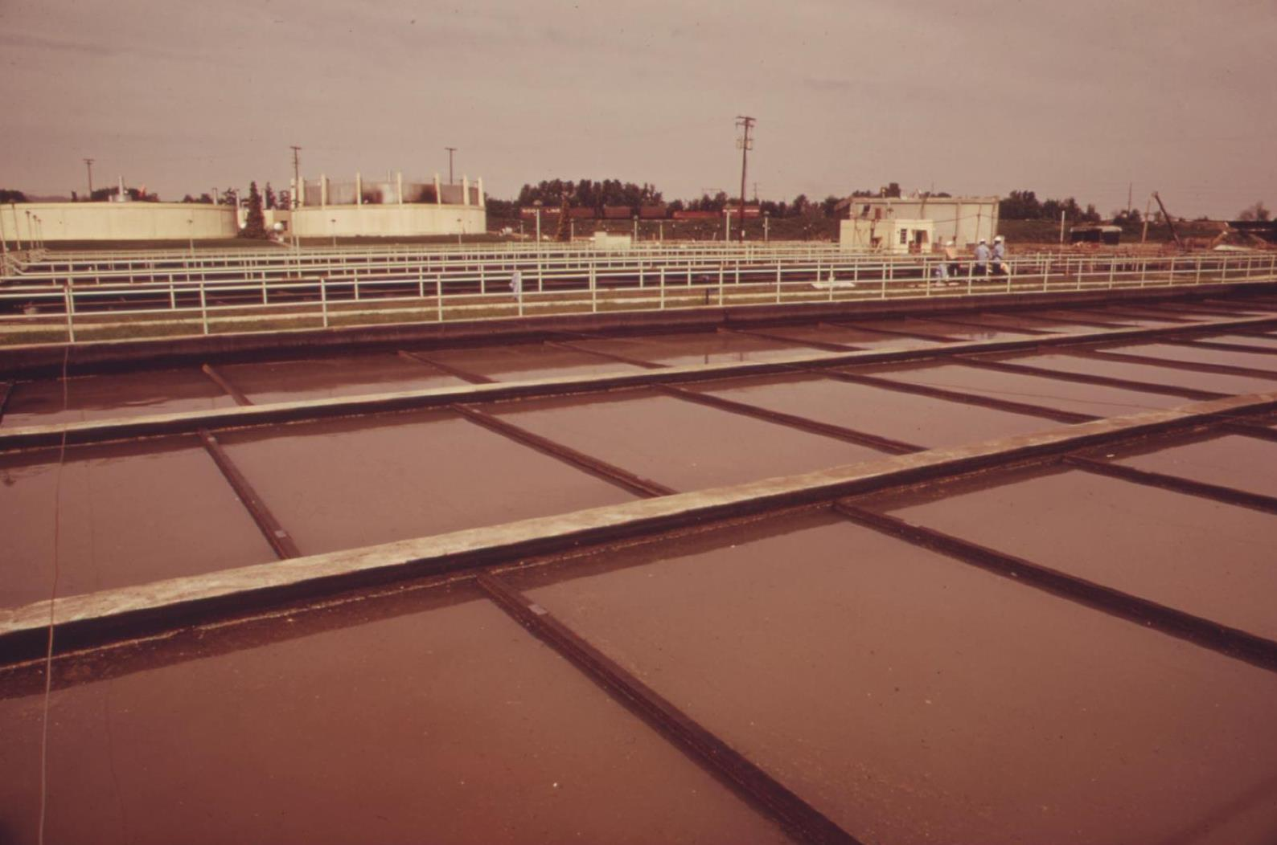
Upgrade Sewage Treatment Plants
Construction grants program (1987 amendments replaced the grant program with a revolving loan)
Infrastructure program on par with the interstate highway system
  16,000+ publicly-owned wastewater treatment plants
  500,000 miles of publicly-owned sewer lines
  $98B since 1972 (as of 2019)
Nitrogen, Phosphorous, Sediment, Pathogens, and a vast array of chemicals
National Archives at College Park, Public domain, via Wikimedia Commons
All content copyright ©2023. James T. Lang. All rights reserved
All content copyright ©2023. James T. Lang. All rights reserved
16
16
16

Slide 17
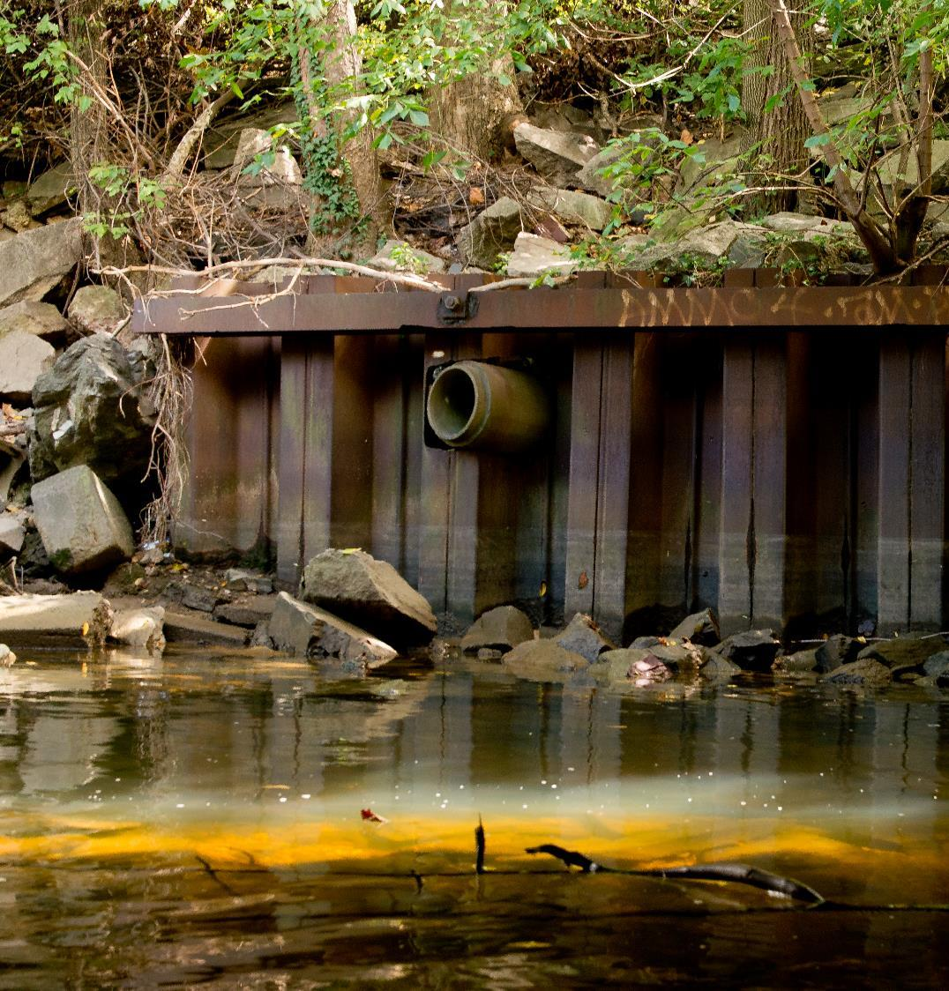
Permits Needed for End of Pipe Discharges
National Pollution Discharge Elimination System
NPDES permit required for
  “point source”
  “discharge”
  of a “pollutant”
  into “waters of the United States”
Virginia runs this program on a delegation from USEPA (the VPDES permit)
National Archives at College Park - Still Pictures, Public domain, via Wikimedia Commons
All content copyright ©2023. James T. Lang. All rights reserved
17
17

Slide 18
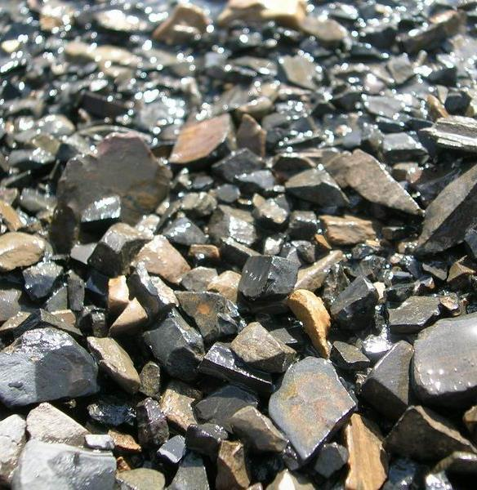
Permits Needed for Placement of Fill
“Fill” is a solid that does not readily wash downstream
Principally, though not exclusively, applies to wetlands
Permit required for
  “discharge”
  of fill material
  from a “point source”
  Into the “waters of the United States”
Two permits required
  USACE permit per section 404 of the CWA
  VWP permit from DEQ
Anton Rakitskiy, Public domain, via Wikimedia Commons
All content copyright ©2023. James T. Lang. All rights reserved
18

Slide 19
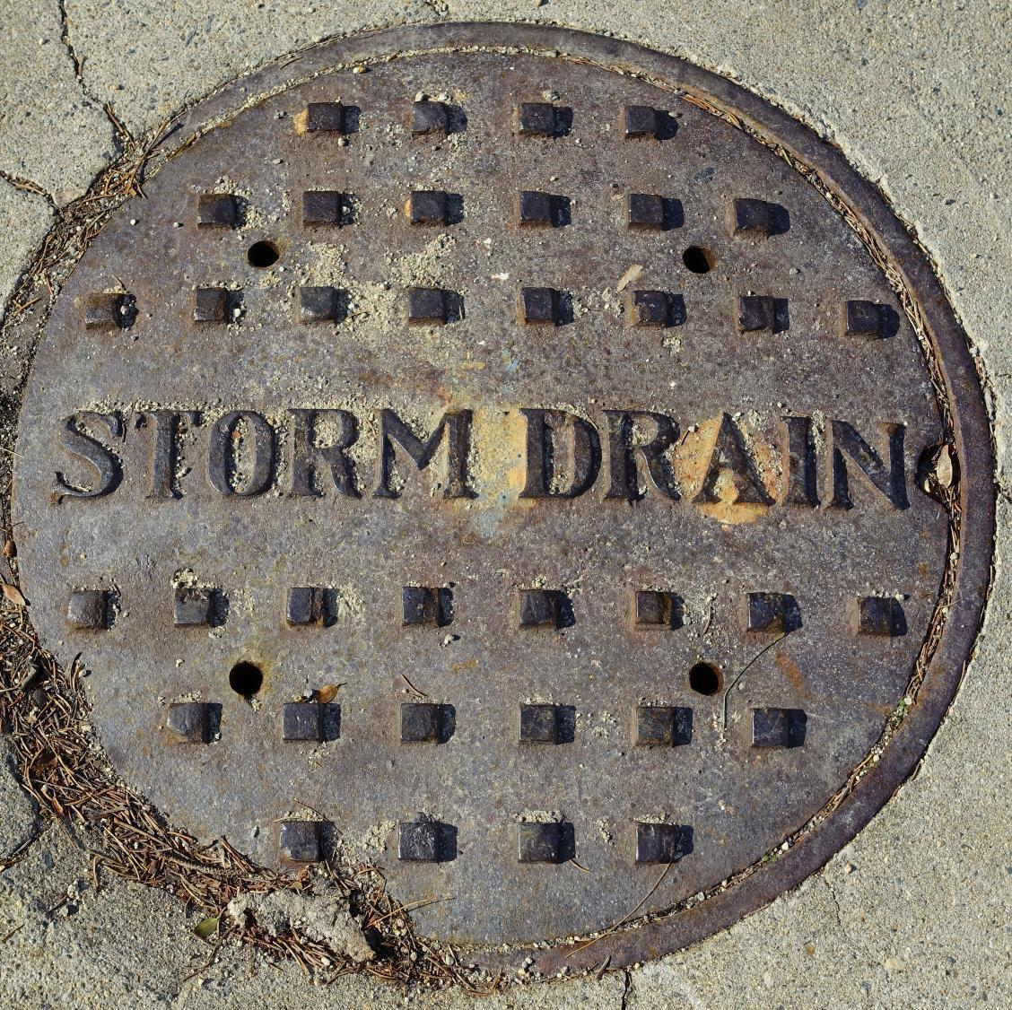
Control Pollution in Stormwater
One in a variety of pathways that carry pollution into our waters
Comes about as a result of runoff from rain
  Oil and grease from streets
  Animal waste and fertilizer from lawns
  Sediment and chemicals from construction sites
  Variety of pollutants from industrial facilities
1987 amendments added detailed mandates re stormwater
1990 EPA issues “Phase I Stormwater Regulations”
1999 EPA issues “Phase II Stormwater Regulations”
Construction sites and Municipal Separate Storm Sewer Systems (MS4)
Daderot, CC0, via Wikimedia Commons

Slide 20
Federal Enforcement
Administrative
  Up to $10k/day (maximum $125k)
Civil
  Up to $25k/day
  Injunction
Criminal
  Negligent violation: up to $25k/day & up to 1 year
  Knowing violation: up to $50k/day & up to 3 years
  Knowing endangerment: up to $250k & up to 15 years
  False statement in application or other document: up to $10k & up to 2 years
Citizen’s Environmental Lawsuit

Slide 21
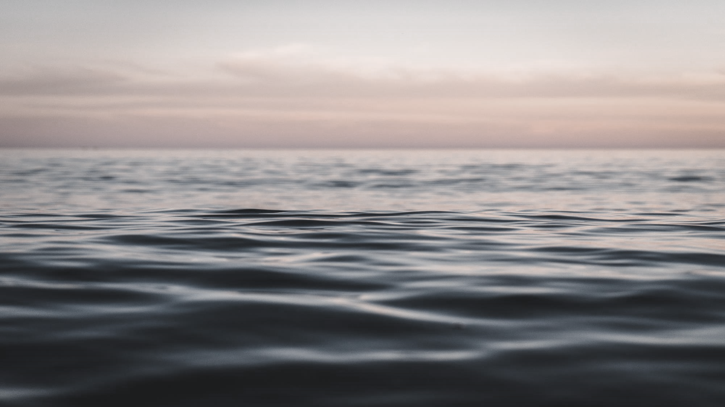
Additional Resources at www.waterfrontpropertylaw.com
Article: Chesapeake Bay Preservation Act
  https://www.waterfrontpropertylaw.com/blog/posts/chesapeake-bay-preservation-act-october-2015/
Article: Sackett v. EPA: CWA does not Regulate Isolated Wetlands
  https://www.waterfrontpropertylaw.com/blog/posts/sackett-v-epa-supreme-court-decision-clean-water-act-does-not-regulate-isolated-wetlands/
Article: How Citizens’ Environmental Lawsuits Can Stop Pollution
  https://www.waterfrontpropertylaw.com/blog/posts/stopping-pollution-with-citizens-environmental-lawsuits/
Article: Oil Spills – The CWA to OPA 90
  https://www.waterfrontpropertylaw.com/blog/posts/clean-water-act-oil-pollution-act/
Article: Virginia’s Living Shoreline Law
  https://www.waterfrontpropertylaw.com/blog/posts/vmrc-issue-permit-for-hardened-shoreline/
Webinar: Wetlands Mitigation Banks
  https://www.waterfrontpropertylaw.com/blog/posts/webinar-wetlands-mitigation-bank/

Slide 22
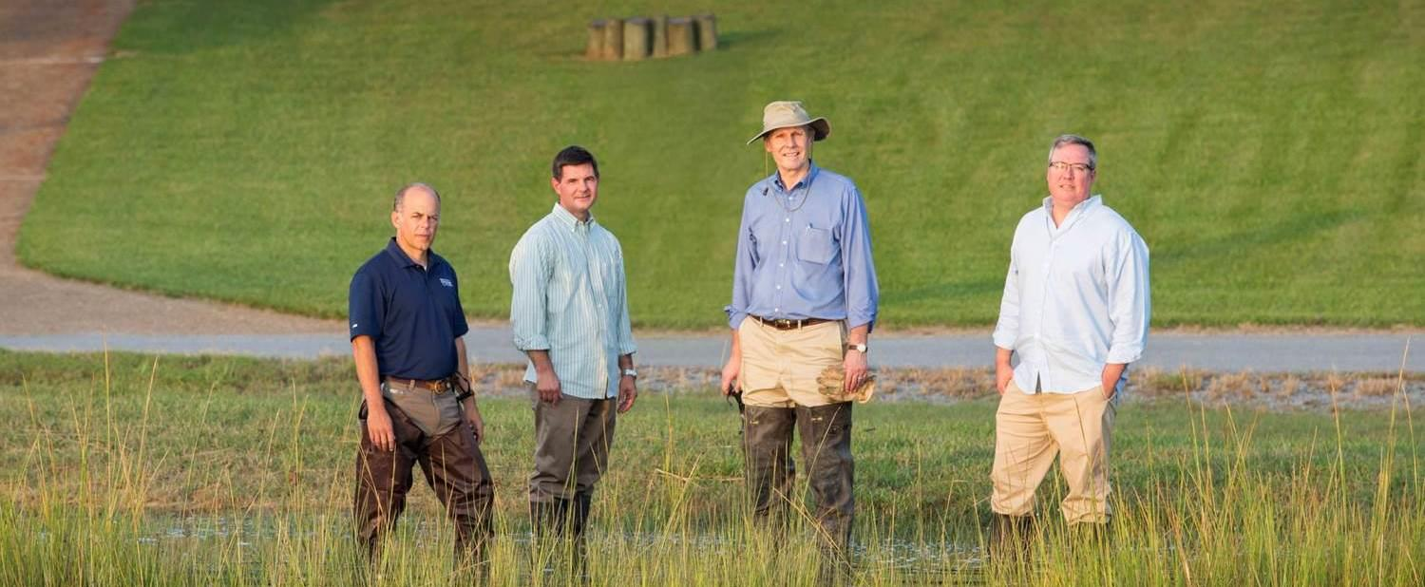



Thank You & Questions
(757) 502-7326
jlang@pendercoward.com

