Slide 1
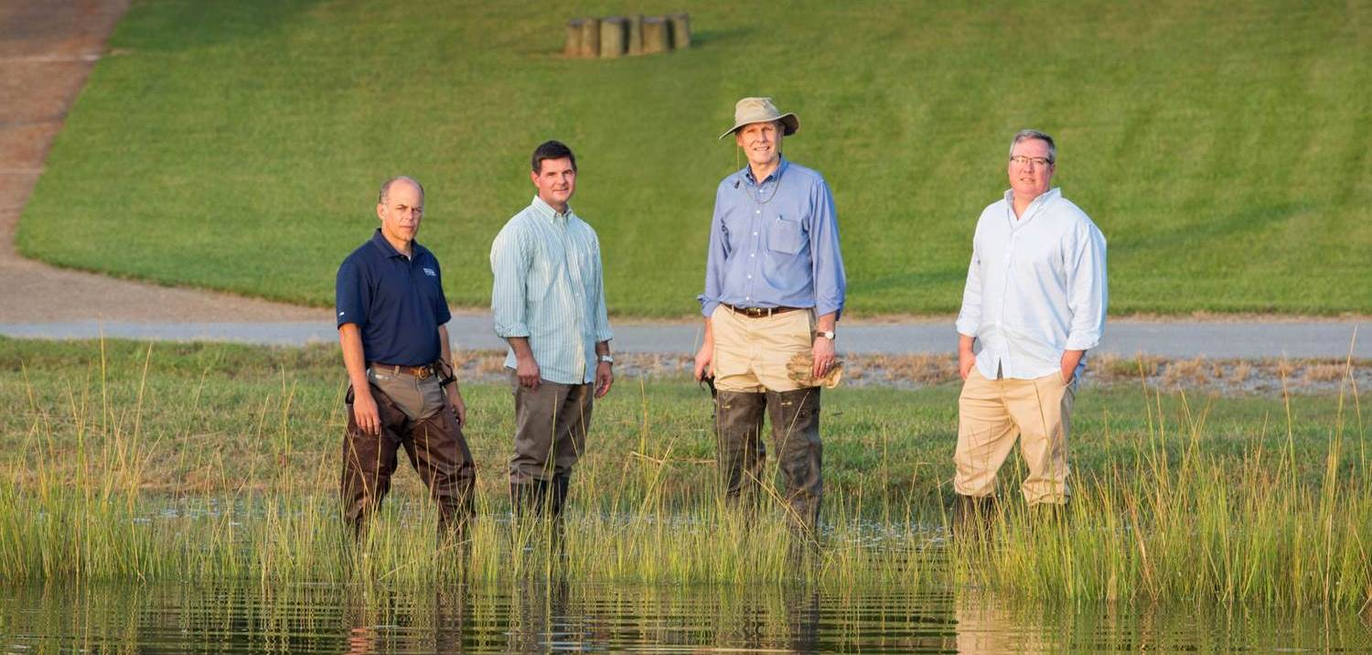
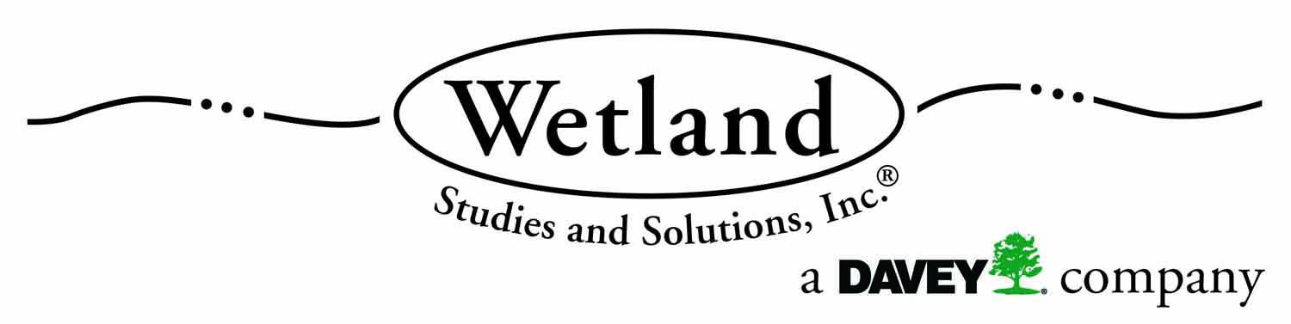


Using Credits From a Wetlands Mitigation Bank
March 25, 2022
.

Slide 2
What We Will Cover Today
Circumstance that creates the need to purchase credits from a wetlands mitigation bank
Why purchasing credits from a mitigation bank is the preferred method to mitigate wetland impacts
How affected habitat drives selection of an appropriate mitigation bank
Relationship between project location and mitigation bank service area
How mitigation ratios determine the compensatory requirement
Pricing of mitigation bank credits
What to do if you are treated unfairly

Slide 3
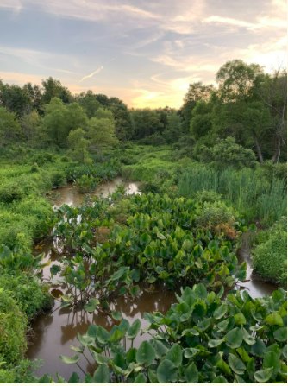
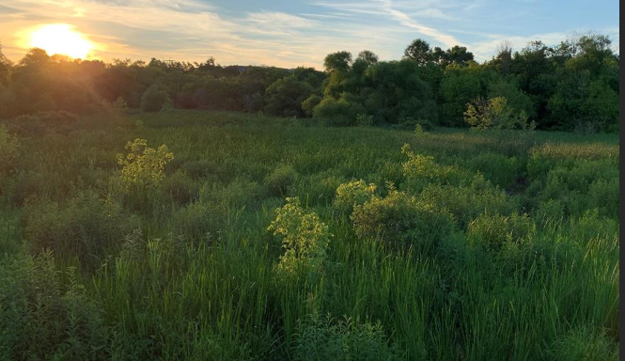
What is a Wetland Mitigation Bank?
A Site, or suite of sites, where resources (e.g. wetlands, streams, riparian areas) are restored, established, enhanced, and/or preserved for the purposes of providing compensatory mitigation authorized by USACE Permits. 33 CFR 332.3

Slide 4
Circumstance that creates the need to purchase credits from a wetland mitigation bank
Virginia has approximately 1M acres of wetlands
  Tidal
  Nontidal
71% in the coastal plain
No-net-loss and net wetland gain in area and function
Development is the biggest activity that converts wetlands to uplands
Purchasing mitigation bank credit likely required during permit process (all residential, commercial, and institutional development projects with wetlands impacts > 1/10 acre)

Slide 5
Scofflaws risk civil or criminal penalties
Administrative
  Up to $10k/day (maximum $125k)
Civil
  Up to $25k/day
  Injunction
Criminal
  Negligent violation: up to $25k/day & up to 1 year
  Knowing violation: up to $50k/day & up to 3 years
  Knowing endangerment: up to $250k & up to 15 years
  False statement in application or other document: up to $10k & up to 2 years
Citizen’s Environmental Lawsuit

Slide 6
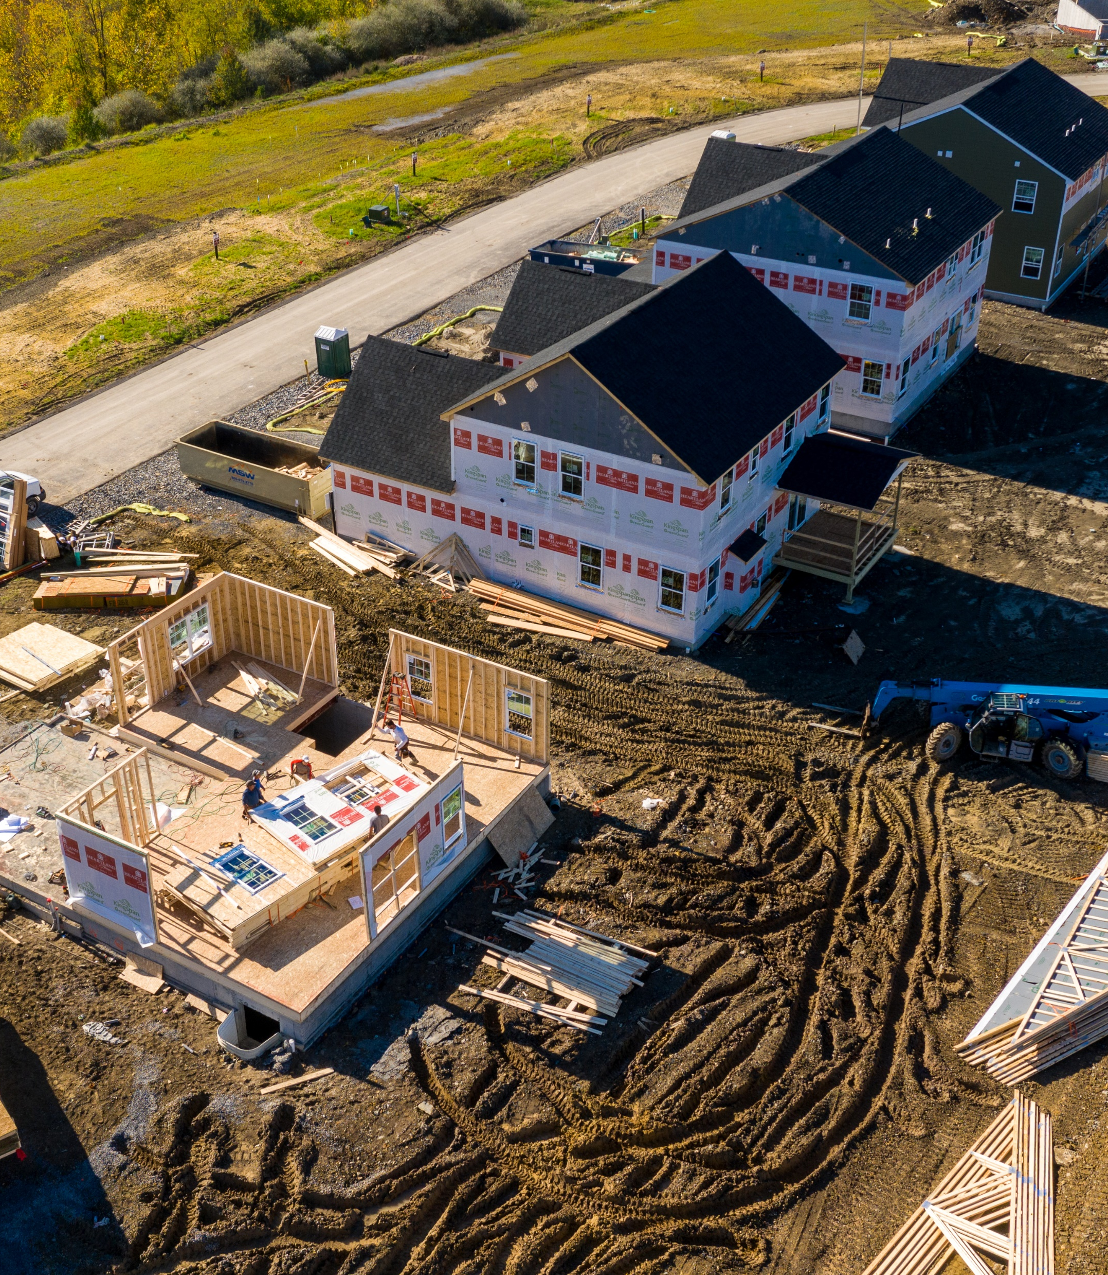
Permit Process
Wetland Delineation
USACE Confirmation (Jurisdictional Determination)
Joint Permit Application for wetland impacts
Receive Permits
Purchase Credits if required
      Photo Credit Steve Heap/Shutterstock.com

Slide 7
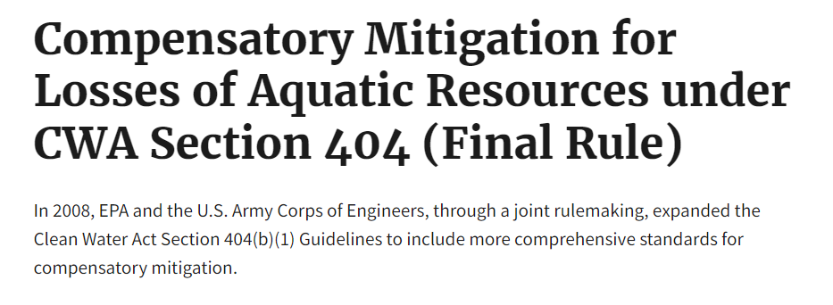
Purchasing credits from a mitigation bank is the preferred method to mitigate wetland impacts
It is required to be the first option considered by the Corps and DEQ.
Saves time and money
Banks are preapproved by the permitting agencies
Liability for the success of the Bank stays with the Mitigation Banker

Slide 8
Alternative Mitigation Options
In-Lieu Fee Trust Fund - Virginia Aquatic Resource Trust Fund
  Second Choice, if Private Credits are not available
Permittee Responsible Mitigation / Onsite Mitigation
  Third Choice – only if approved by Permit agencies
  Needs to be more ecologically beneficial than purchase of mitigation credits
  Requires permitting as part of the JPA – Tied to permit approval timeline
  Need approved Restoration Plan
  Financial Assurances Required
  Wetland success criteria must be met
  Monitoring is required up to 10 years

Slide 9
Affected Habitat Type drives selection of appropriate Mitigation Credits
In-Kind Mitigation
Wetlands
  Non-Tidal
  Tidal Vegetated
  Non-Vegetated Tidal: Intertidal Mudflats, Sand flats
Streams
Might shallow water bottom be next?

Slide 10
Mitigation Ratios Determine the Compensatory Requirement
Habitat Type Mitigation Ratio
Forested wetlands 2:1
Scrub-shrub wetlands 1.5:1
Emergent wetlands 1:1
Wetland Conversion - forested to emergent wetlands 1:1
Streams – Unified Stream Methodology
  Field assessment needed to determine Credit ratio
  Can range from 0.5:1 to 1.5:1

Slide 11
Relationship Between Project Location and Mitigation Bank Service Area
River Basin
  James River
  York River
  Etc.
Hydrologic Unit Code – HUC Code
  Smaller units than a River Basin
  Lower James, Middle James, etc.
Service Area
  Each Bank has an approved Service Area
  Must stay within the same River Basin

Slide 12
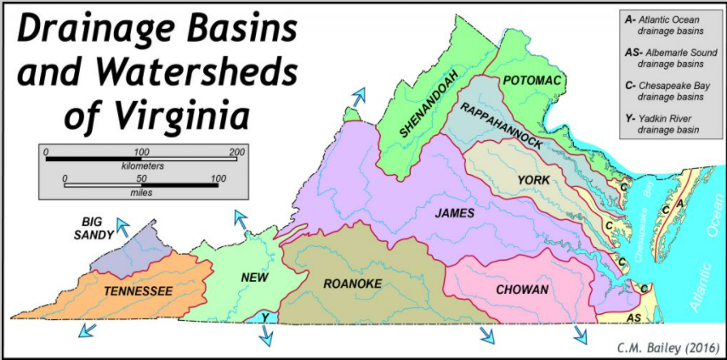
Virginia River Basins

Slide 13
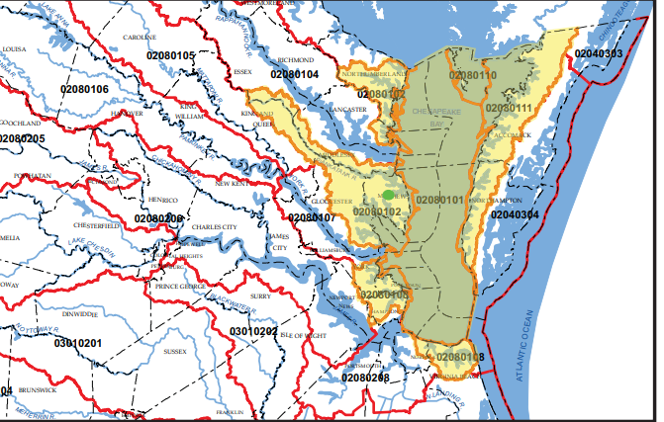
Mitigation Bank Service Area
Chesapeake Bay Wetland Mitigation Bank
Virginia Wetland Consulting LLC

Slide 14
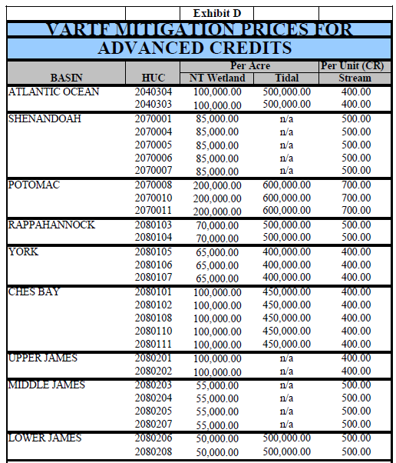
Pricing of Mitigation Bank Credits
Recent Estimates – Costs Vary
Lynnhaven (02080108)
  Non-Tidal Wetlands ≈ $100,000 per acre
Lower James (02080208)
  Non-Tidal Wetlands= $35,000 per acre
  Tidal Wetlands ≈ $1.2 million per acre
  Stream $500 per linear foot
Albemarle (03010305)
  Non-Tidal Wetlands = $15,000 per acre

Slide 15
Credit Purchase Example
Lynnhaven River
  Impacts: 0.25 acres
  Habitat Type: Forested Wetlands
  Mitigation Ratio: 2:1
  Compensation Requirement: 0.5 acres
  Unit Cost (Estimate): $100,000 per acre
  Estimated Total Cost $ 50,000

Slide 16
How to find a Mitigation Bank
DCR Virginia Hydrologic Unit Explorer
  Shows the HUC Boundaries
  https://consapps.dcr.virginia.gov/htdocs/maps/HUExplorer.htm
USACE RIBITS Website
  Find Banks Approved for use in your Project Area
  Available Credit Types
  https://ribits.ops.usace.army.mil/ords/f?p=107:2::::::

Slide 17
What to do if you are treated unfairly
Who do you have on your team
  Consultant?
  Attorney?
  Not smart to “do it yourself”
Keep negotiating
Understand the rules and the processes the agencies are working within.
Abandon the project
Use court to reverse the agency

Slide 18
Additional Resources
Wetlands Law and Regulation in Virginia
  https://www.waterfrontpropertylaw.com/blog/posts/wetlands-law-virginia/
The VMRC’s Implementation of the Living Shoreline Requirement of SB776
  https://www.waterfrontpropertylaw.com/blog/posts/vmrc-implementation-of-living-shoreline-requirement/
The Supreme Court’s Hawkes Co. Decision May Help Save Your Project When Wetlands are Present
  https://www.waterfrontpropertylaw.com/blog/posts/supreme-court-hawkes-co-decision-presence-of-wetlands/EPA Fact Sheet
Wetland and Stream Mitigation and Restoration Resources
  https://www.wetlands.com/wetland-mitigaton

Slide 19

Questions?
(757) 502-7326
jlang@pendercoward.com
963-2008
chickman@wetlands.com

