Slide 1
Lawsuits Challenging Environmental Permits
Jim Lang August 18, 2023

Slide 2

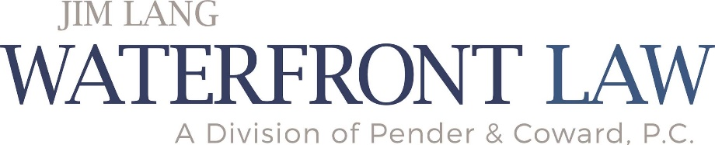
What We Will Cover Today
Situations where judicial review could be important
What does a “win” look like
How to get a Court to take a second look at an environmental regulatory agency’s decision
How cases of this type differ from the “normal” civil case
Estimated cost
Things you can do to increase your opportunity of winning

Slide 3

Situations Where Judicial Review Could be Important
The VMRC grants a permit for installation of 5 acres of floating oyster cages in the water next to your property
Your neighborhood of 250 homes suffers from flooding but a citizen’s environmental group filed a lawsuit challenging the wetlands permit issued by the USACE – their lawsuit has stalled installation of the new flood control system and could result in the project being cancelled
The DEQ or local government issues a stop work order at a construction site because of an alleged violation of the stormwater rules, or the erosion and sediment control rules
State agency refuses to issue a permit that duck hunter needs to erect stationary blind on shore or in nearby public waters

Slide 4
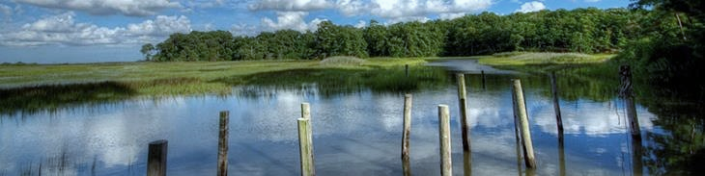
What Does a “Win” Look Like
The Court vacates the agency decision and sends the matter back to the agency to address the errors that the Court identified
The Court DOES NOT select the outcome for the agency

Slide 5

How Do You Get The Case Into Court?
You must bring the case in the correct court
You must have “standing”
  Injury
  The agency decision “caused” the injury
  The remedy sought “redresses” the injury
You must exhaust administrative remedies (“final” agency action)
You must meet filing deadlines
You must serve the right papers at the proper places
There may be a filing fee

Slide 6

Standard of Review -- State
Virginia Administrative Process Act, Va. Code 2.2-4000 to 4031
Judicial deference for facts found by the agency
  “the duty of the court with respect to issues of fact shall be limited to ascertaining whether there was substantial evidence in the agency record upon which the agency as the trier of the facts could reasonably find them to be as it did” (quoting Va. Code 2.2-4027)
  Courts “have authority to reject agency factfinding only if, considering the record as a whole, a reasonable mind would necessarily come to a different conclusion” (Campbell v. Dep’t of Forestry (Va. Ct of App. 2005))
No judicial deference for procedural errors or errors of law

Slide 7
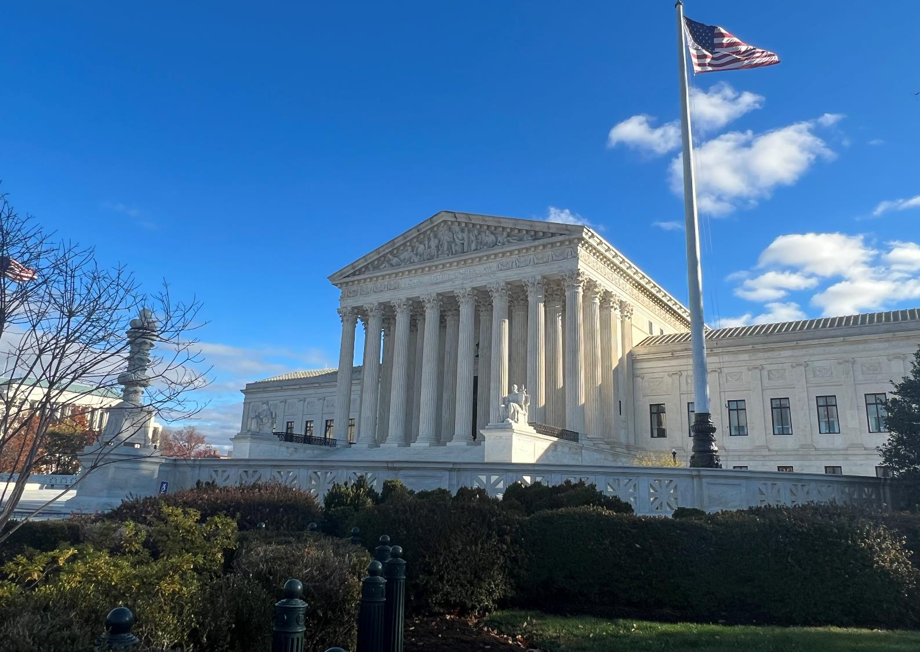
Standard of Review -- Federal
(Federal) Administrative Procedure Act, 5 U.S.C. 701 to 706
Standard of review mirrors the points made regarding standard of review on the prior slide
Photo credit: By Pacamah- Own work, CC BY-SA 4.0, https://commons.wikimedia.org/w/index.php?search=Supreme+Court&title=Special:MediaSearch&go=Go&type=image

Slide 8

How Cases of This Type Differ From “Normal” Civil Cases
No jury
The “administrative record” is the sole source of evidence
Standard of review favors the agency
You might recover some/all of your legal fees if you win

Slide 9

Estimated Cost
Every case is different
Cost varies accordingly
Estimate $25,000 to $125,000

Slide 10

Things You Can Do To Increase Chance of Winning
Photo credit: By Petras Gagilas - Own work, CC BY-SA 2.0, https://commons.wikimedia.org/w/index.php?search=chess+board&title=Special:MediaSearch&go=Go&type=image
Find an attorney who is well versed in litigation of this type
Get the attorney involved in the earliest stages
If you wait too long the attorney may not have the material in the administrative record that he or she needs in order to win your case

Slide 11

Additional Resources
Dealing With Government Agency Decisions: Can You Take the Government to Court?
  https://www.waterfrontpropertylaw.com/blog/posts/lawsuits-against-government-agencies/
Federal Court Case Victory Will Protect 250+ Homes in Virginia Beach From Stormwater Flooding
  https://www.waterfrontpropertylaw.com/blog/posts/waterfront-law-protects-virginia-beach-homes/

Slide 12



Thank You & Questions
(757) 502-7326
jlang@pendercoward.com

