Slide 1
How To Build A Pier in Virginia
Jim Lang and Joe Keffler June 23, 2023

Slide 2
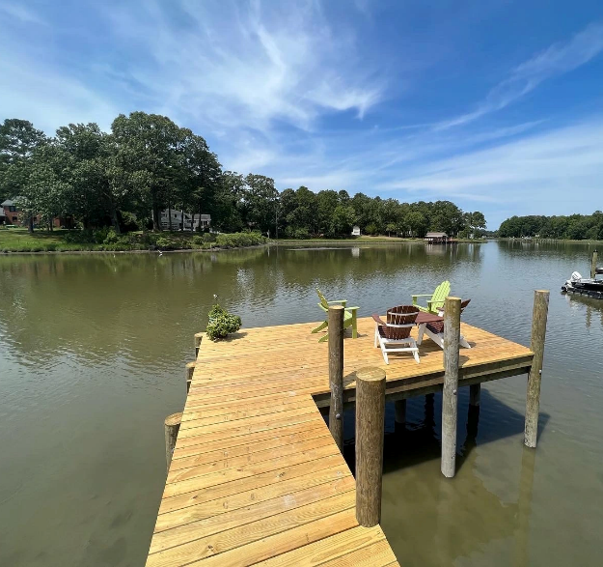

What We Will Cover Today
Legal issues around pier construction projects
The Joint Permit Application (JPA)
How to find a reputable pier designer
How to find a reputable pier construction contractor
Pier construction process
Pricing
Pier maintenance and longevity

Slide 3

Legal Issues Around Pier Construction Projects
Legal risk
As built pier does not conform to permit
Pier built without permits
Pier modified without permits
Pier built outside the riparian area (if state owned bottom)
False information submitted during the regulatory process
Pier interferes with navigation
Not much legal risk
Pier compromises a neighbor’s view of the water

Slide 4

How Our Clients Get Caught Up In The Legal Process
Agency can issue order to violator
Agency can impose fine on violator
Agency can sue violator
Another person can sue violator
Court review of agency decision to grant/deny permit

Slide 5

The Joint Permit Application
Virginia Marine Resources Commission acts as “clearinghouse”
Federal
State
Local
Adjacent property owners can object

Slide 6
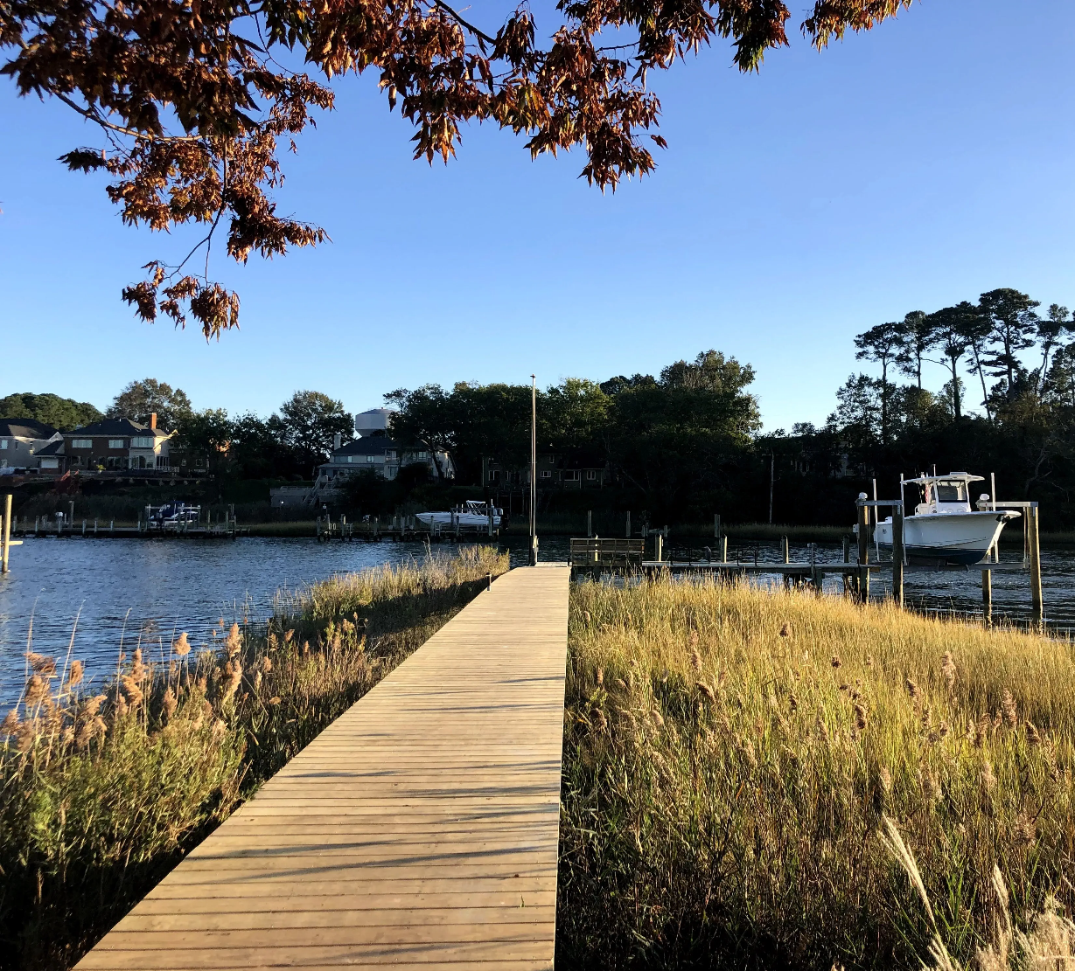
Is the Bottom Privately Owned or State Owned?
Privately owned (definitely one less permit)
Lake
Pond (stormwater or natural)
Man made canal
State owned
Bays
Rivers
Creeks
Shores of the sea
Unless conveyed via a King’s grant

Slide 7
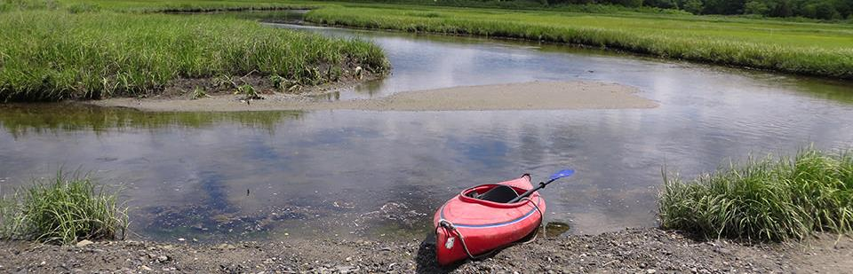
If Privately Owned Bottom
Permission from property owner
Wetlands compliance (tidal vs. nontidal)
US Army Corps of Engineers if waterbody is “navigable”
Building permit from locality
State agencies other than VMRC (infrequent)
Department of Environmental Quality
Department of Historic Resources

Slide 8
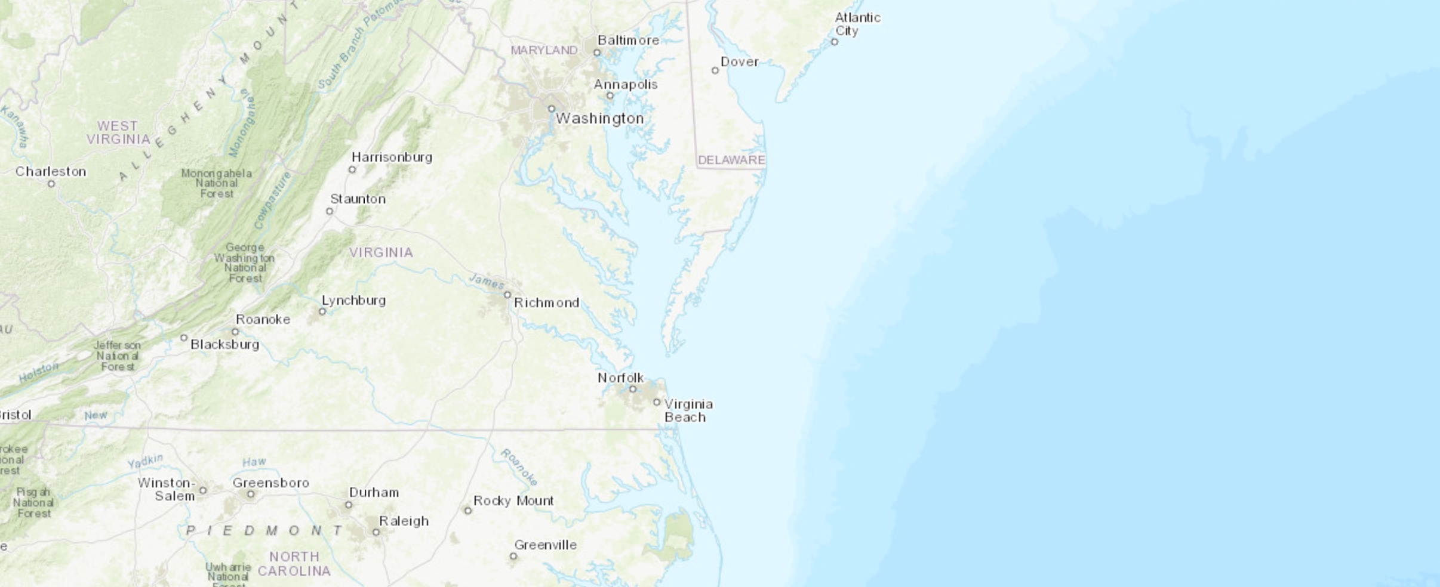
If State Owned Bottom
Permit from Virginia Marine Resources Commission
Acts as “property manager” for owner, State of Virginia
Submit JPA
No Permit Needed letter vs. Permit
Riparian area
Wetlands compliance (tidal vs. non-tidal)
US Army Corps of Engineers if waterbody is “navigable”
Building permit from locality
State agencies other than VMRC (infrequent)
Department of Environmental Quality
Department of Historic Resources
Photo Credit. Coastal Geospatial and Educational Mapping System, 2012. Virginia Coastal Zone Management Program

Slide 9
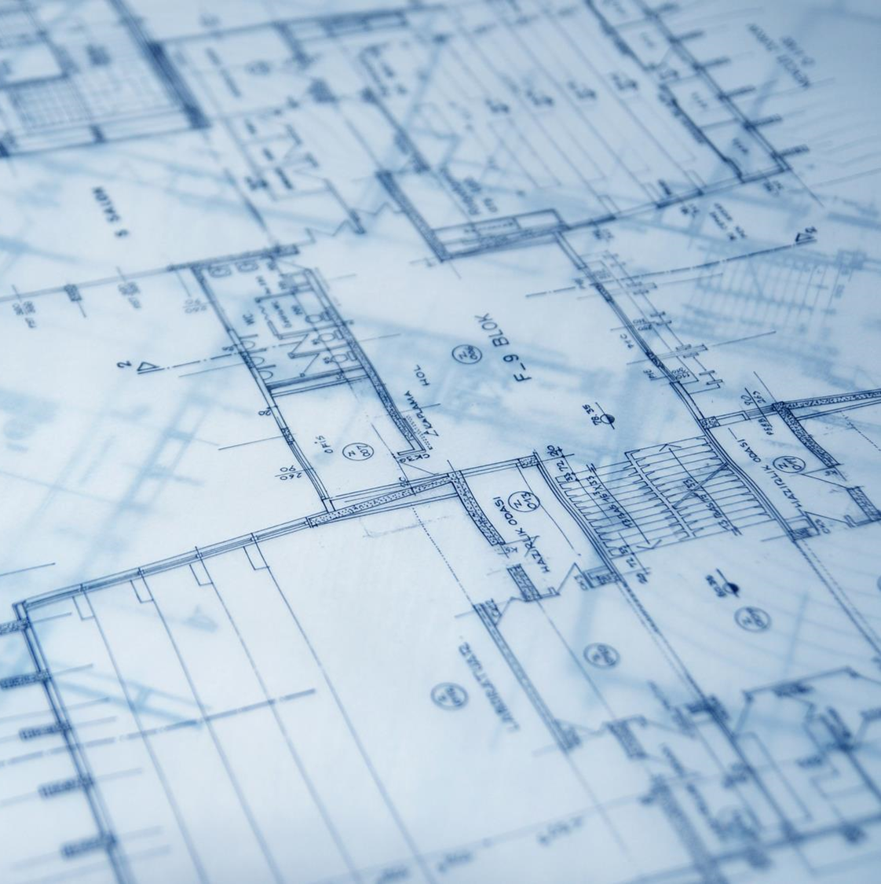
How To Find A Reputable Pier Designer
What is a Permit Agent?
Experience
Word of mouth
Reputable Permit Agents in Virginia Beach
David Butler with Gallup Surveyors
Richard Calvert with Calvert Marine
Bob & Jon Simon with Waterfront Consulting Inc
David Kledzik with Marine Engineering

Slide 10

How To Find A Reputable Pier Construction Contractor
Contractors License
Correct Class
Correct City and State
Insurance
Marine Liability
Workers Compensation
United States Longshore & Harbor Workers Coverage
Additional Due Diligence
Reviews & word-of-mouth experiences
Ask to tour contractor’s previous projects

Slide 11
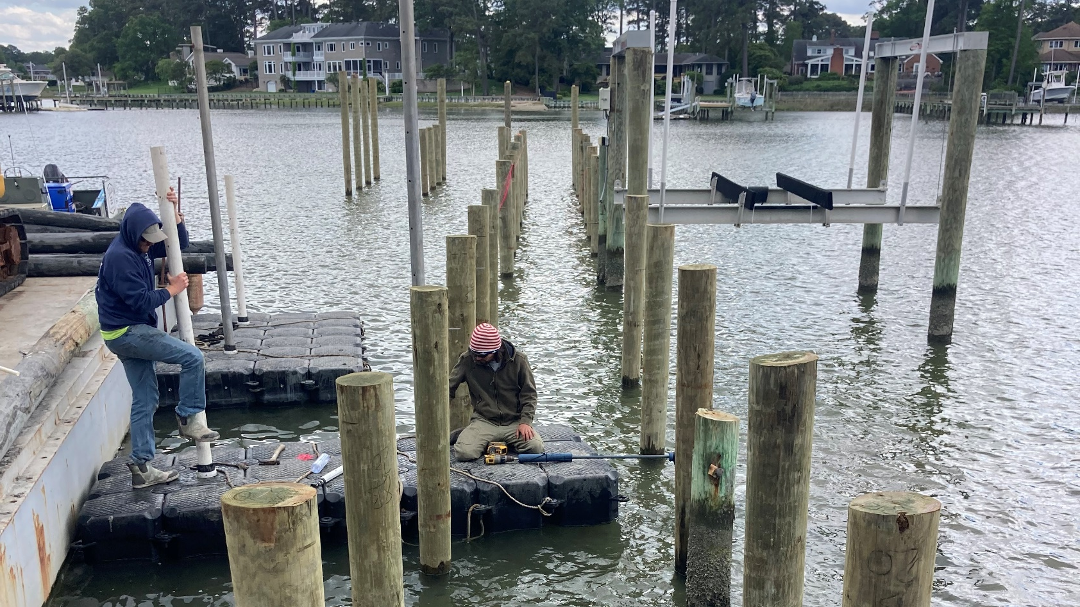

Pier Construction Process
Building Permit
Pier Options
Design & Layout
Boat Lifts, Boat Houses, Floating Docks, Etc
Materials
Order of Operations
Mobilization
Pile Installation
Framing
Decking
Accessories

Slide 12
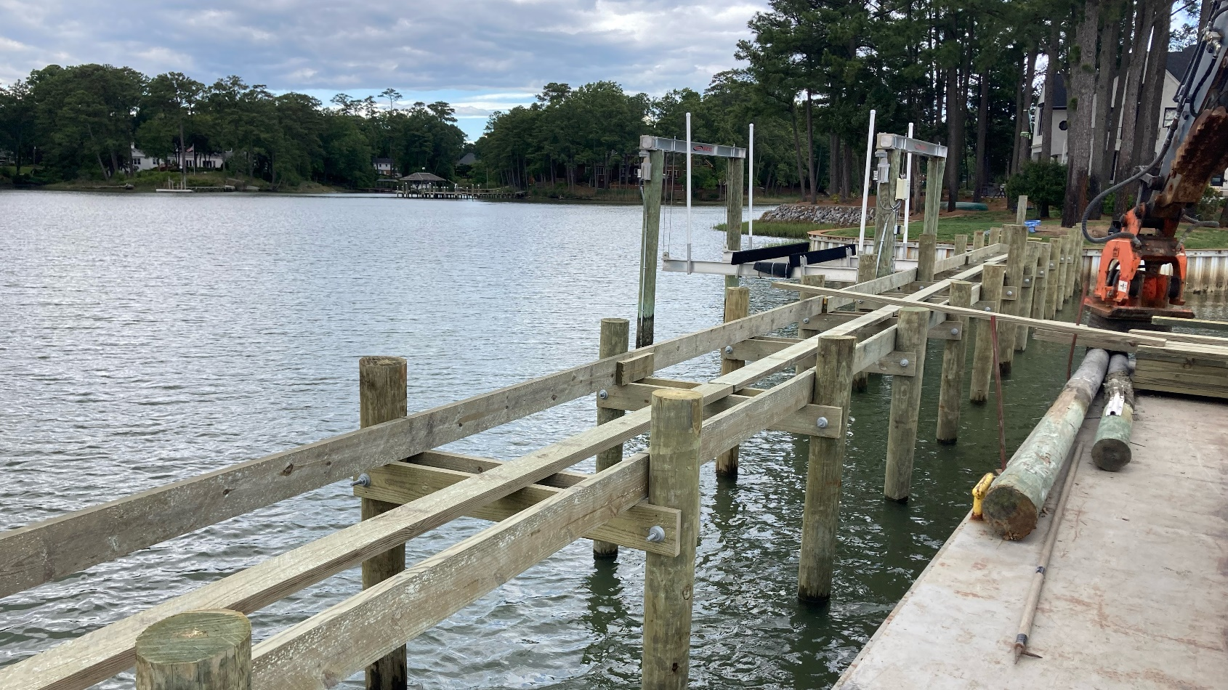
Pier Construction Process
Building Permit
Pier Options
Design & Layout
Boat Lifts, Boat Houses, Floating Docks, Etc
Materials
Order of Operations
Mobilization
Pile Installation
Framing
Decking
Accessories

Slide 13
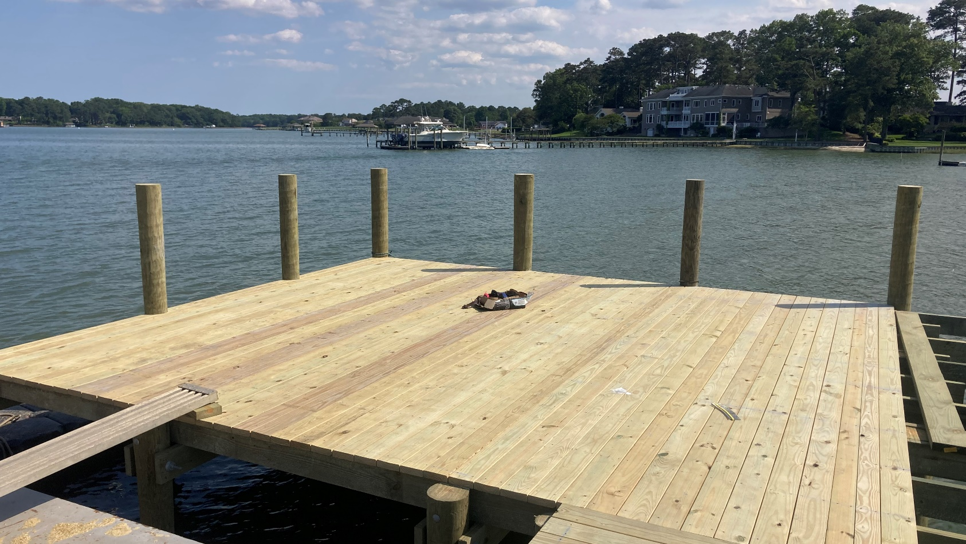
Pier Construction Process
Building Permit
Pier Options
Design & Layout
Boat Lifts, Boat Houses, Floating Docks, Etc
Materials
Order of Operations
Mobilization
Pile Installation
Framing
Decking
Accessories

Slide 14

Pier Pricing
Main Cost Drivers
Construction Access
Overall Length & Square Footage
Additional Waterfront Structures
Decking Material

Slide 15
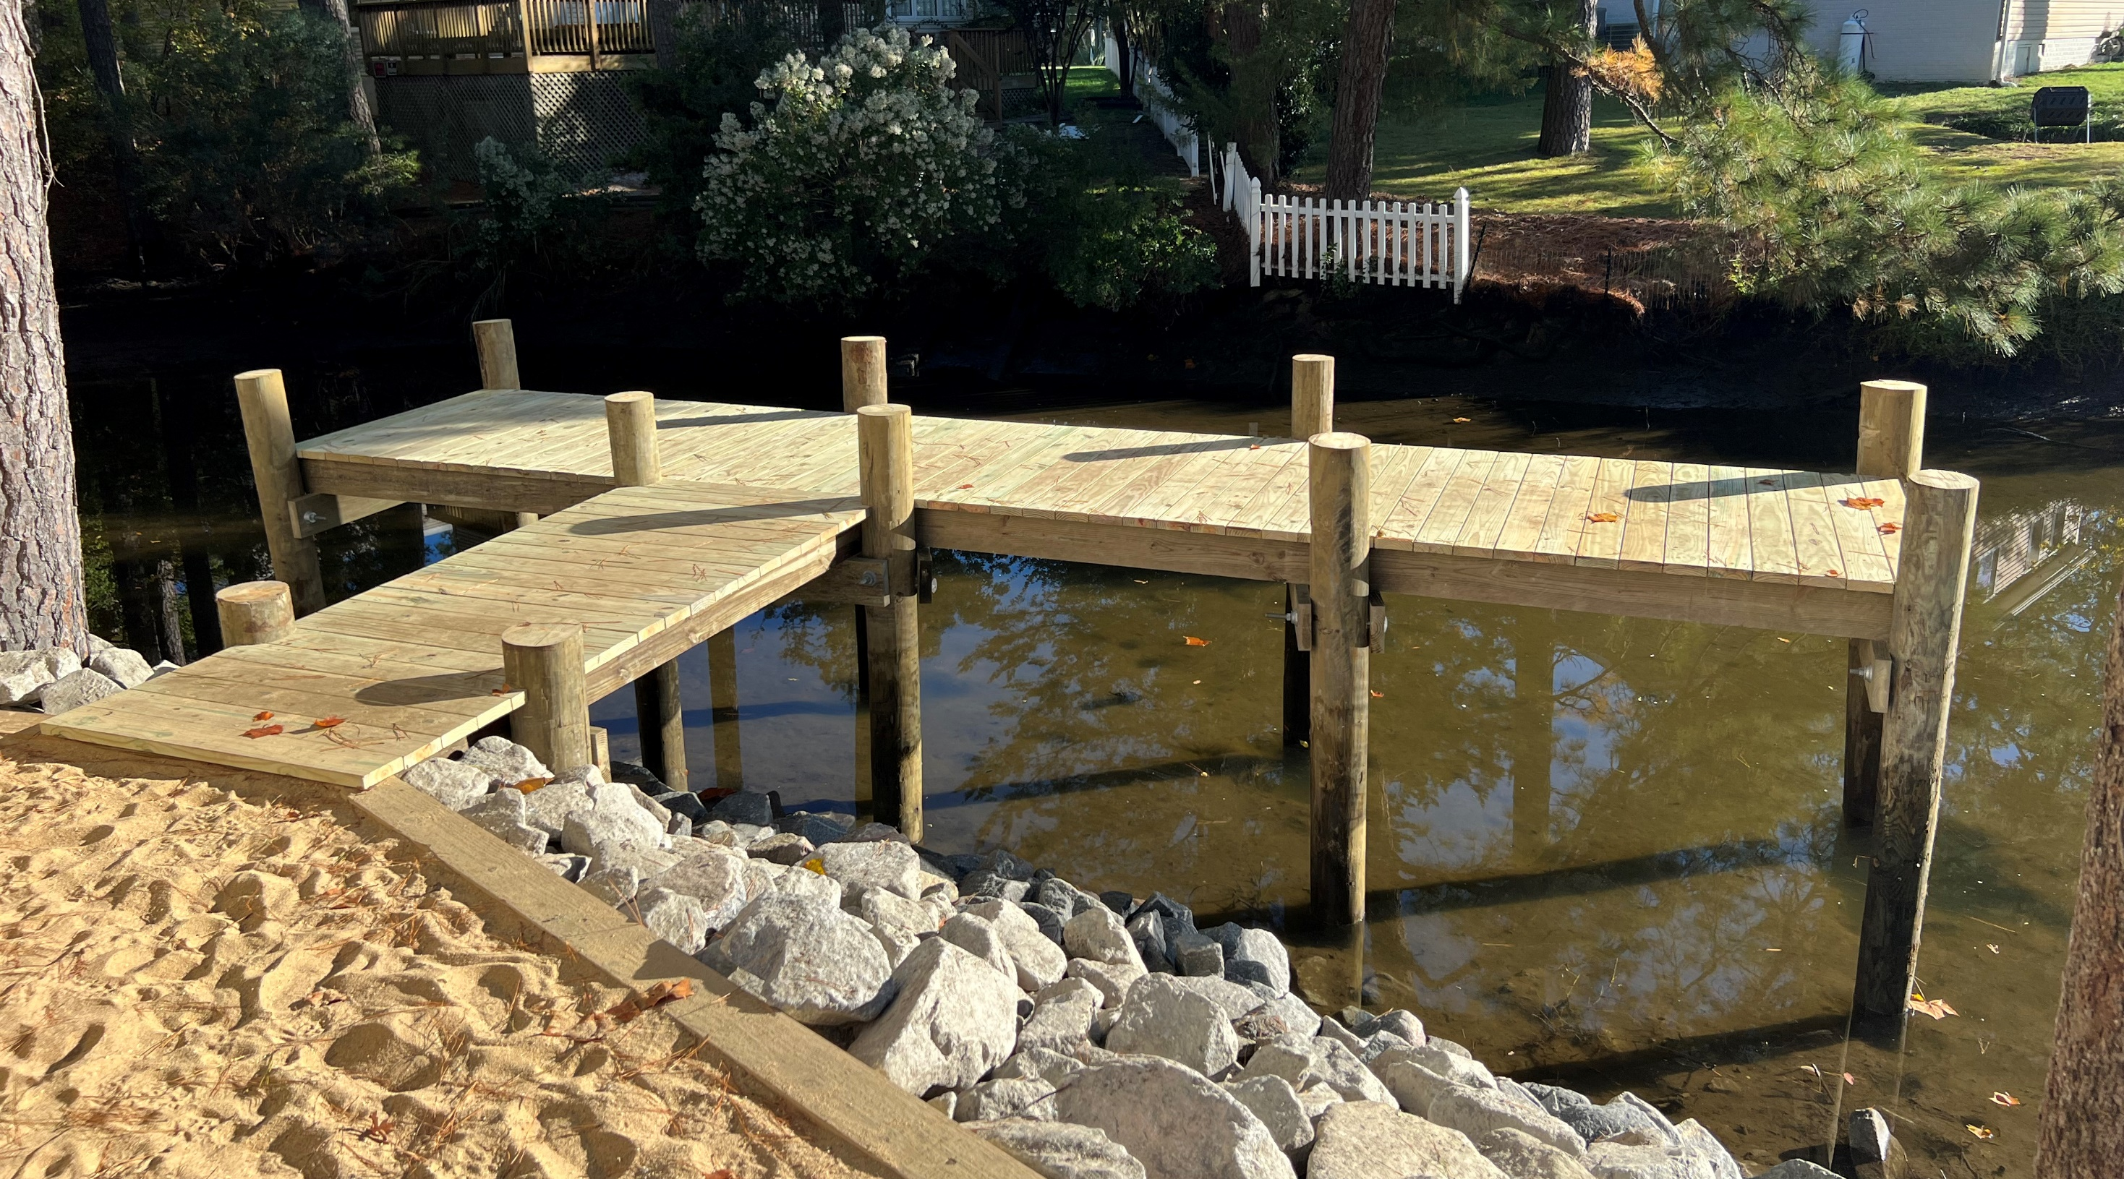
Pier Pricing
$10,000
Main Cost Drivers
Construction Access
Overall Length & Square Footage
Additional Waterfront Structures
Decking Material

Slide 16
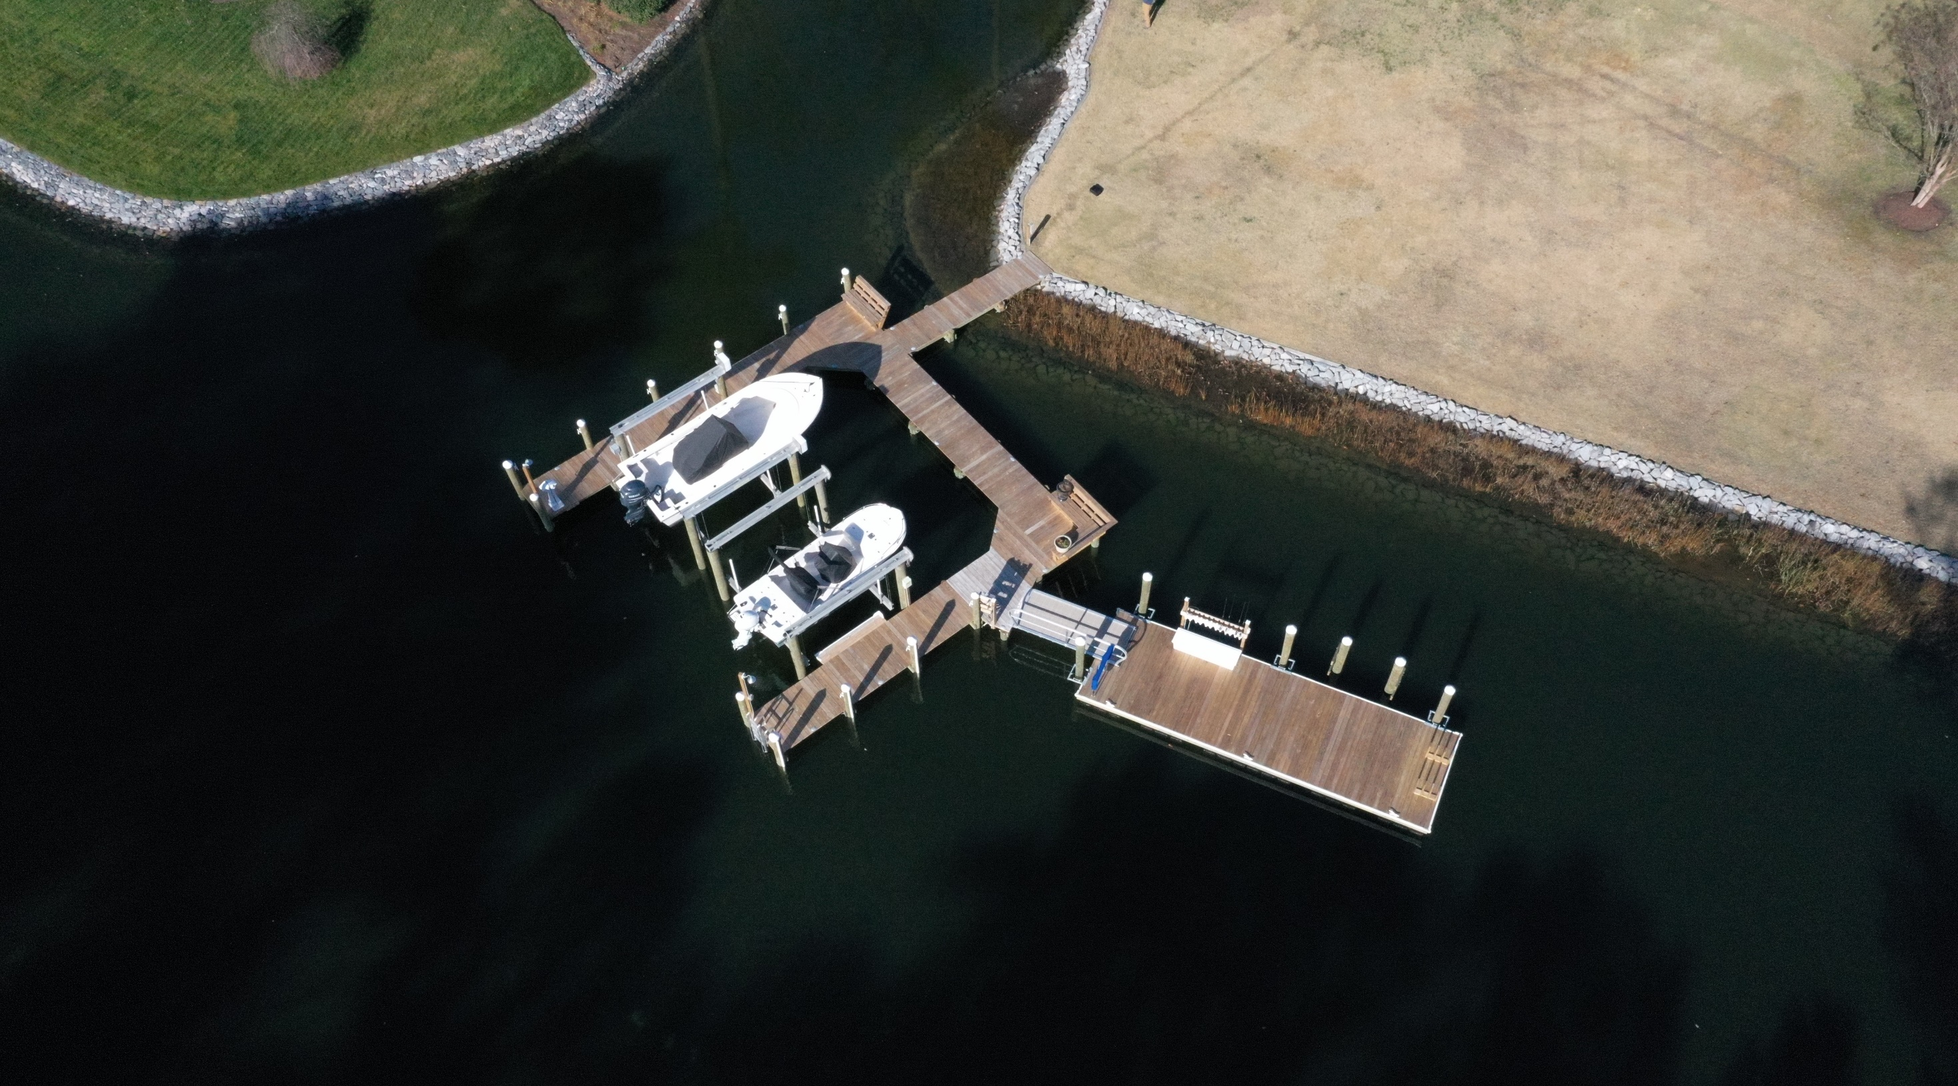
Pier Pricing
$65,000
Boat Lifts
Main Cost Drivers
Construction Access
Overall Length & Square Footage
Additional Waterfront Structures
Decking Material
Floating Dock

Slide 17
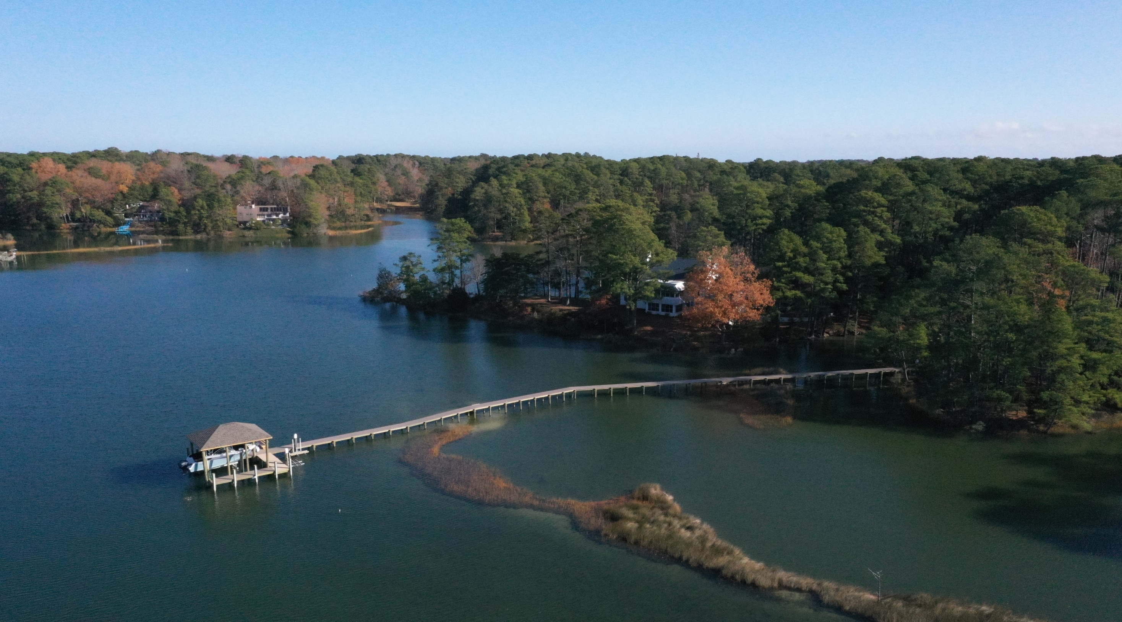
Pier Pricing
Main Cost Drivers
Construction Access
Overall Length & Square Footage
Additional Waterfront Structures
Decking Material
$160,000

Slide 18
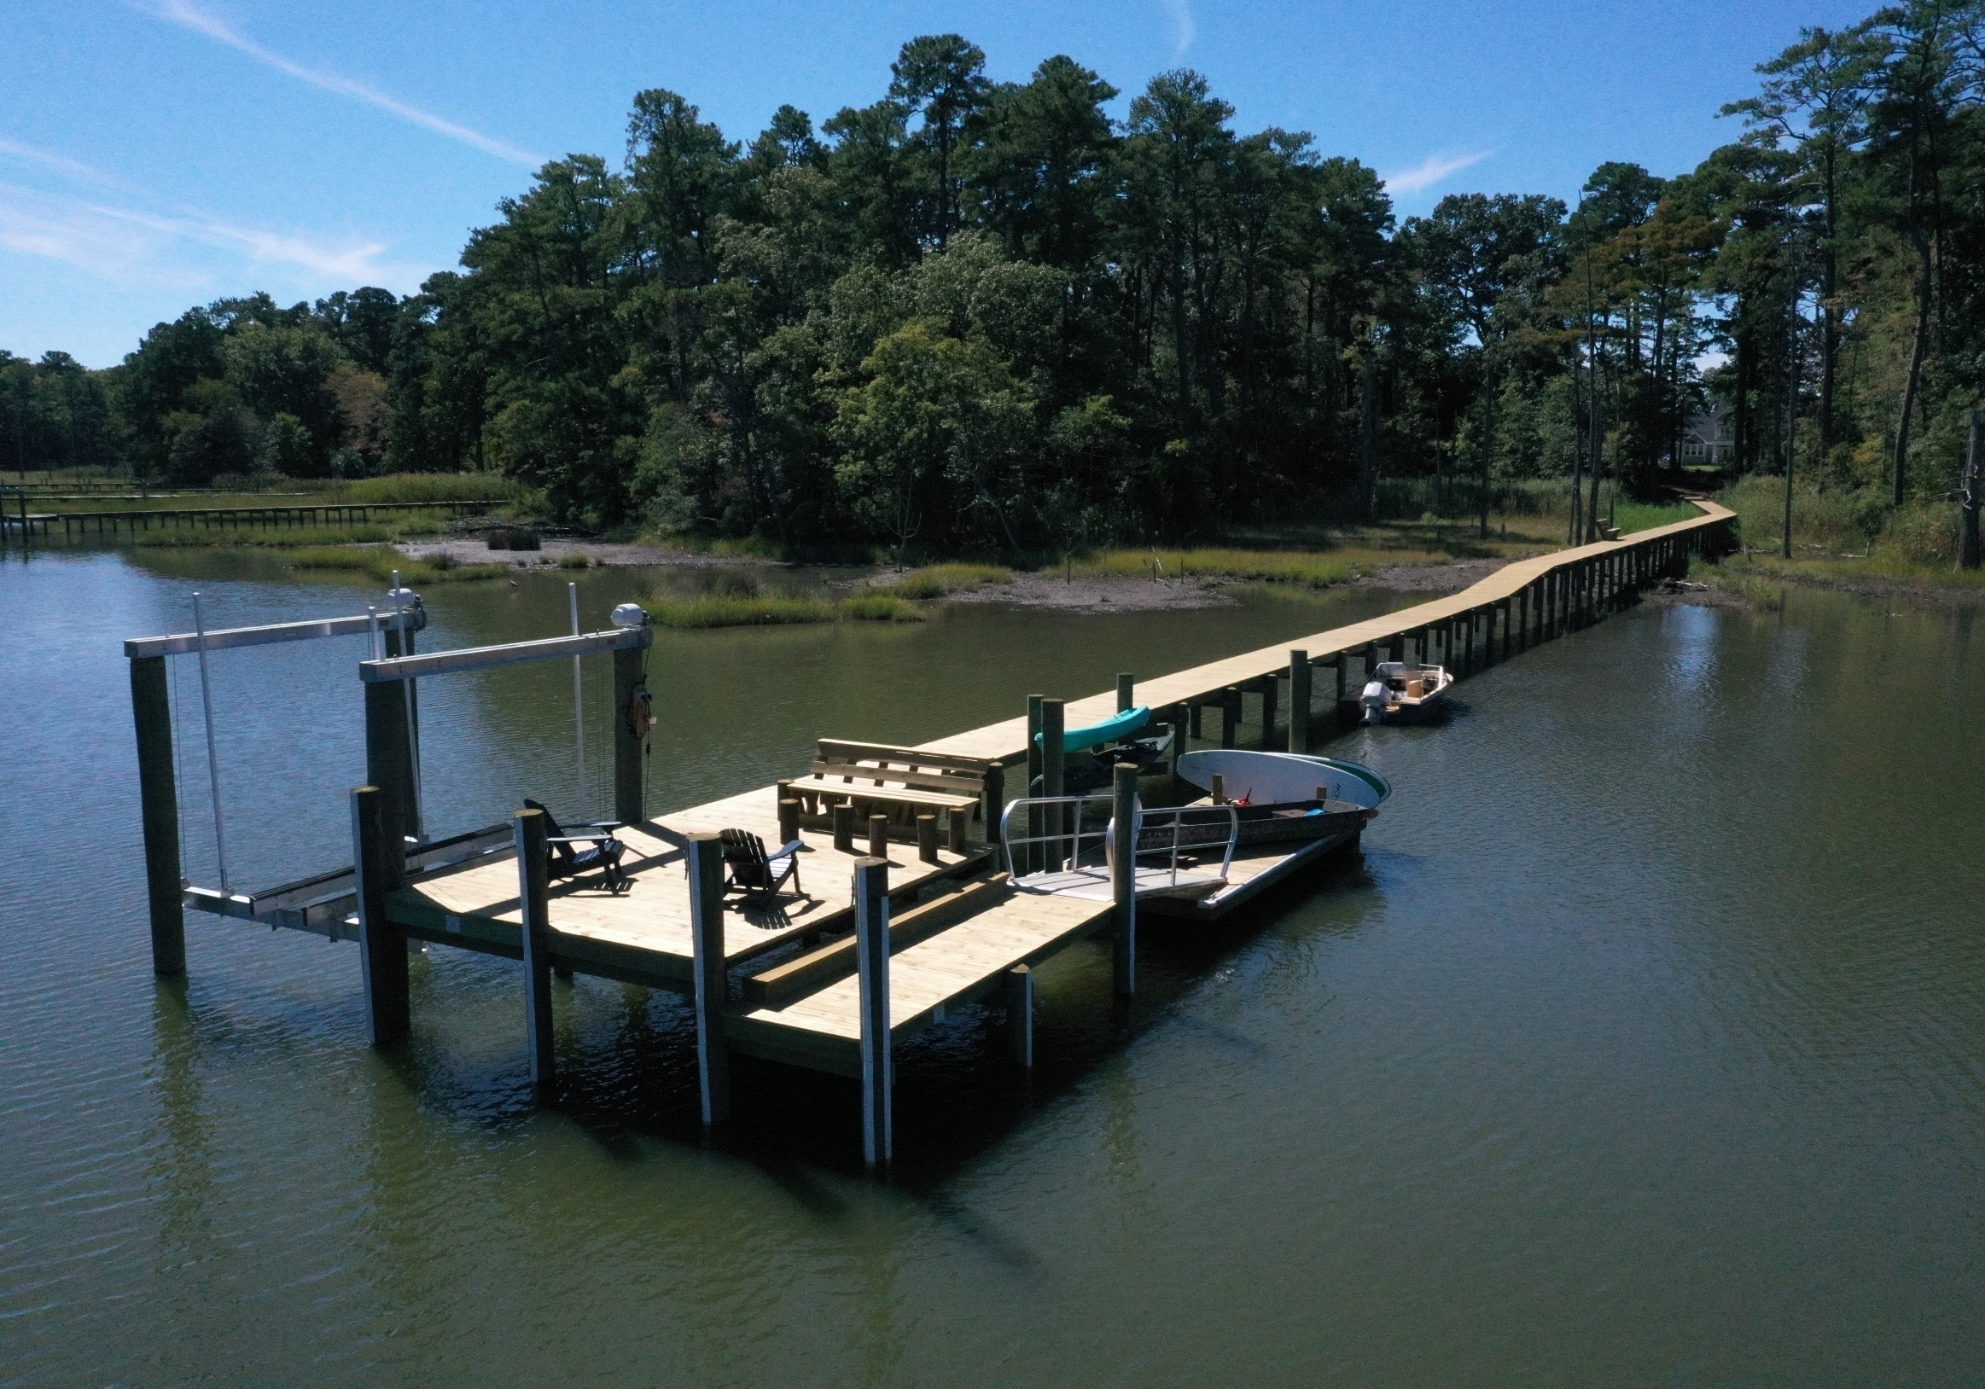
Pier Maintenance & Longevity
Maintenance
Plumbing & Power
Decking
Boat Lifts
Longevity
Saltwater Environment
Mother Nature & Acts of God

Slide 19
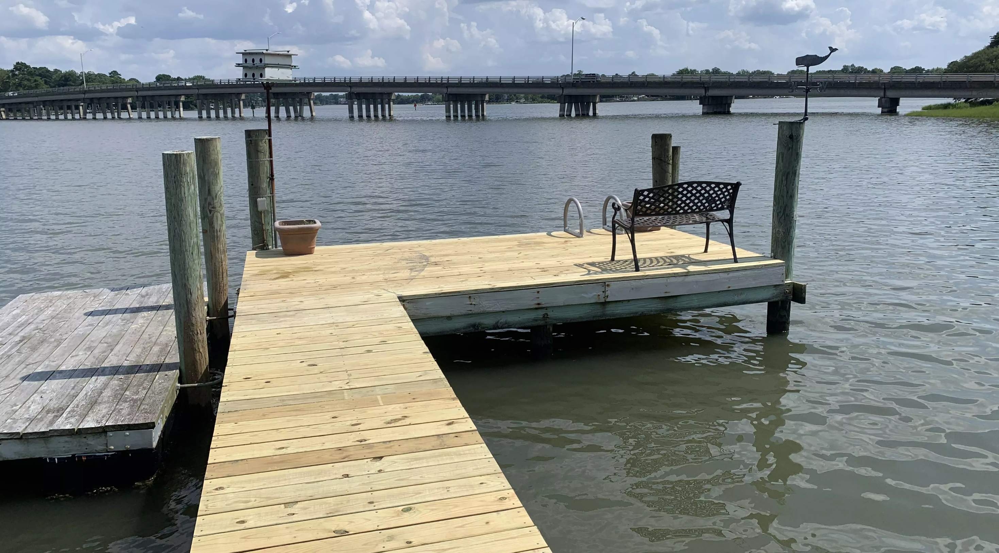
Additional Resources
Colin Marine Construction: https://colinmarine.com/
VMRC guidance on pier permits: https://mrc.virginia.gov/regulations/hm-permits.shtm
Jim Lang’s blog article on piers in Virginia: https://www.waterfrontpropertylaw.com/blog/posts/building-pier-in-virginia/
Jim Lang’s blog article on establishing your riparian area: https://www.waterfrontpropertylaw.com/blog/posts/what-is-a-riparian-area-under-virginia-law/
Jim Lang’s blog article on King’s grants: https://www.waterfrontpropertylaw.com/blog/posts/kings-grant-confers-private-ownership-of-submerged-va-land/

Slide 20
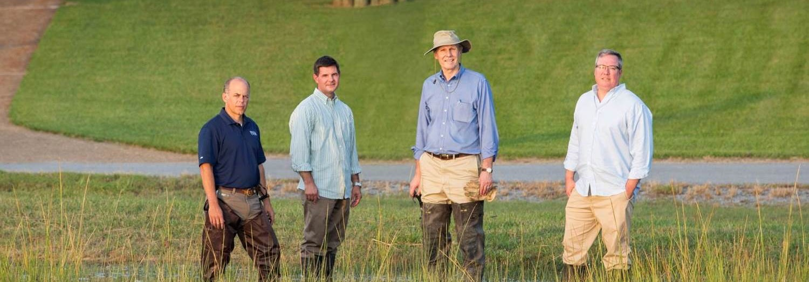

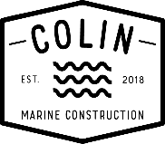


Thank You & Questions
Jim Lang
(757) 502-7326
jlang@pendercoward.com
Joe Keffler
(443) 624-8213
joe@colinmarine.com

