Slide 1



What to do About Bad Actors Causing Trouble on the Water
May 19, 2022
All content copyright © 2021. James T. Lang. All rights reserved.

Slide 2
What We Will Cover Today
The importance of bottomland ownership
Your rights if your property is on a lake or a pond
Your rights if your property is on a bay, river, creek, or the shores of the sea
How admiralty and maritime law can help
How law enforcement can help
All content copyright © 2021. James T. Lang. All rights reserved.

Slide 3
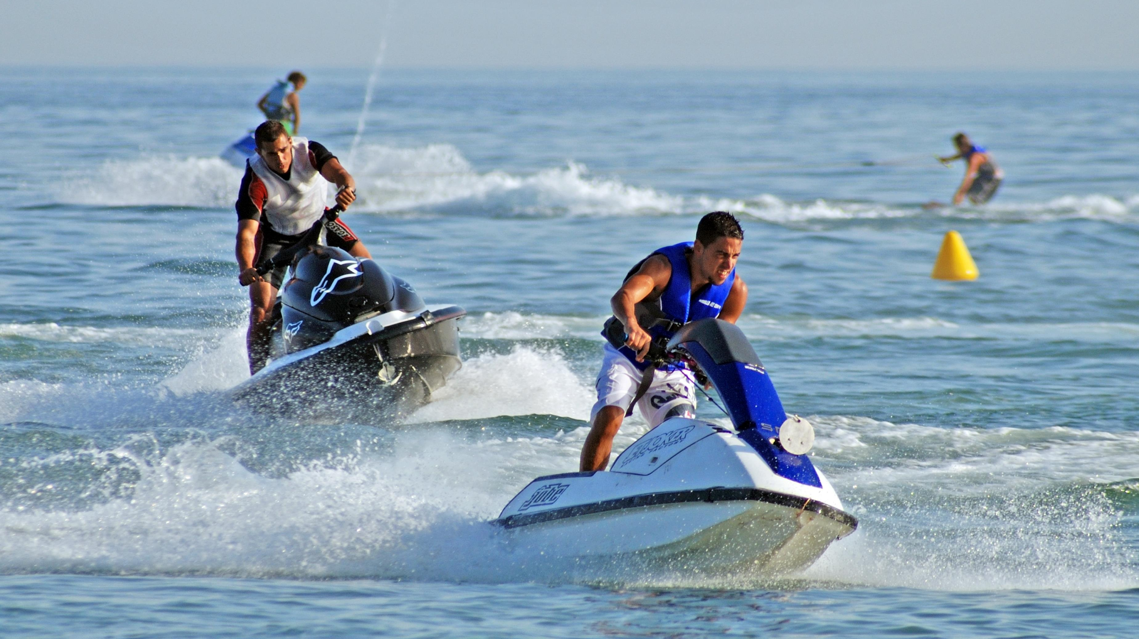
Photo credit: Caron Badkin/Shutterstock

Slide 4

Photo credit CandyBox Images/Shutterstock

Slide 5
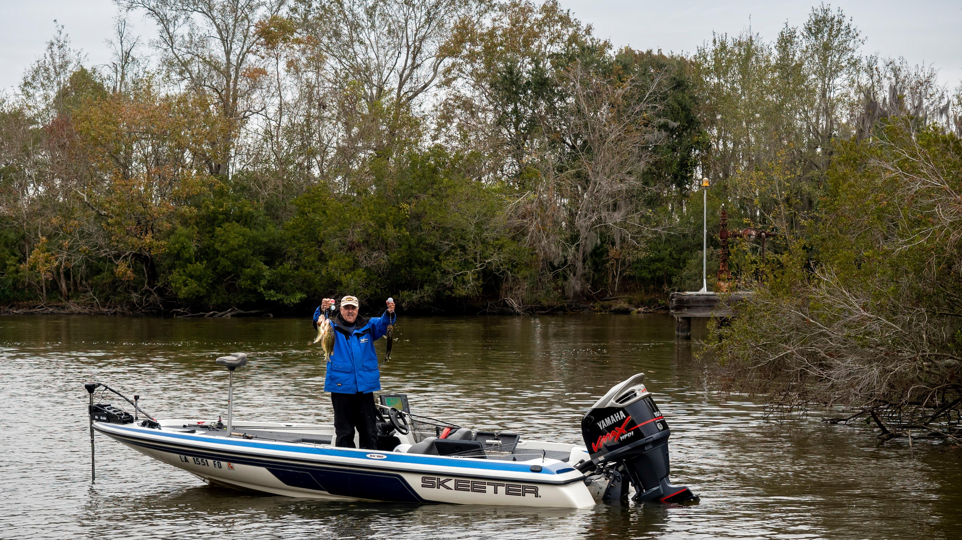
Photo credit Victor Wong/Shutterstock

Slide 6
Waterfront Property Owners’ Typical Complaints
Trespassers on private waterbody (fishing, boating, swimming)
Reckless operation of boat or jet ski
Wake damage
Boating under the influence
Noise
Dump garbage in the water
Discharge pollution in the water
Abandoned boats

Slide 7
Trespassers on Private Waterbody
(1 of 2)
If you own the bottom you can prohibit outsiders from fishing, boating, swimming
Lake or pond = privately owned bottom
  https://www.waterfrontpropertylaw.com/blog/posts/do-i-control-water-on-waterfront-property/
Creek, River, Bay, Shore of the Sea = bottom usually state-owned
  https://www.waterfrontpropertylaw.com/blog/posts/control-bay-river-creek-seashore-on-waterfront-property/
Waterfront property owner’s liability for persons injured on the water
  https://www.waterfrontpropertylaw.com/blog/posts/waterfront-property-law-liabilities/

Slide 8
Trespassers on Private Waterbody
(2 of 2)
Civil trespass
  Waterfront Property Law team at Pender & Coward can assist
Criminal trespass: Va. Code 18.2-119
  Class 1 misdemeanor (12 months/$2500)
  Police officer can issue summons or citizen gets summons from magistrate
  Must warn the violator orally or in writing (“No Trespassing” sign)
  If it escalates into a confrontation, call 911
  Otherwise if police assistance needed use the non-emergency number
  Have plat showing bottom land ownership available to show the officer
  75% dismissed with warning (others deferred finding or convict and punish)

Slide 9
Reckless Operation of Boat or Jet Ski (1 of 3)
Va. Code 29.1-738
  “No person shall operate any motorboat or vessel . . . in a reckless manner so as to endanger the life, limb, or property of any person”
  Class 1 misdemeanor (12 months / $2500)
Va. Code 29.1-738.03
  Personal watercraft operator is reckless if
    Weaving through vessels
    Following another vessel or jumping the wake of another vessel
    Turning sharply to spray an object or person
  Class 1 misdemeanor (12 months / $2500)

Slide 10
Reckless Operation of Boat or Jet Ski (2 of 3)
Inland Navigation Rules apply to every vessel on the navigable waters of the U.S. shoreward of navigational demarcation lines that separate the high seas from the inland waters (33 C.F.R. pt. 83)
  Inland Rule 5: Look-out
  Inland Rule 6: Safe speed
  Inland Rule 7: Risk of collision
  Inland Rule 8: Action to avoid collison
33 U.S.C. 2072
  Whoever operates a vessel in violation of this chapter is liable to a civil penalty of not more than $5,000
USCG responsible for enforcing

Slide 11
Reckless Operation of Boat or Jet Ski (3 of 3)
Va. Code 29.1-744.3
  Unlawful to operate motorboat (except personal watercraft) at speed greater than slowest possible when within 50’ of structure or person in the water (class 4 misdemeanor = $250)
Va. Code 29.1-739
  Must stop and render assistance if involved in a collision
  Must give name, address and ID of vessel
Va. Code 29.1-740: Penalty if fail to stop and render assistance
  Class 6 felony if serious injury/death (1 to 5 years/$2500)
  Class 1 misdemeanor if property damage only (12 months/$2500)

Slide 12
Wake Damage
Va. Code 29.1-744(D) & (E)
  Placement and removal of “No Wake” buoys
  Misdemeanor to violate “No Wake” zone
Civil matter
  Inland Rule 5: “Every vessel shall at all times maintain a proper look-out . . . so as to make a full appraisal of the situation”
  Waterfront Property Law team at Pender & Coward can assist

Slide 13
Boating Under the Influence
Va. Code 29.1-738(B)
  Called “BUI”
  Same blood alcohol levels as used for DUI (motor vehicles)
  Narcotic drug
  Prohibition applies to motorboat which is “underway” and “not at anchor, or made fast to the shore, or aground”
  Class 1 misdemeanor (12 months / $2500)

Slide 14
Noise
Engine noise
  Va. Code 29.1-737
  The exhaust shall be muffled in a reasonable manner
Loud music
  VB ordinance (section 23-69)
  Between 10pm and 7am
    Prohibits sound >55dB received inside residential dwelling
  Between 7am and 10pm
    Prohibits sound >65dB received inside residential dwelling
  Class 1 misdemeanor (12 months / $2500)

Slide 15
Dump Garbage/Discharge Pollution in Water
Va. Code 62.1-44.5(A)(1)
  Unlawful to discharge any waste into state waters
  Discharger must notify authorities within 24 hours
  Stiff penalties (Va. Code 62.1-44.32)
VB ordinance (section 6-32)
  Unlawful to dump any garbage into water (30 days / $1,000)
Virginia Discharge of Oil into Waters Law
  Va. Code 62.1-44.34:18
    Discharger liable for cleanup cost and damages suffered by third parties
  Va. Code 62.1-44.34:19
    Discharger must “immediately” notify authorities of the discharge

Slide 16
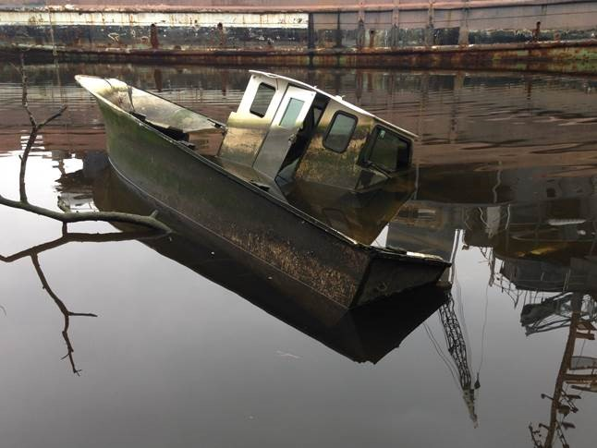
Abandoned Boats
https://www.waterfrontpropertylaw.com/blog/posts/what-next-the-derelict-vessel-left-in-the-waters-at-your-home-or-business/
Va. Code 29.1-733.25: Acquiring title to an abandoned watercraft
City of Hampton retrieves and disposes
VB ordinance (section 6-26): Class 2 misdemeanor to sink or abandon a vessel

Slide 17

Questions?
(757) 502-7326
jlang@pendercoward.com

